Slide 1
Survey and Investigation of Buildings Damaged by Category III, IV and V Hurricanes in FY 2024-2025 (Preliminary)
Hurricane Helene (9/28/2024 and 10/1/24)
Hurricane Milton (10/12/2024)
David O. Prevatt, Ph.D., PE, F.ASCE, Professor
Kisinger Campo & Associates Term Professor
University of Florida, Gainesville, FL
Co-PI: Kurtis G. Gurley, Professor, University of Florida
Co-PI: David B. Roueche, Associate Professor, Auburn University
15 October 2024

Slide 2
Agenda
Introduction
Summary of Events
UF Reconnaissance
  Horseshoe Beach (9/28/2024) and Cedar Key, FL (10/01/2024)
  Inland Lakes (10/12/2024)
Other Data Sources
  NOAA Aerials
  StEER Network – ongoing work
Discussion and Comments

Slide 3
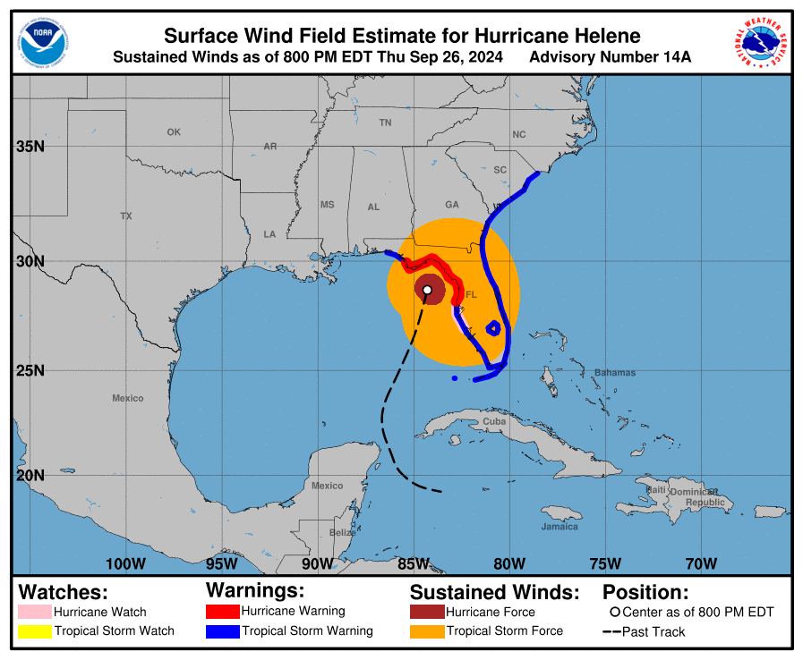
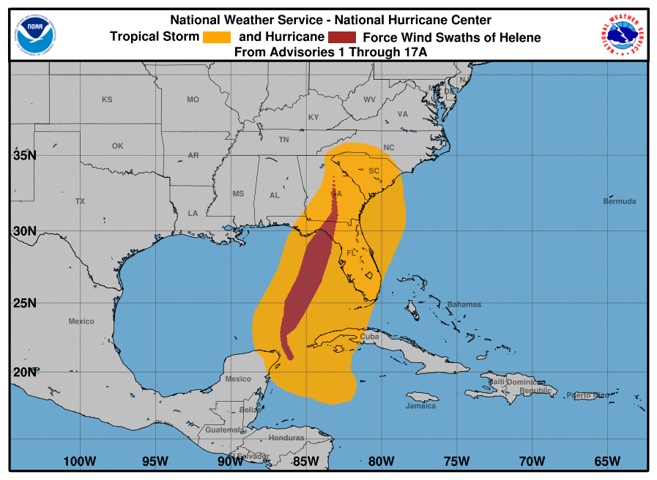
Notes:
Hurricane Helene - landfall in the Big Bend - Thursday, September 26, 2024 at 11:10 pm EDT.
The maximum sustained winds was 140 mph (225 km/h) NOAA aircraft (NHC, 2024h).
Hurricane Helene’s –Rapid intensification before landfall
By 2 am EDT, Helene was moving at nearly 26 mph (42 km/h) and had maximum sustained winds of 90 mph (145 km/h) (NHC, 2024j).
At 5 am EDT on September 27, 2024, Helene was downgraded to a tropical storm

Slide 4
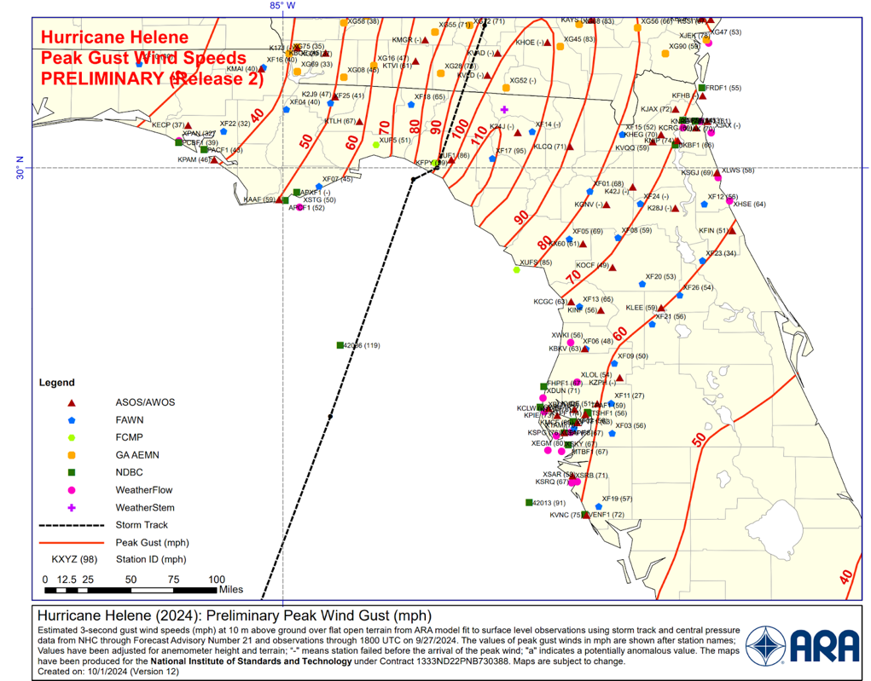
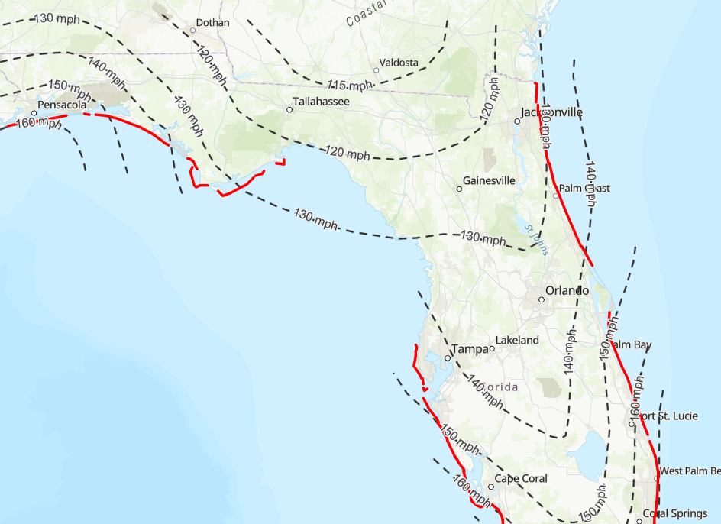
Helene’s Wind Swath vs. Design Wind Speeds
ASCE 7-22 Design Wind Speeds (mph)

Slide 5
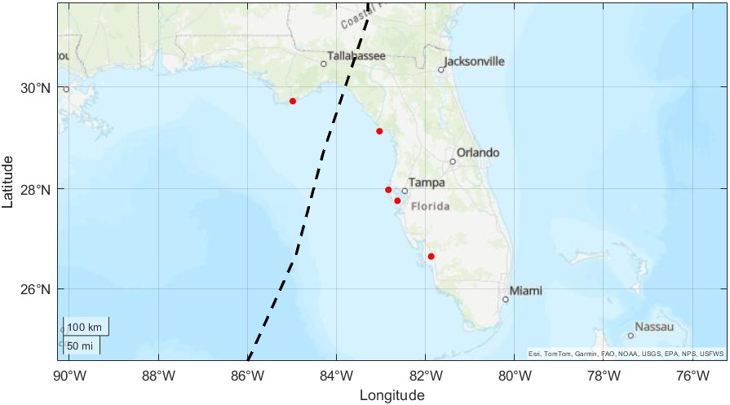
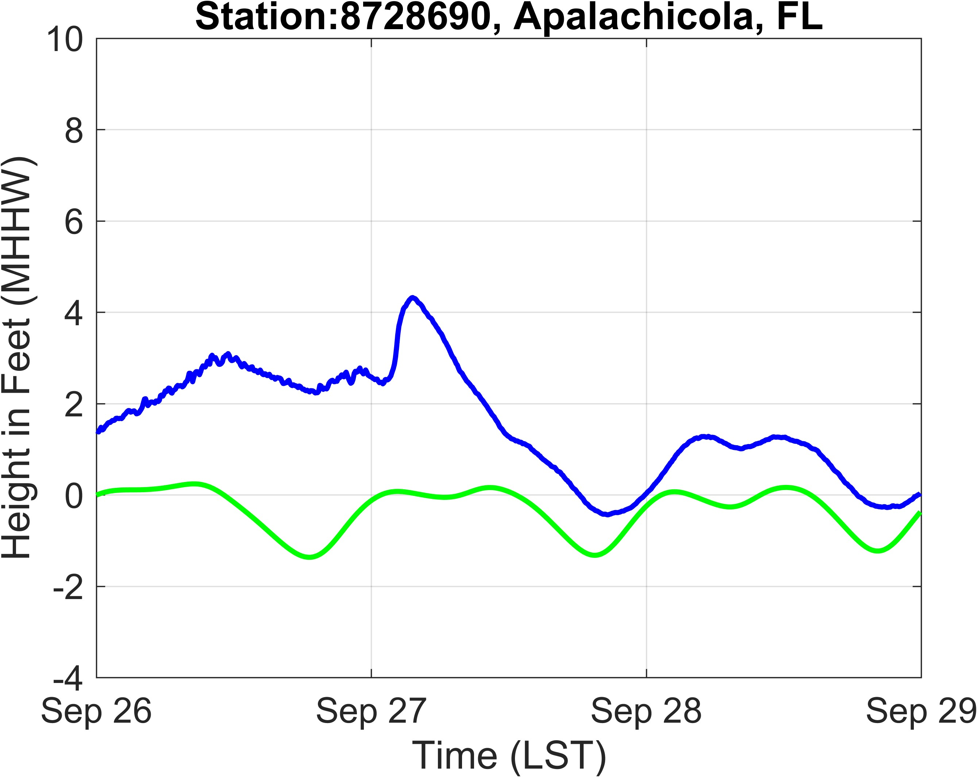
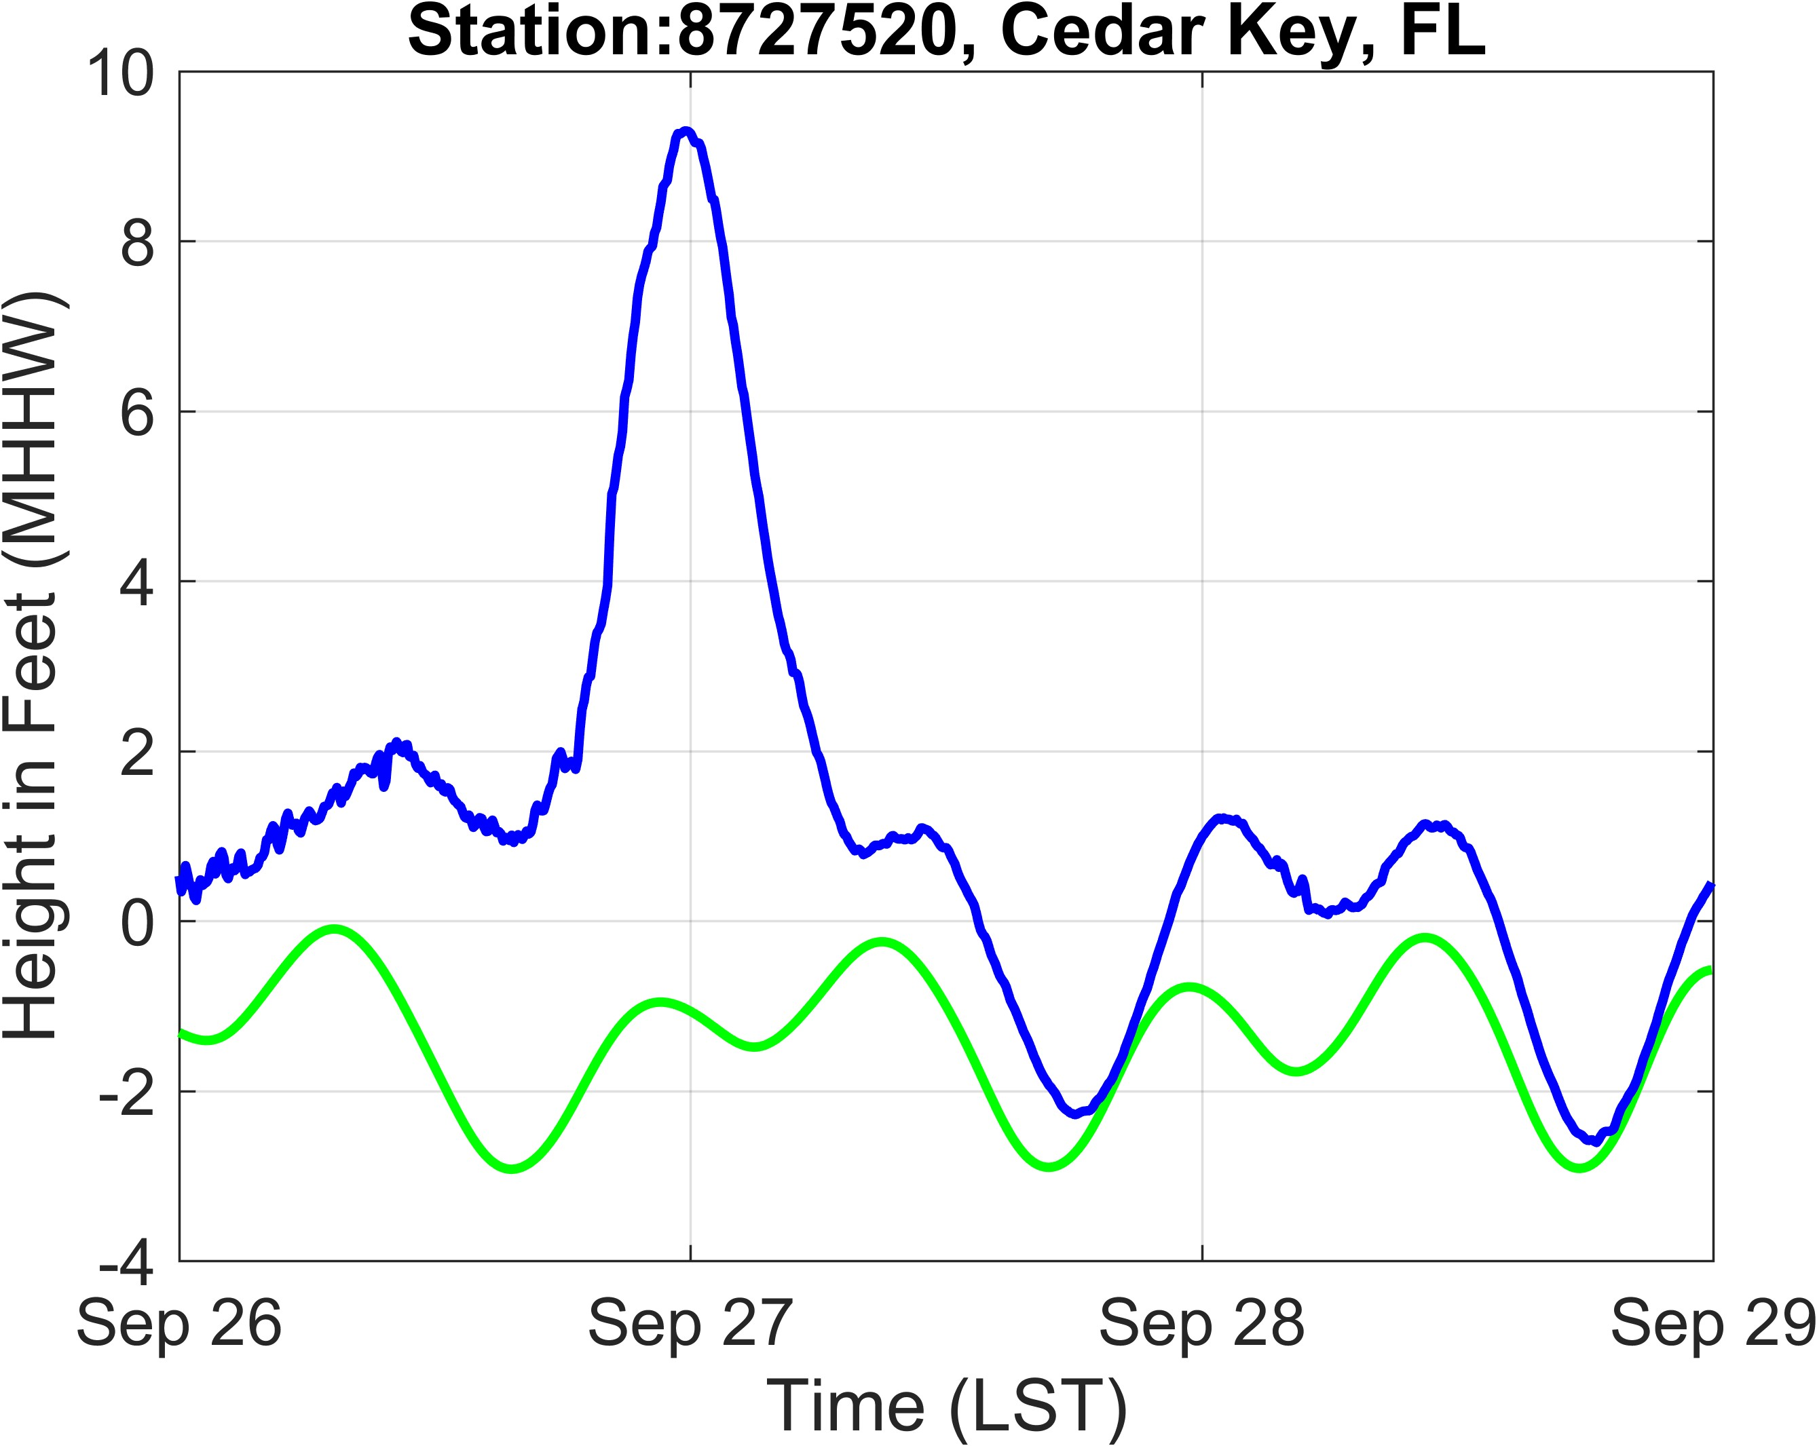
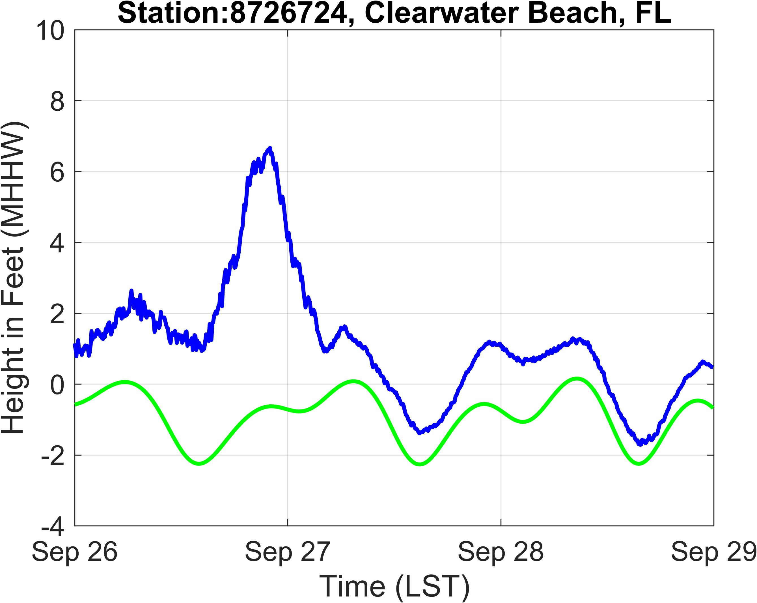
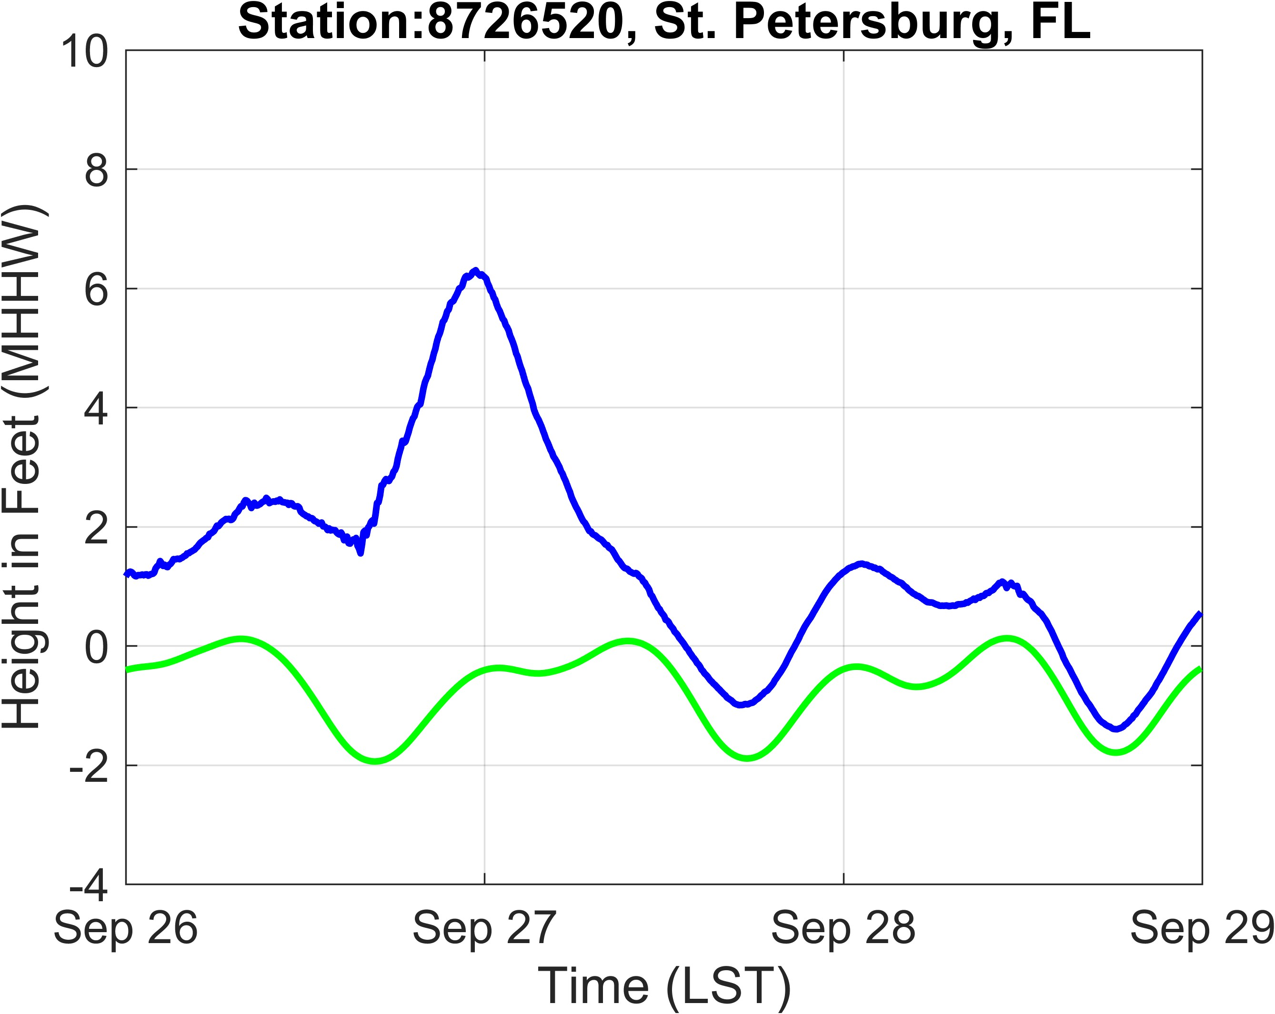
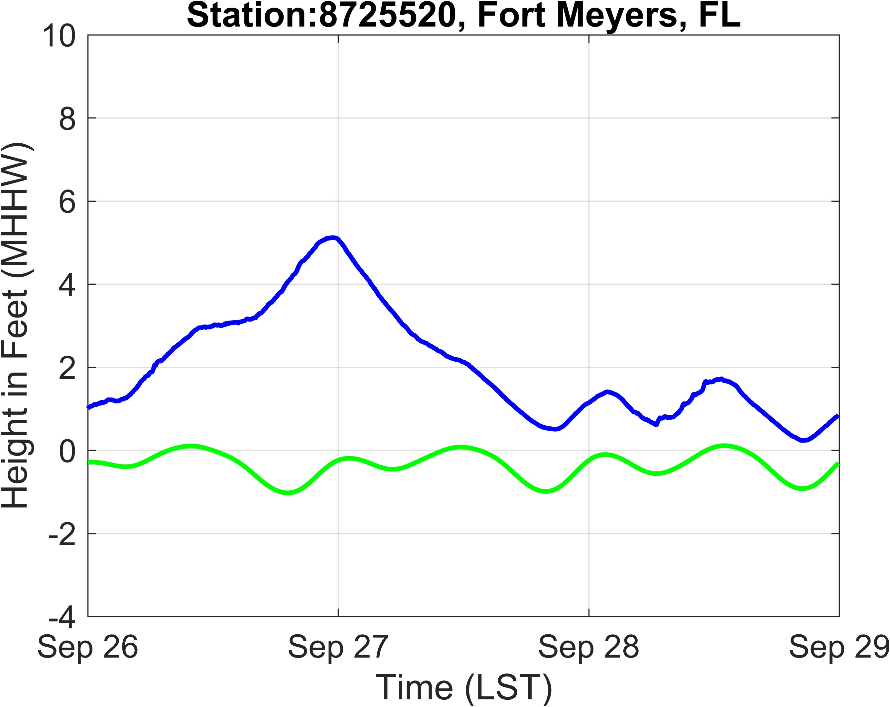
Hurricane Helene (2024)

Slide 6
Observations (Helene)
Single-Family Residential Structures – Storm surge and wave impacts
Keaton Beach, Dekle Beach, Cedar Key, Steinhatchee, Horseshoe Beach, Suwannee.
Manufactured Homes – Foundations failed and dislocated houses
Multi-family Residential Structures – Uprooted trees falling on structure Tallahassee, FL
Commercial Buildings – Building cladding failures (mainly roof covers) in Perry, Steinhatchee and Cedar Key, FL
Schools, Government & Critical Facilities – No observed building damage

Slide 7
Horseshoe Beach, FL
Storm surges were reportedly up to 15 ft as reported by residents.
Damage Patterns Observed
  Scouring around column footings and ground slabs
  Failed reinforced concrete columns and wood piers
  Buildings swept off foundations.
  Roofing and wall cladding failures (minor)
  Cladding failure to underside of elevated floors (per Ibrahim et al, 2023)
Note: By 10/1/24 the debris at Cedar Key, FL cleaned up – we could not make observations of building performance there.

Slide 8
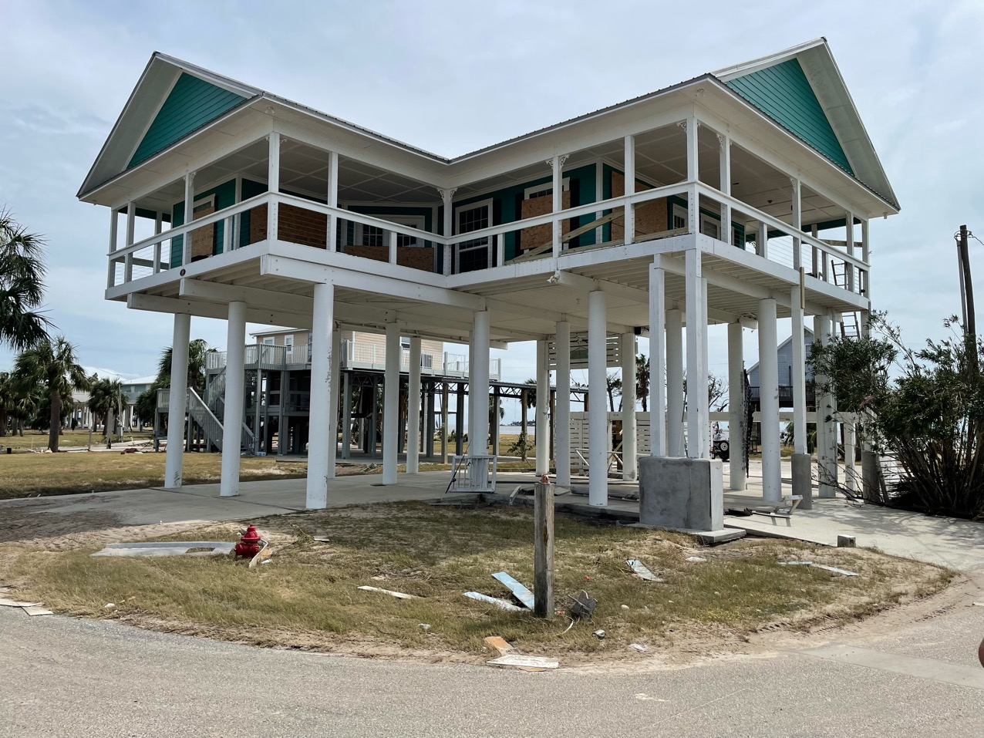
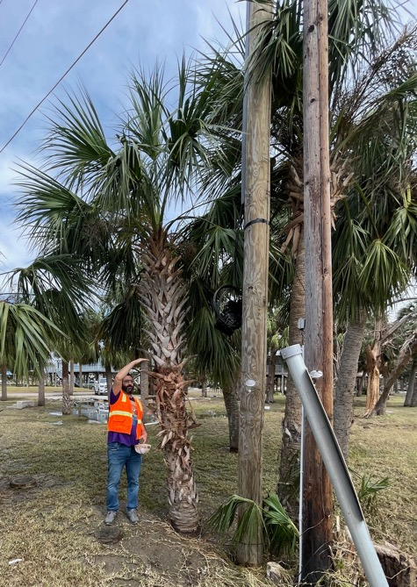
Above storm surge and waves (Survived)
7 ft

Slide 9
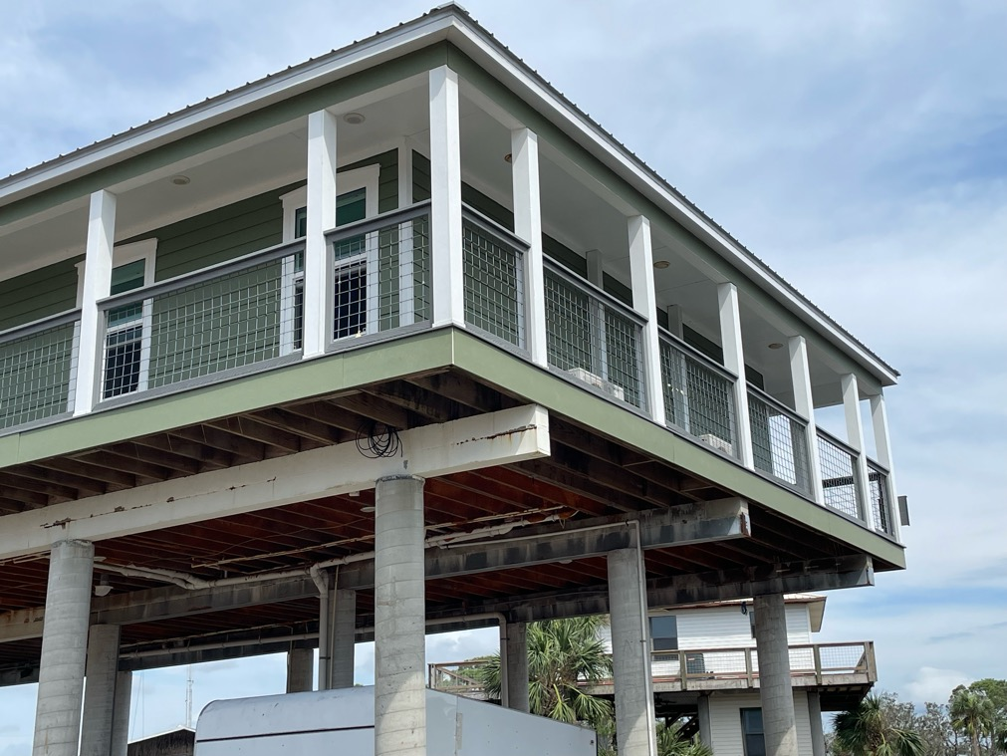
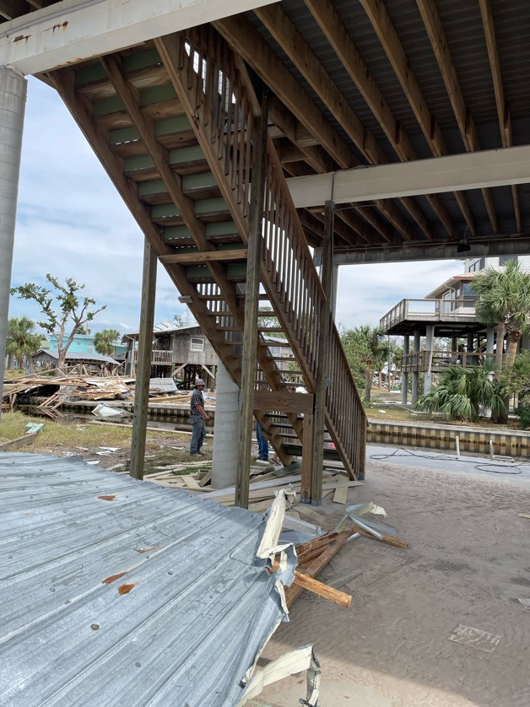
Reinforced concrete frames (survived)

Slide 10
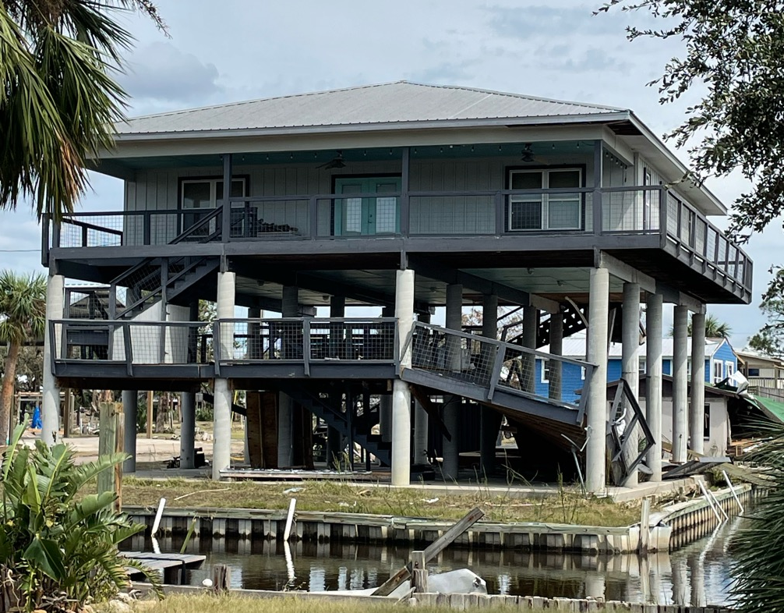
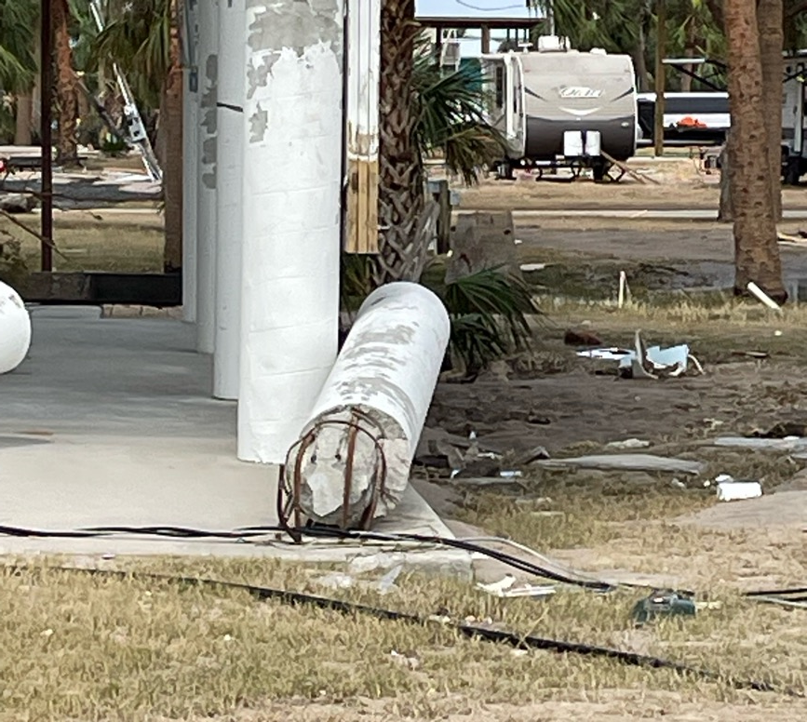
Partial Structural Damage

Slide 11
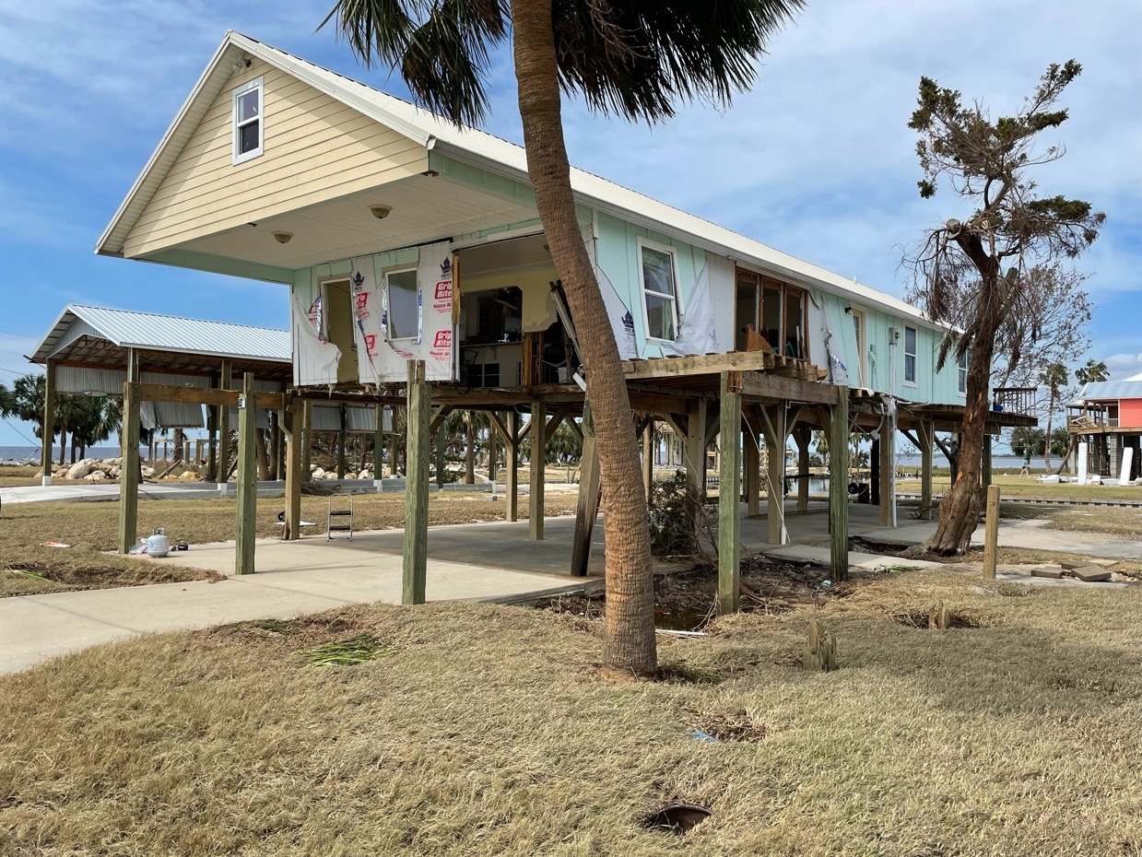
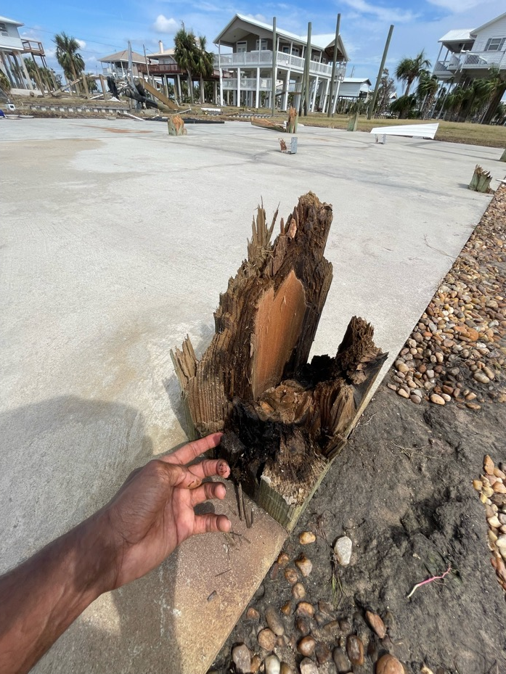
Wood column, lower height structures (failed)

Slide 12
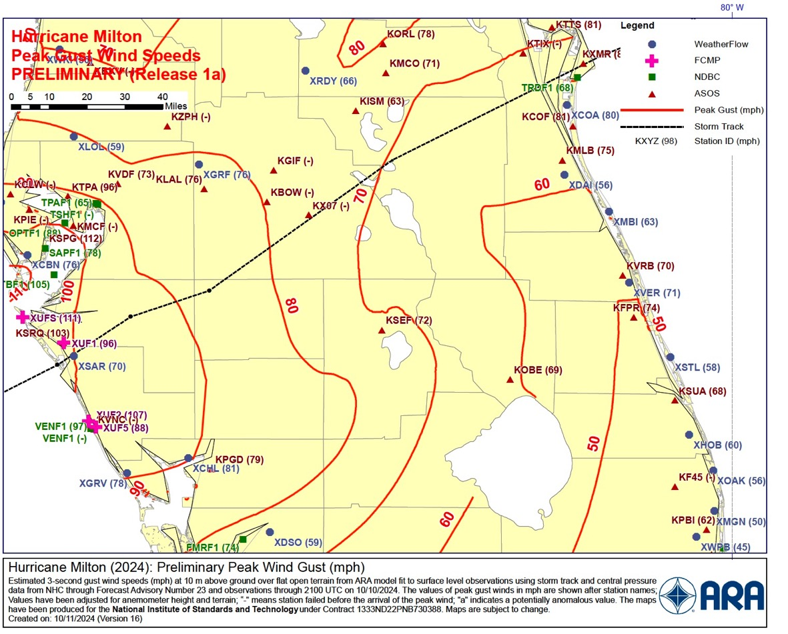
Milton’s Wind Swath

Slide 13
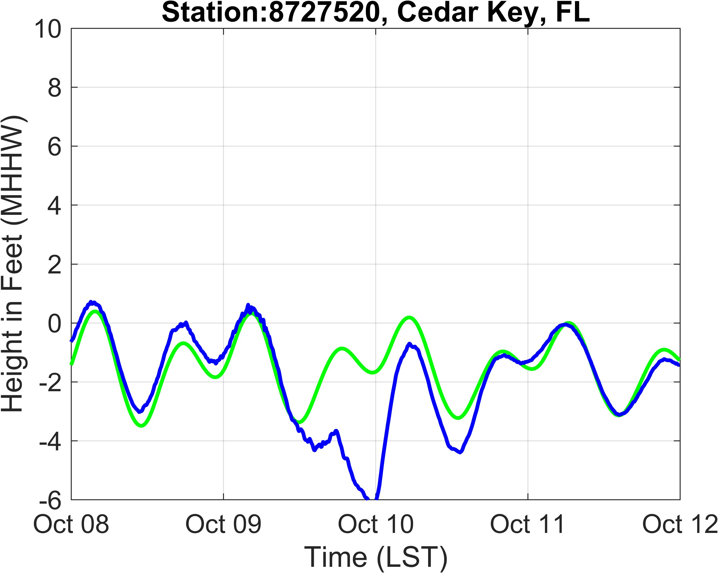
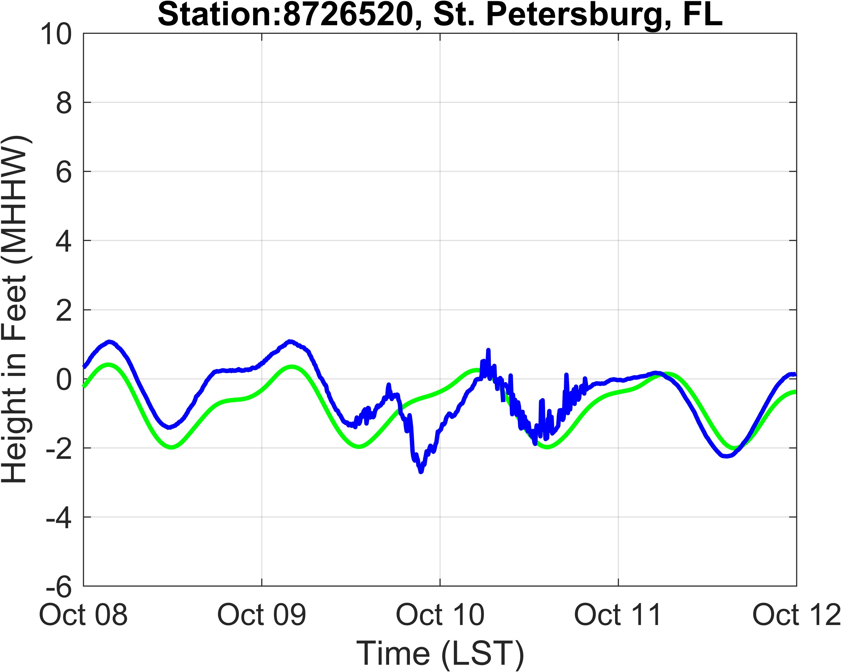
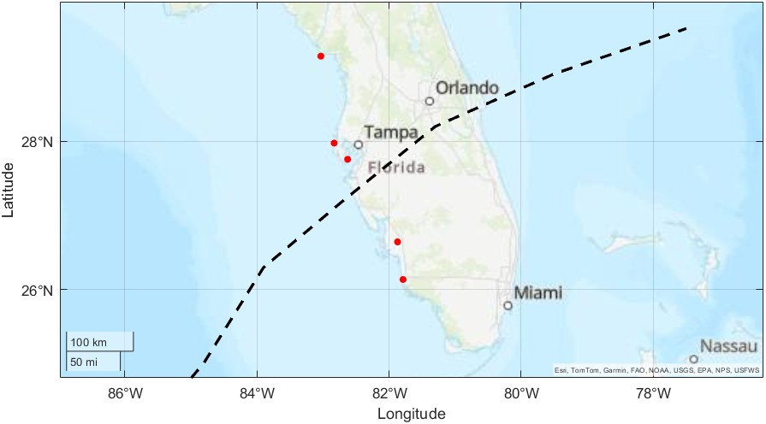
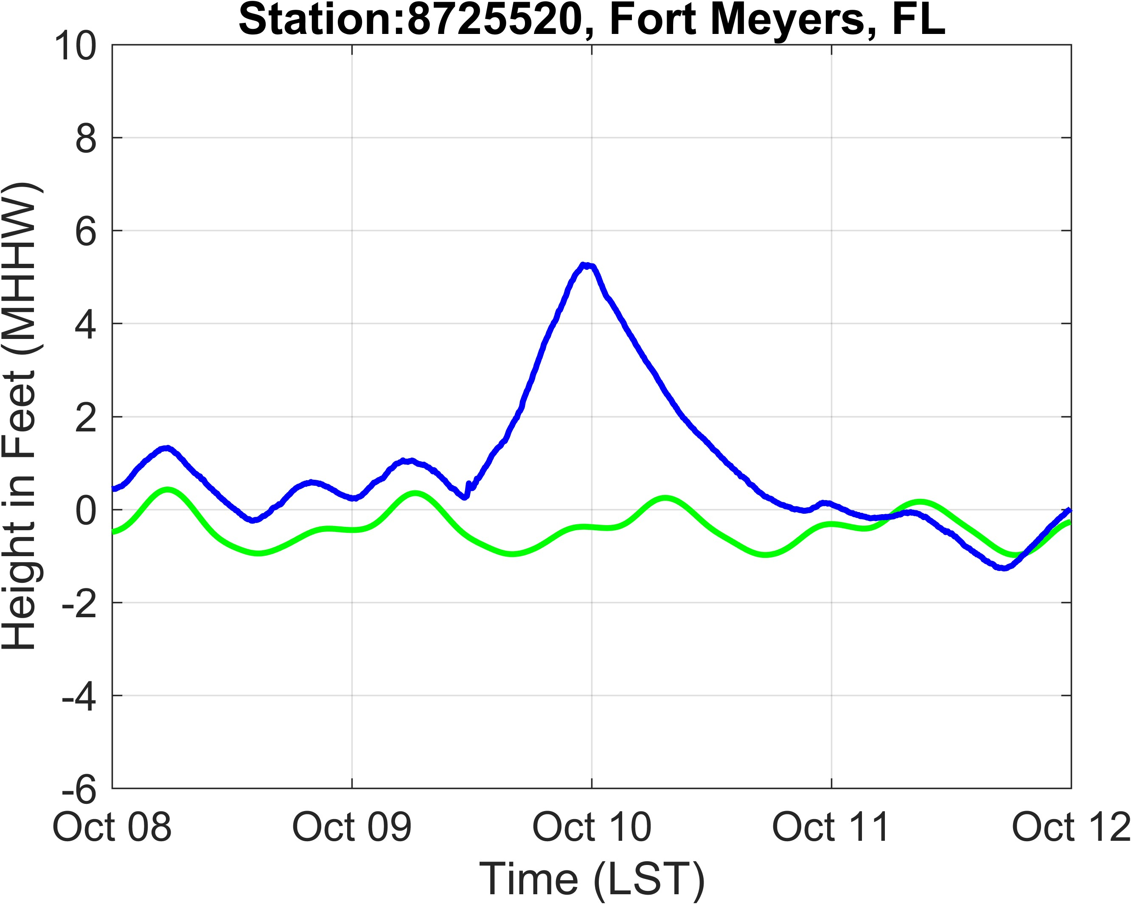
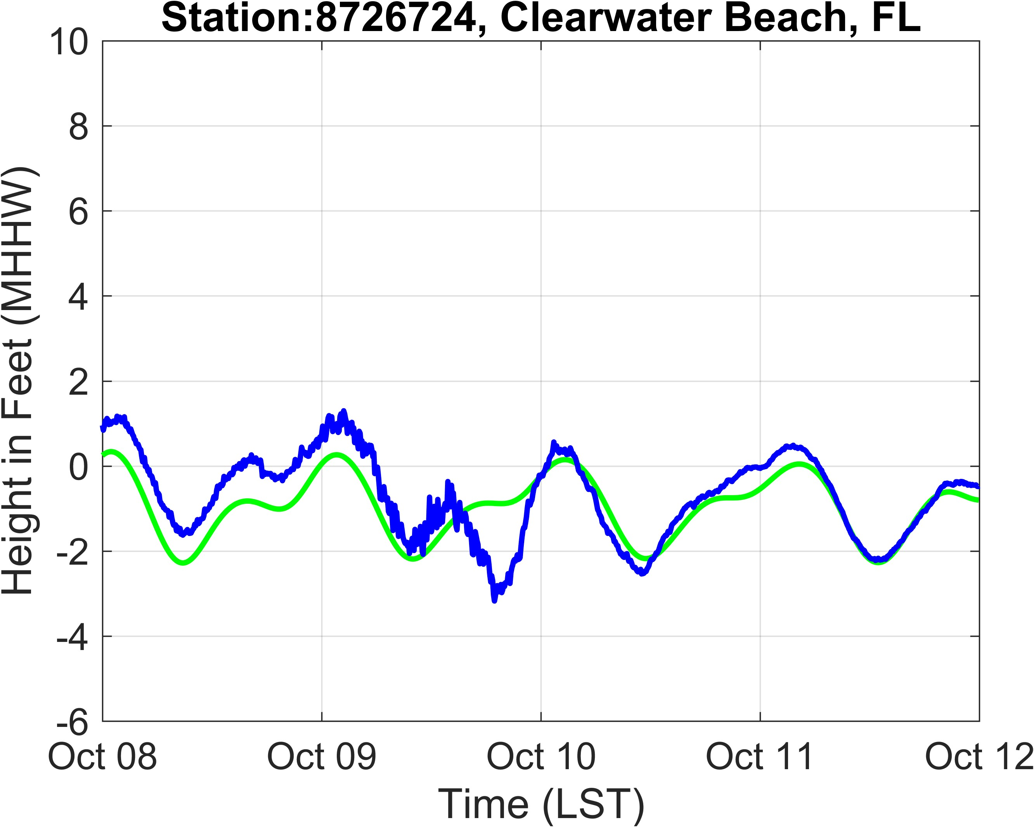
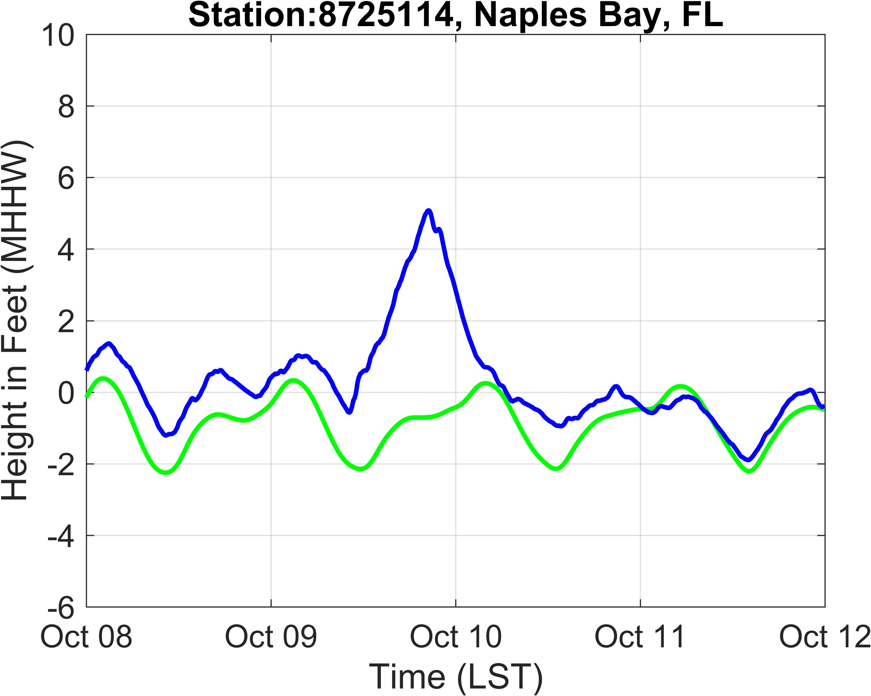
Hurricane Milton (2024)

Slide 14
Observations (Milton)
Table 4.1. Summary of Building Performance in Northwestern Florida, by Occupancy
Single-Family Residential Buildings | Extensive damage in areas like Keaton beach, Dekle Beach, Cedar Key, Steinhatchee, Horseshoe beach, Suwannee, and Tallahassee. The causes of damage ranged from surge and wave load induced dislocation and damage from wind-feBled trees on roofs.
Multi-Family Residential Buildings | Tree fall induced damage has been reported in the Tallahassee region. For other regions, no observations are available for this class at time of this report.
Commercial Buildings | Several commercial buildings in Perry, Steinhatchee, and Cedar Keys area were damaged due to wind and storm surge and waves. The damage appears limited to the building envelope, primarily roof cover.
Healthcare/Medical Facilities | No observations available for this class at time of this report.
Schools | No observations available for this class at time of this report.
Government Facilities | No observations available for this class at time of this report.
Mobile/Manufactured Homes | Foundation failure and dislocation of mobile homes has been reported in Steinhatchee, Florida
Critical Facilities | No observations available for this class at time of this report.
Historical Buildings | No observations available for this class at time of this report.
Religious Institutions | At least one report of damage to a church in this region exists.
At landfall Hurricane Milton was a minimal Category II hurricane (max. peak 3-second gust wind speed was 108 mph). Milton’s power dissipated quickly as it moved inland.
Moderate Wind Speeds – Milton’s winds were less than design wind speeds for the impacted areas and it did not produce much design level impacts.
Roof Cover Loss– NOAA’s aerial photography shows only limited roof cover loss, as expected for this moderate wind speed.
Fenestration – UF team observed no fenestration failures from windborne debris inland, where winds were no more than 70 mph
Storm surge and wave action– In a few limited areas coastal structures were impacted by storm surges and waves. Structures elevated above the storm surge and wave height had a better chance of survival.

Slide 15
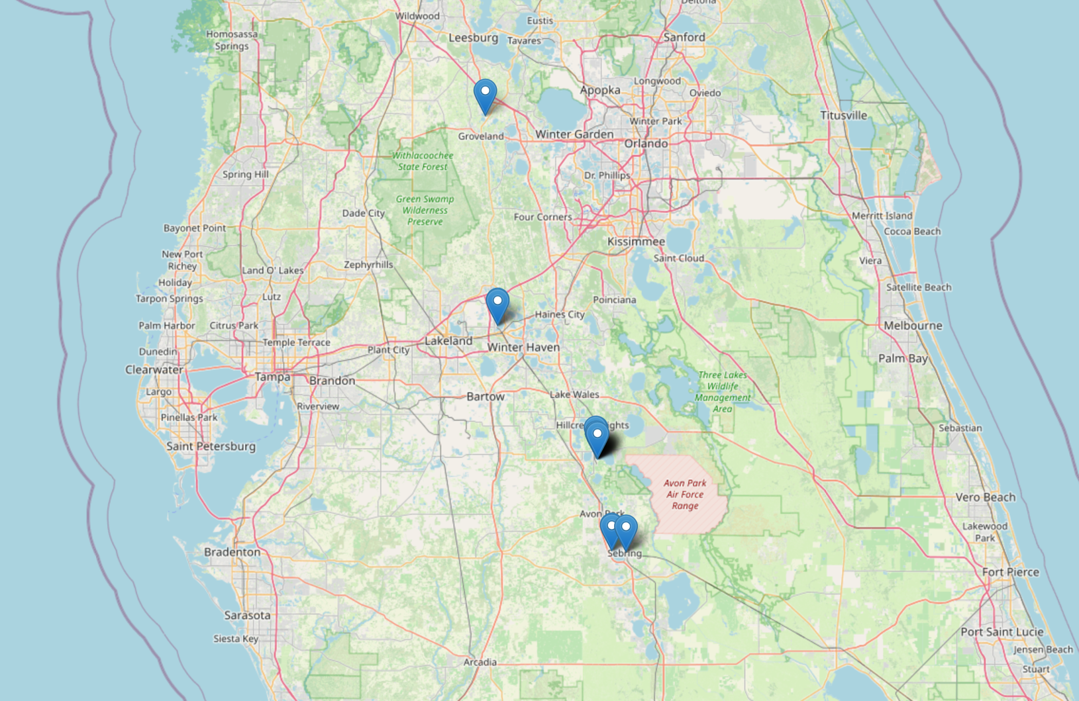

Slide 16
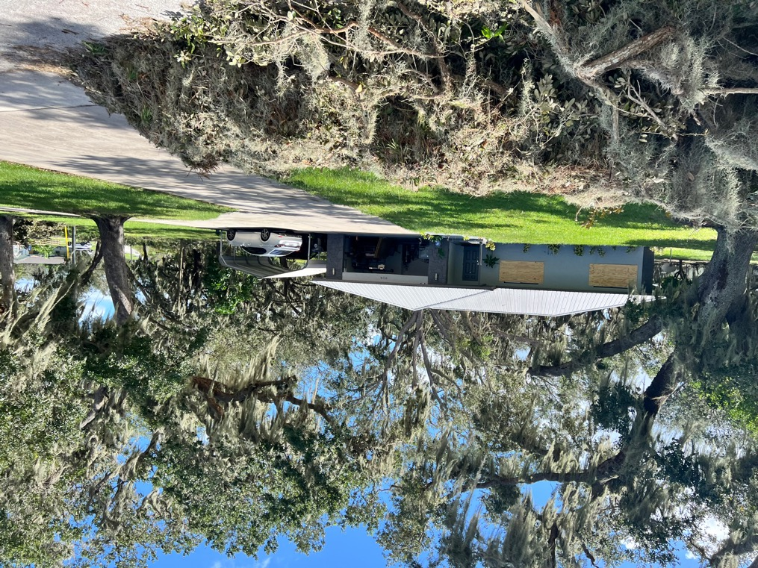
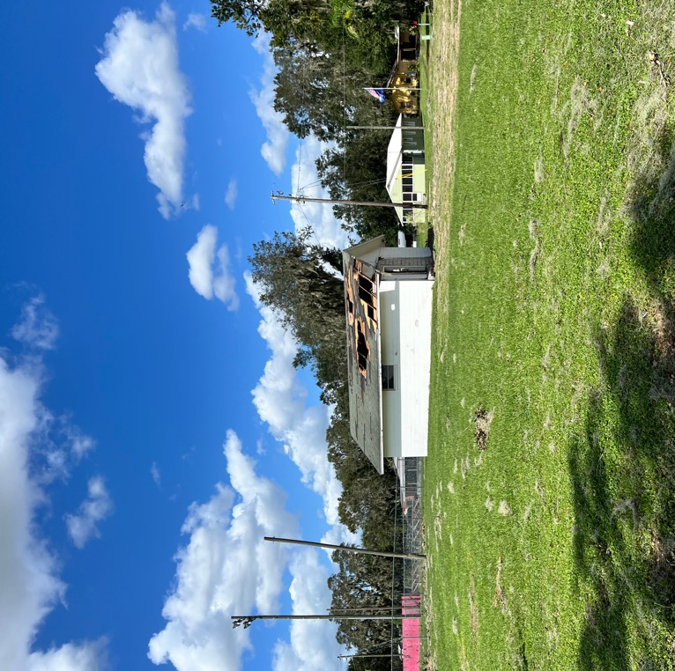
Building performance inland (H. Milton)

Slide 17
Summary
Hurricane Helene: opportunities exist to learn about residential performance from storm surge. Areas impacted most by Helene do not have a CCCL (no sandy beaches), so there may be some opportunities to look at performance and construction relative to what would be required by the CCCL.
Hurricane Milton: limited potential for gathering new data. Only significant storm surge damage only in isolated areas, and the wind speeds low to moderate.
Tornado Outbreak: Hurricane Milton spawned a tornado outbreak some degrees of damage suggested EF-3 tornadoes. This offers potential for calibrating DOD estimates of damage to structures that were originally designed for hurricane wind speeds.

Slide 18
Thank you for your attention.

Slide 19
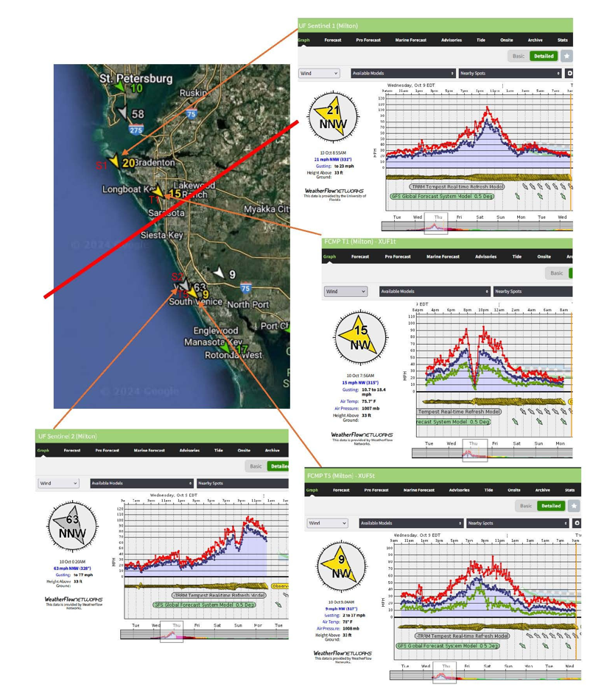
Hurricane Milton
Hurricane Helene
Station | Type | Latitude | Longitude | Height (ft) | Max 3-sec Gust (mph) | Max 1-min Avg (mph)
T1 | FCMP | 30.0407 | -83.7182 | 33 | 76.03 | 51.52
T5 | FCMP | 30.1912 | -84.2126 | 33 | 50.78 | 39.39
T6 | FCMP | 29.7576 | -83.493 | 16.5 | 89.88 | 65.14
S2 | Sentinel | 29.137 | -83.0295 | 33 | 85.03 | 70.78
105 mph
95 mph
University of Florida wind anemometry data – thanks to Dr. Brian Phillips
108 mph
90 mph

