Slide 1
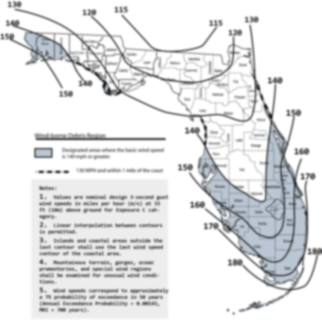

The Florida Building Code Update – Revised Code Change Process
Codes and Standards
Mo Madani, CBO, Technical Unit Director
Joe Bigelow, Training Design

Slide 2
Florida Statute (HB 1021)
553.73 Florida Building Code.—
(3) The commission shall use the International Codes published by the International Code Council, the National Electric Code (NFPA 70), or other nationally adopted model codes and standards for updates to needed to develop the base code in Florida to form the foundation for the Florida Building Code.

Slide 3
Florida Statute (HB 1021) - continued
553.73 Florida Building Code.—
(7)(a) The commission, by rule adopted pursuant to ss. 120.536(1) and 120.54, shall adopt an updated update the Florida Building Code every 3 years through review of. When updating the Florida Building Code, the commission shall select the most current updates version of the International Building Code, the International Fuel Gas Code, International Existing Building Code, the International Mechanical Code, the International Plumbing Code, and the International Residential Code,

Slide 4
Florida Statute (HB 1021) - continued
553.73 Florida Building Code.—
(7)(a) At a minimum, the commission shall adopt any updates to such codes or any other code necessary to maintain eligibility for federal funding and discounts from the National Flood Insurance Program, the Federal Emergency Management Agency, and the United States Department of Housing and Urban Development,

Slide 5
Florida Statute (HB 1021) - continued
553.73 Florida Building Code.—
((7)(c) The commission may adopt as a technical amendment to the Florida Building Code modify any portion of the foundation codes identified in paragraph (a), but only as needed to accommodate the specific needs of this state.

Slide 6
62G20-2.002 Statewide Amendments to the Florida Building Code
61G20-2.002 (1)(a)(2)2 – (Proposed Language)
2. Technical amendment needed to accommodate the specific needs of this state
includes but is not limited to amendments to the Florida Building Code that provide for the following:
  a. Establish minimum life safety construction requirements to protect buildings and their occupants from fire, wind, flood, and storm surge using the latest technical research and engineering standards for buildings and materials products.
  b. Provide for flood protection provisions that are consistent with the latest flood protection requirements of the National Flood Insurance Program.
  c. Maintain eligibility for federal funding and discounts from the National Flood Insurance Program, the Federal Emergency Management Agency, and the United States Department of Housing and Urban Development.
  d. Provide for energy efficiency standards for buildings that meet or exceed the national energy standards as mandated by Title III of the Energy Conservation and Protection Act.
  e. Maintain coordination with the Florida Fire Prevention Code.
  f. Provide for the latest industry standards and design.

Slide 7
Triennial Update
Step 1 - Review
1
Commission
Selects
2018 I-Codes “model Codes
10/10/2017
2
POSTED-
complete listing of the code changes to the BCIS
1/2/2018
3
TACs
review
changes to the ICodes and make recommend-ations
6/11-22/2018
4
postED
TACs’ recommend-ations online for further public review
7/10/2018
5
Commission
considers
TACs’ recommenD-ations
10/10/2018
6
POSTED
Commission’s recommend-ations online
11/1/2018
13 Months
Foundation 6th Edition (2017) FBC + Commission approved I-Code Changes
Step 2 - Original
26 Months
1
Public
Propose Mods/FL specific needs
11/2/2018-12/15/2018
2
Staff
Reviews amendments Posts to the BCIS
1/2/2019
3
1st 45 day comment period ends
2/18/2019
4
POSTED-on BCIS proposed code changes
3/1/2019
5
TACs
consider proposed mods (1st 45 day comm. period)
3/18-21/2019
6
POSTED-
on BCIS
TAC recommendations
4/12/2019
13 Months
7
2nd 45 day comment period ends
6/14/2019
8
POSTED-proposed changes with comments to the BCIS
6/21/2019
9
TACs
consider public comments on their actions on the proposed mods
7/8-12/2019
10
POSTED-
TAC’s consideration of public comments on BCIS
7/22/2019
11
Commission
considers TAC recommendations (2nd 45 day comment period)
8/12-13/2019

Slide 8


Code Printing
Integration 7th Edition (2020) FBC
Florida Supplement (9/19/2019)
Integrated (4/20/2020)
Rulemaking Hearing (6/8/2020)
Code takes effect no sooner than 6 months after publication
Effective Date (12/31/2020)
Step 1
+
Step 2
Glitch
15 months
2017 FBC
7th Edition (2020) FBC
26 Months
15 Months
3 Year - ~41 Month Cycle

