Slide 1
BCIS Product Approval Enhancements 2011
Suzanne Davis
Mo Madani
Joe Bigelow

Slide 2
Proposed Improvements
Overview from Wish List
1. User Interface (UI) Overhaul
Streamline the homepage menu
No loss in functionality
More intuitive menu
Simplify wording on General Users
“Your Account” for Logged in Users
Addition of dynamic pages
“What do you want to do?”

Slide 3
2. Entities
Overhaul the business functions of the entities application process
Separation of New, Renew, and Revision Menu Options
Change the status to be consistent with other application processes
Accreditation Entities – ability to upload proof of compliance

Slide 4
Entities Continued
Notification email to include both DCA & TBA with amounts shown
Ability to print/save receipts
Create a verification function for QA agency’s audit of manufacturers
Fix the 12 month extension glitch

Slide 5
3. Manufacturers
Emails: Keeping track of receipts, add a comprehensive inbox
Add a “notes” box for DCA access only
Maintain history information through the inbox
Allow for upload of QA audit, QA Contract, & Validation Checklist

Slide 6
4. Administrator
Establish Standard Procedures for reviewing applications by the Administrator (TB&A)
Need more information box

Slide 7
5. Development
Stakeholders
Trials

Slide 8
Part I:
Homepage Menu Options

Slide 9
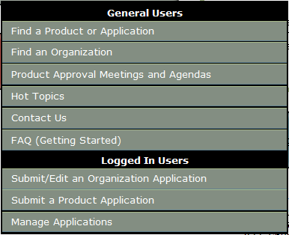
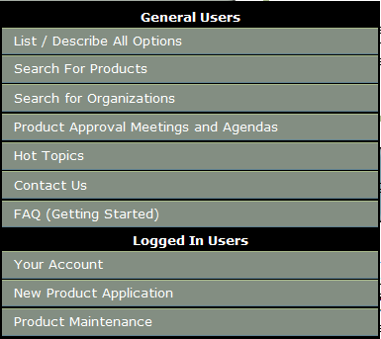
Streamline homepage – no loss in functionality
Old
New

Slide 10
Entities and Manufacturers Can…
Submit/Edit an Organization Application
Submit a Product Application
Manage Applications & Registration

Slide 11
Part 2: Entities

Slide 12
Accreditation Entities – ability to upload proof of compliance
1
Currently no upload function for certificates
Previously Handled offline
The goal of the enhancement to have an upload screen with browse button to find the file

Slide 13
Quality Assurance Entities: QA verification
2
Function is in the Rule
not in the BCIS
9N-3.005 Product Evaluation and Quality Assurance for State Approval.
(3) Products listed in Rule 9N-3.001, F.A.C., shall be manufactured under a quality assurance program audited by an approved quality assurance entity. (d) Quality assurance agencies shall audit the quality assurance program of manufacturers and audit production quality of products. Auditing of a quality assurance program shall be by one or more of the following methods: visits to manufacturing facilities, inspection of products at construction sites, inspection of products at state distribution facilities or testing of regular production items. Such auditing shall be performed at intervals not to exceed 12 months.

Slide 14
Quality Assurance Entities: QA verification -Continued
Annual upload of pdf file
Added directly to the FL # application
Check and balance - Verification handled by the PA Administrator
The goal of the enhancement to have an upload screen with browse button to find the file

Slide 15
Entity Status Consistency
3
Some BCIS screens show entity as approved, some show it expired
Example of Rule language: Rule 9N-3.008 (c) Approvals shall be valid until such time as Commission approval requirements change, the quality assurance agency no longer qualifies under current requirements; the accreditation expires, or is removed, or is both expired and removed; or the approval is suspended or revoked.

Slide 16
Entity Status Consistency - Continued
Entities can be expired but maintain Approved status on other screens
Result: Can be misleading as to what the “real” status is
Enhancement: Change the status to be consistent with other application processes
At this time we do not have a specific solution. However we will take to the stakeholder meeting

Slide 17
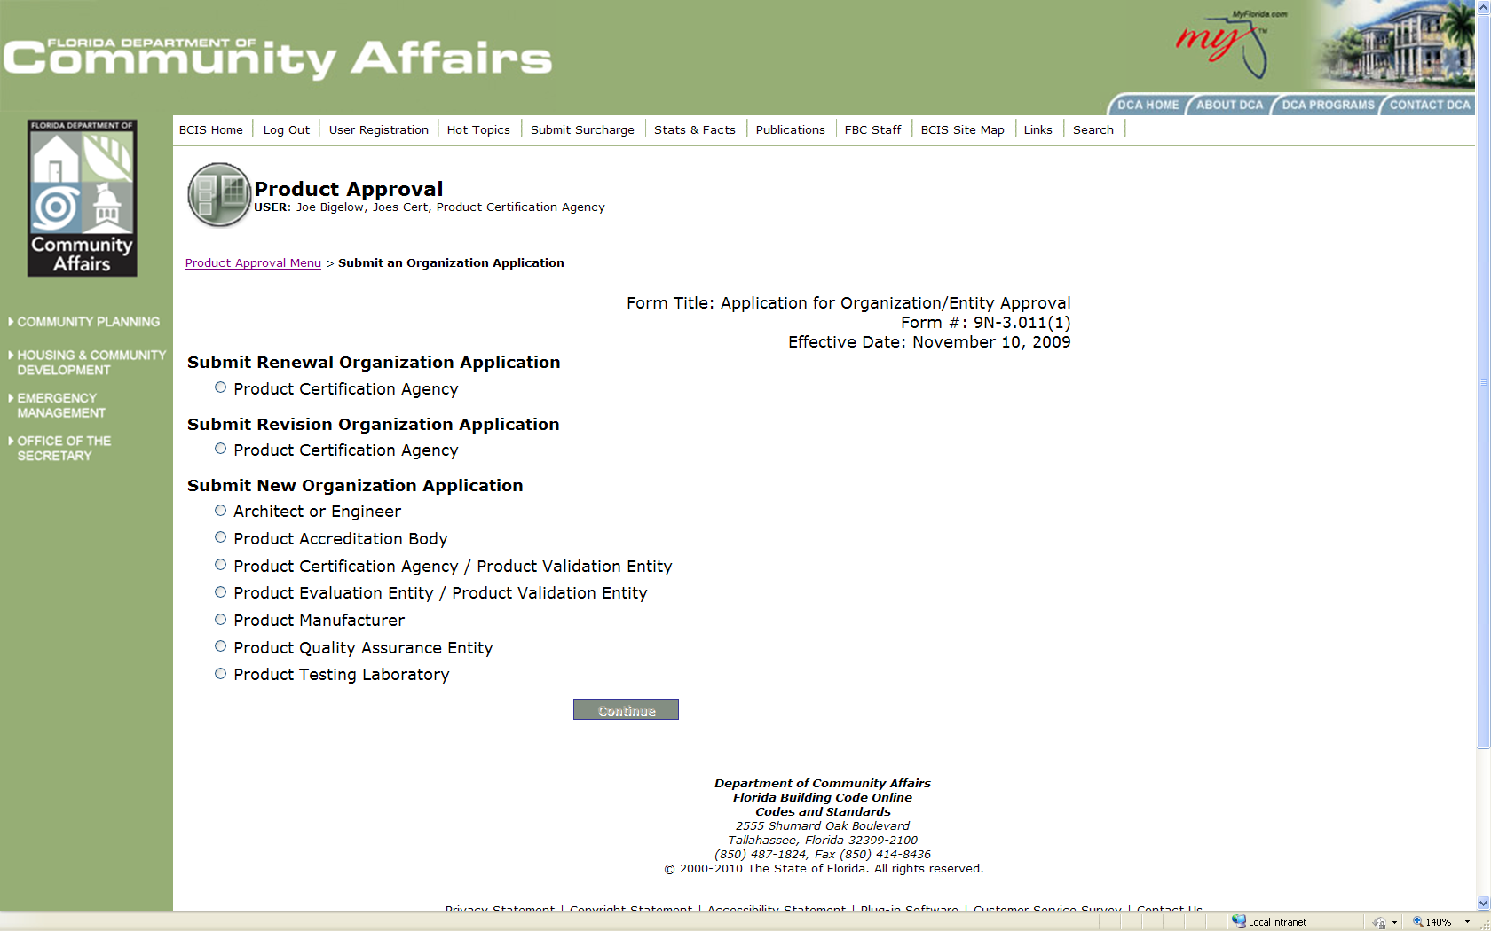
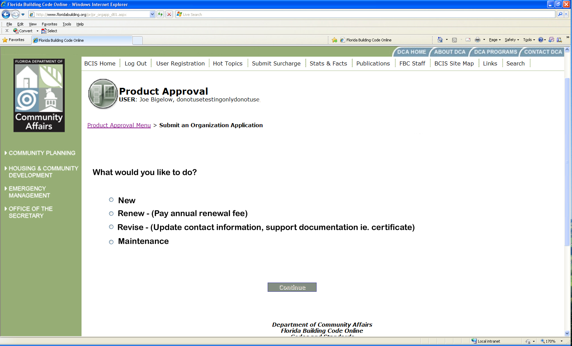
Old Entities Screen

Slide 18
New Screen for Entities
4
Separation of New, Renew, and Revision Menu Options
What do you want to do next?
Menu Selection for ‘New’ Only

Slide 19
Rule 9N-3 Update
Define New
Define Renewal
Define Revision
Define Editiorial
Define Maintenance (if used)
Current status
Renewal allows Revision
Revison allows renewal
New allows editorial
Enahancement: provide flexibility with no extra fees. To be addressed with the stakeholders

Slide 20
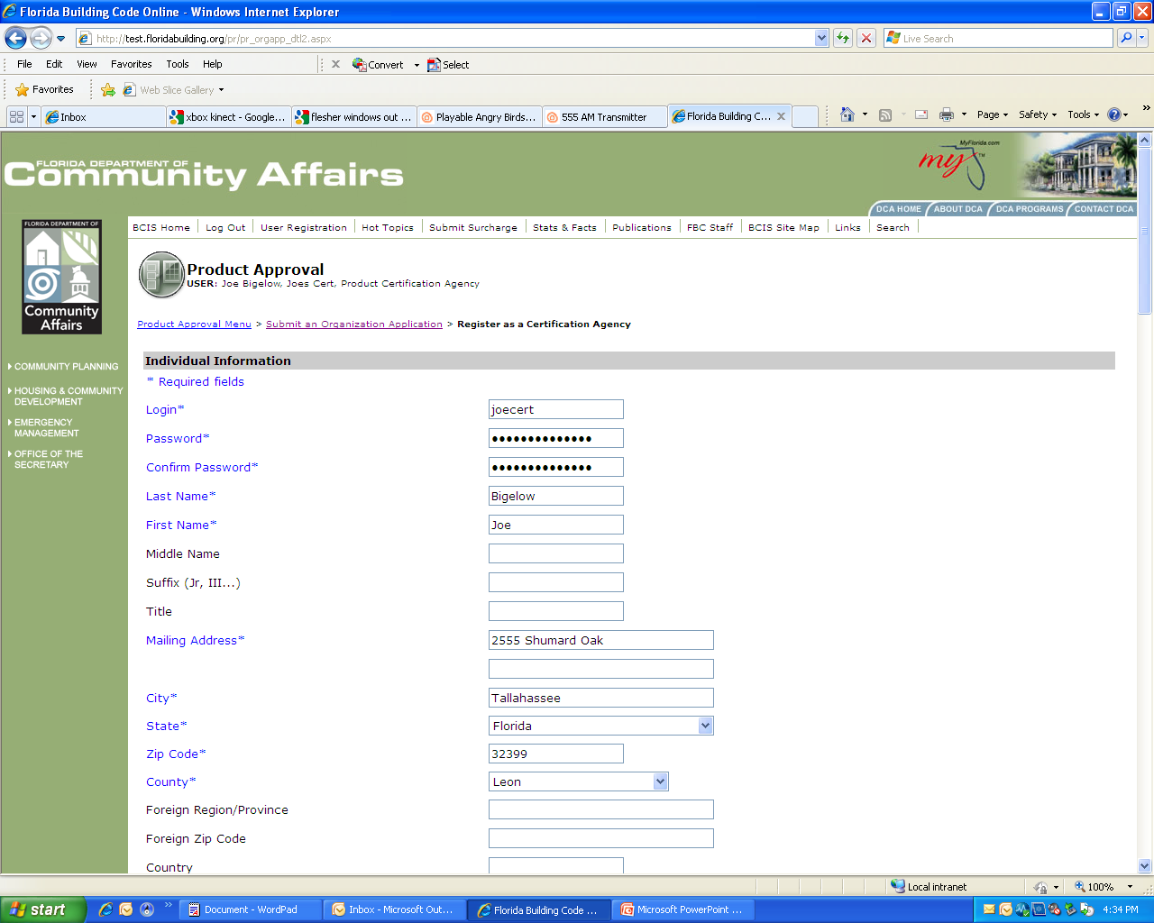
New Button
What do you want to do next?
Fills Out The Registration Page
& Uploads Documents
Notes:
Change “Submit New Organization Application” to “Are You A…?
Move the Product Manufacturer button to the bottom of the list (entities seem to be first) for consistency (currently alpha order)

Slide 21
New Button - Page
Notes:
Change “Submit New Organization Application” to “Are You A…?
Move the Product Manufacturer button to the bottom of the list (entities seem to be first) for consistency (currently alpha order)

Slide 22
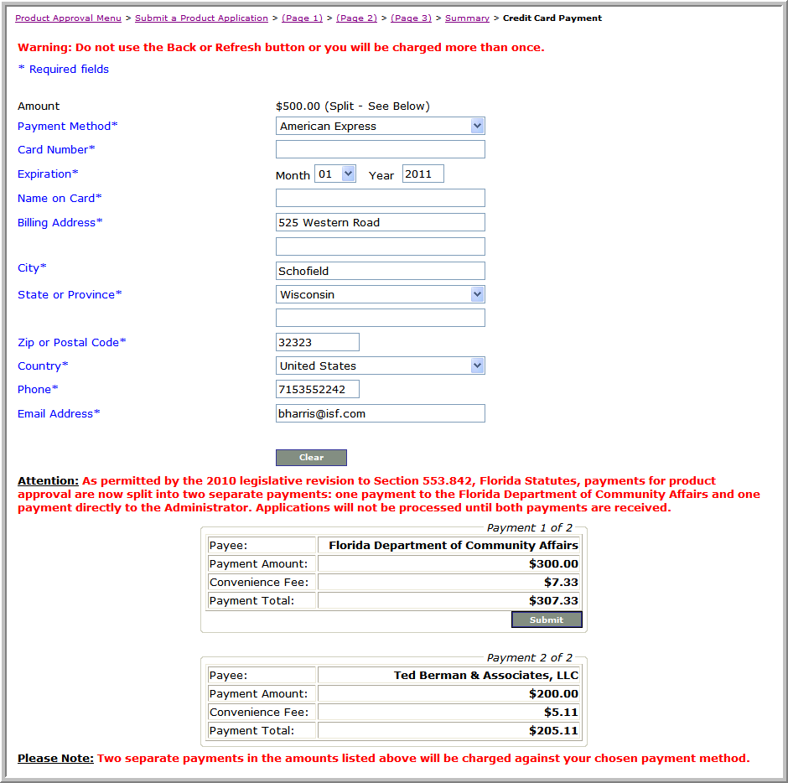
Renewal button
What do you want to do next?
Allows No Changes:
Payment s Only
Notes:
Add the menu for renewal and slide up same as New
Dynamic using registration information.

Slide 23
Entity renewal - Page
Current notification only shows one portion of the payment
Notification email to include both DCA & Product Approval Administrator with amounts
shown

Slide 24
Entity Renewal Bug-fixes
Fix the 12 month extension glitch (Every time application is resubmitted, 12 month extension is added)
Grace period/editing window,
for Accreditation certificate turnaround – needs attention
180 days to 30 days

Slide 25
Revision button
What do you want to do next?
ALL Changes & Uploads
Notes:
Add Menu for revision and slide up.

Slide 26
Revision
Registration changes - Editorial and no fee
ie. Changing to new phone number
Changes made to restricted fields require fee.
Ie. New certificate upload

Slide 27
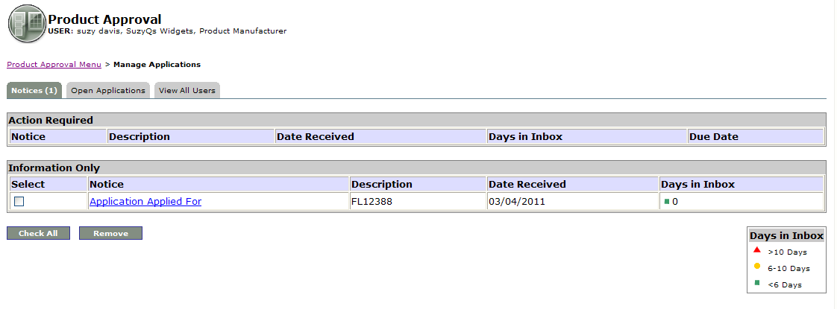
Maintenance button
What do you want to do next?
Management of Applications
& Notifications
Notes:
Add in-box view and slide up.

Slide 28
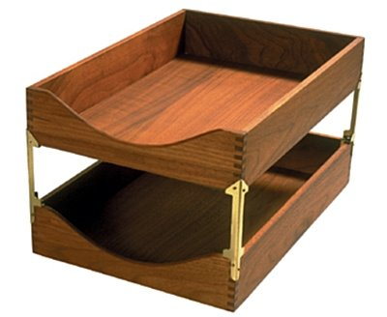
“Maintenance” button - Page
Inbox
Manage notices
Enhancement to view
current clients in current code
associated to them in
the BCIS

Slide 29
Registration
Inbox
Manage Clients

Slide 30
Registration
Inbox
My Clients

Slide 31
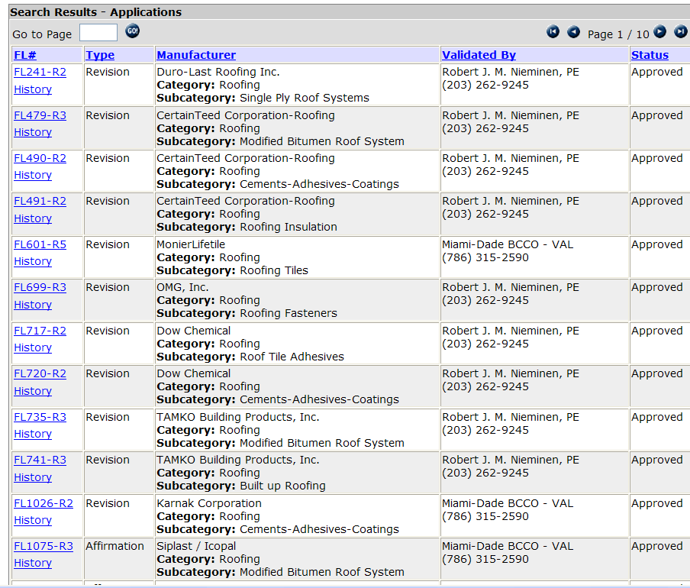
Registration
Inbox
My Clients
ABC Roofing
Joe Validator
555-255-2555
ABC Roofing
Joe Validator
555-255-2555
ABC Roofing
Joe Validator
555-255-2555
ABC Roofing
Joe Validator
555-255-2555
Joe Validator
555-255-2555

Slide 32
Part 3: Manufacturers

Slide 33
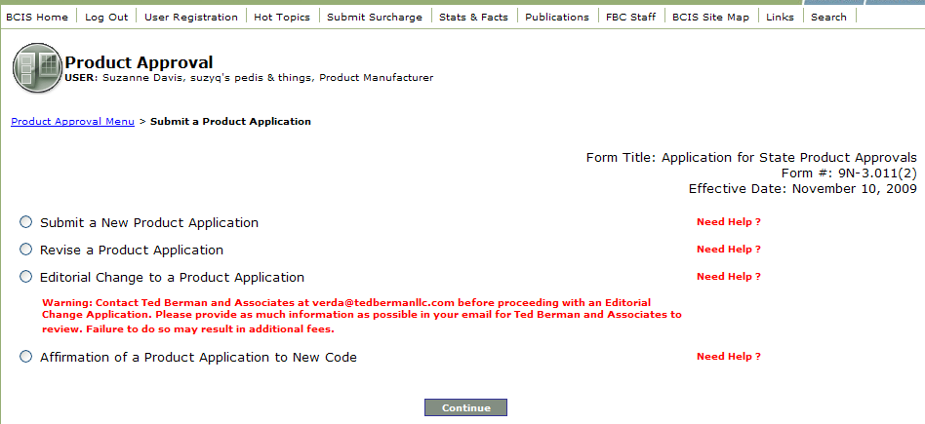
“What do you want to do next”
What do you want to do next?
New Product
Submit a new Product
Maintenance
Notes:
Change 1st Renewal to “New”
Move the Product Manufacturer button to the bottom of the list (entities seem to be first) for consistency (currently alpha order)

Slide 34
New Screen for Manufacturers General Users
1
What do you want to do next?
New Product
A New Look
Maintenance
Notes:
Change 1st Renewal to “New”
Move the Product Manufacturer button to the bottom of the list (entities seem to be first) for consistency (currently alpha order)

Slide 35
Registration
Inbox
My Products

Slide 36
Registration
Inbox
My Products

Slide 37
Registration
Inbox
My Products
ABC Roofing
Joe Validator
555-255-2555
ABC Roofing
Joe Validator
555-255-2555
ABC Roofing
Joe Validator
555-255-2555
ABC Roofing
Joe Validator
555-255-2555
ABC Roofing
Joe Validator
555-255-2555
ABC Roofing
Joe Validator
555-255-2555
ABC Roofing
Joe Validator
555-255-2555
ABC Roofing
Joe Validator
555-255-2555

Slide 38
Quality Assurance Contract proof upload
1
Sent to PA Administrator currently
Needs to be uploaded by manufacturer under maintenance as no charge
Verified by PA Administrator

Slide 39
Part 4 –
Administrator

Slide 40
Administrator checklist Example – Cert Method Will look different for other compliance methods
1
REVIEW PROCEDURES BY PRODUCT APPROVAL SYSTEM ADMINISTRATOR.
Certification Method.
1. Verify that Certification Agency Certificate (CAC) is issued to the Product Manufacturer’s name on the application, for the product described on application and for the testing standards on application.
2. Verify that testing standards on application are as adopted on the building code. If not as adopted (year of standard) an equivalency of standards shall be uploaded on proper location of application.
3. Verify that the application lists the proper category and subcategory of product.
4. Verify that the testing standards on CAC and application are the building code required by the building code for this category/subcategory.
5. Verify that limits of use on CAC are same as on application or that proper references are indicated to documents showing those limits of use.
6. Verify that the product is properly described on application and as described on CAC.
7. Verify that proper installation instructions are included and in accordance with Rule 9B-72.070(5) FAC.
8. Verify that installation instructions are as tested. If rational analysis was performed to develop installation instructions an evaluation report shall be required.
9. Verify that structural components are properly specified. (Type, grade, properties, etc.)
10. Verify that no rational analysis was used to develop the CAC. If used recommend to applicant to change method to evaluation report by FL PE.
11. Verify that application was validated by an approved validation entity. If validation was done by a Florida licensed professional verify that proper validation checklist was submitted signed and sealed by validator.
12. If installations instruction are done by a licensed professional not independent from manufacturer, that the application is validated by an independent validator that will perform a technical validation.
13. Verify that proper QA Contract date is entered on application and that it is current.
14. Send proper comments on deficiencies to applicant, or if complete indicate application has been reviewed and placed as “Pending FBC Approval”.

Slide 41
Needs More Information Box
2
Allows “back and forth” with administrator
Handled in the application through administrator’s interface
Similar in functionality to the Proposed Code Modification module

Slide 42
Part 5: Development

Slide 43
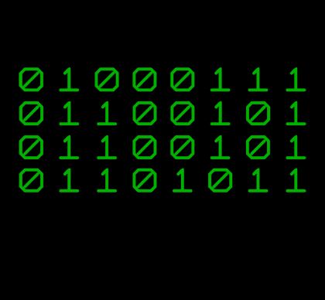
Field Testing
Stakeholder meetings
To address specific areas of concern
Can be conducted by webinar
Meetings TBD
Create an Entity control group
Test functionality of New, Renew, & Revision upgrades
Test functionality of Communications upgrades
Create a Manufacturer control group
Test functionality of QA contract audit uploads
Test functionality of communications upgrades

Slide 44
Thank you
If you have any questions please contact our offices at 850-4870-1824

