Slide 1
Florida Building Commission Lightning Protection Workgroup
February 12, 2018

Slide 2
Presentation Outline
Florida’s Lightning Problem
Selecting a Standard for Lightning Protection
Lightning Protection Recommendations

Slide 3
Protection Provided By the FBC
WASTEFUL ENERGY CONSUMPTION
TERMITES
WIND STORMS
ARCHITECTURAL BARRIERS
RADON
FIRE & SMOKE
TOXINS & POISIONS
HAIL
RAIN & FLOODING
SUBSTANDARD BUILDING PRODUCTS
EXCESSIVE TEMPERATURES
HURRICANES

Slide 4
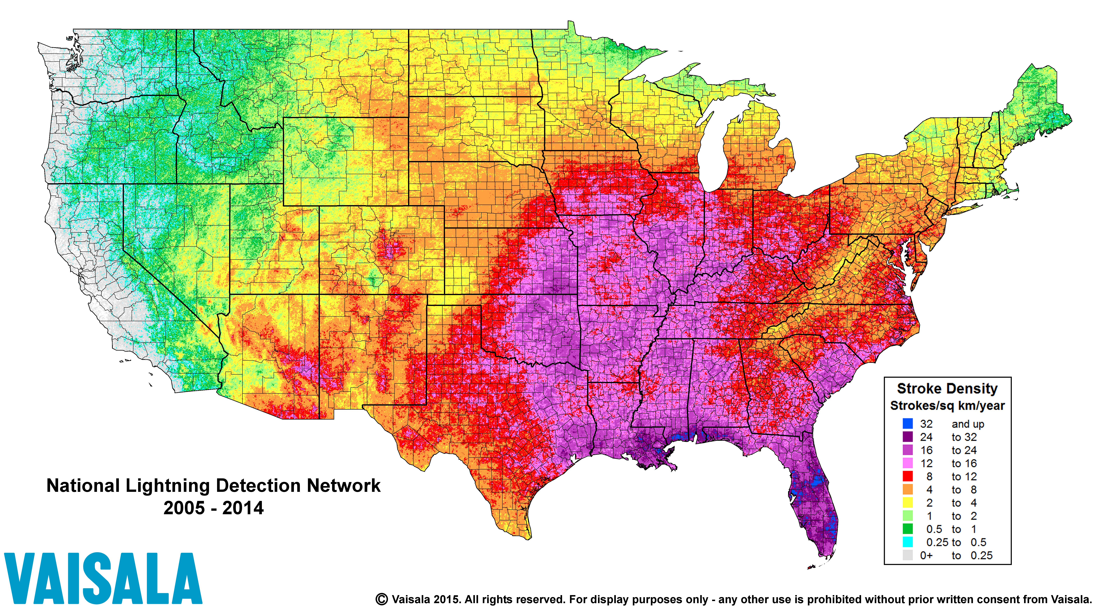

Slide 5
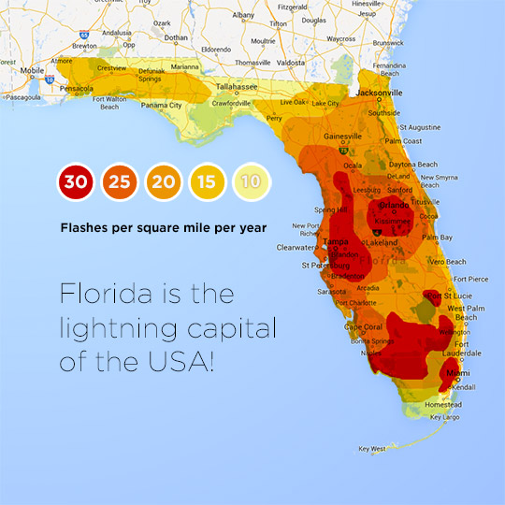
Average of 100 thunderstorms per year
1.5 million lightning strikes per year
Florida leads the nation in:
Lightning Deaths
Total Number of Insurance Claims
Total Losses per insurance Claim

Slide 6
Risk Assessment (Annex L)
A Risk Assessment is a comparison between the probability of the building being struck by lightning to the expected losses that would resulted from lightning damage.
If the “expected lightning strike frequency to the structure” is less than the “tolerable lightning strike frequency to the structure” – an LPS may not be needed.
If the “tolerable lightning strike frequency to the structure” is less than the “expected lightning strike frequency to the structure” – an LPS recommended.

Slide 7
Risk Assessment (Annex L)
Expected Lightning Strike Frequency
The yearly average flash density in the region where the structure is located
The equivalent collective area of the structure
The environmental coefficient accounting for the surrounding topography of the site of the structure.

Slide 8
Risk Assessment (Annex L)
Tolerable Lightning Strike Frequency
(Potential structural, environmental, & monetary loses)
Building Structure / Roof Structure
Value / Flammability of the Structures Contents
Occupancy of the Structure
Environmental Impact / Continuity of Services

Slide 9
Lightning protection requirements have been included in the FBC since the very first edition.
The 2001 FBC required lightning protection for hospitals (Article 419) and in the state requirements for educational facilities (Article 423). This edition of the code referenced the NFPA 780-1997 for compliance.
The 2004 FBC added lightning protection to nursing homes (Article 420). This edition of the code continued to reference the NFPA 780-1997 for all three occupancy types.
The 2007 FBC updated the reference to the NFPA 780-2004.
There were no changes to the 2010 or 2014 editions of the FBC with regard to the lightning protection, other than section relocation.
The 2017 FBC update the reference to the NFPA 780-2014

Slide 10
Selecting a Standard for Lightning Protection
Precedents: NFPA standards have been adopted in Florida prior to and ever since the first FBC
Certification: Product safety standards are harmonized to correlate with recognized safety standards
Traceable: Developed by and inclusive of all stakeholders, open consensus process, published archives, public access, etc.

Slide 11
104.11 Alternative materials, design and methods of construction and equipment.
The provisions of this code are not intended to prevent the installation of any material or to prohibit any design or method of construction not specifically prescribed by this code, provided that any such alternative has been approved. An alternative material, design or method of construction shall be approved where the building official finds that the proposed design is satisfactory and complies with the intent of the provisions of this code, and that the material, method or work offered is, for the purpose intended, not less than the equivalent of that prescribed in this code in quality, strength, effectiveness, fire resistance, durability and safety.

Slide 12
Lightning Protection Recommendations
Option #1 – Chapter 27 requirement for all occupancies of the FBC-B (Modification 6460 with minor revisions)
Option #2 – Chapter 27 requirement for the uses and occupancies detailed in Chapter 4 of the FBC-B, with 10 exceptions
Option #3 – Chapter 4 requirement for the uses and occupancies detailed in the Chapter, with 10 exceptions
Option #4 – Chapter 4 requirement applying to the (9) medical-type uses and occupancies only (Section 449, 450, 451, 452, 457, 463, 464, 467, and 469)

Slide 13
NEW – Section 2703 Lightning Protection
2703.1 Lightning Protection. A lightning protection system shall be provided for all new buildings and additions in accordance with NFPA 780, Standard for the Installation of Lightning Protection Systems.
2703.2 Where additions are constructed to existing buildings, the existing building’s lightning protection system, if present, shall be interconnected to the new lightning protection system.
2703.3 Surge-protective devices (SPDs) shall be installed in accordance with NFPA 70, National Electrical Code, as required by NFPA 780, Standard for the Installation of Lightning Protection Systems.
Exceptions:
1. One- and two-family dwellings
2. Lightning protection shall not be required for any building or addition where determined to be unnecessary by evaluation using the Risk Assessment Guide in NFPA 780, Standard for the Installation of Lightning Protection Systems or an alternative method approved by the authority having jurisdiction.

Slide 14
NEW – Section 2703 Lightning Protection
2703.1 Lightning Protection. A lightning protection system shall be provided for all new buildings and additions in accordance with NFPA 780, Standard for the Installation of Lightning Protection Systems. The requirements of this section apply to the special uses and occupancies detailed in Chapter 4 of this code.
2703.2 Where additions are constructed to existing buildings, the existing building’s lightning protection system, if present, shall be interconnected to the new lightning protection system.
2703.3 Surge-protective devices (SPDs) shall be installed in accordance with NFPA 70, National Electrical Code, as required by NFPA 780, Standard for the Installation of Lightning Protection Systems.
Exceptions:
1. The following special uses and occupancies:
1.1. Section 405: Underground buildings
1.2. Section 409: Motion picture projection rooms
1.3. Section 416: Drying rooms
1.4. Section 418: Organic coatings
1.5. Section 426: Hyperbaric facilities
1.6. Section 454: Swimming pools and bathing places
1.7. Section 458: Manufactured buildings
1.8. Section 460: Mausoleums and columbariums
1.9. Section 462: Use of asbestos in new public buildings or buildings newly constructed for lease to government entities–prohibition
1.10. Section 465: Control of radiation hazards
2. Lightning protection shall not be required for any building or addition where determined to be unnecessary by evaluation using the Risk Assessment Guide in NFPA 780, Standard for the Installation of Lightning Protection Systems or an alternative method approved by the authority having jurisdiction.

Slide 15
401.3 Lightning Protection.
401.3.1 A lightning protection system shall be provided for all new buildings and additions in accordance with NFPA 780, Standard for the Installation of Lightning Protection Systems. The requirements of this section apply to the special uses and occupancies described herein.
401.3.2 Where additions are constructed to existing buildings, the existing building’s lightning protection system, if present, shall be interconnected to the new lightning protection system.
401.3.3 Surge-protective devices (SPDs) shall be installed in accordance with NFPA 70, National Electrical Code, as required by NFPA 780, Standard for the Installation of Lightning Protection Systems.
Exceptions:
1. The following special uses and occupancies:
1.1. Section 405: Underground buildings
1.2. Section 409: Motion picture projection rooms
1.3. Section 416: Drying rooms
1.4. Section 418: Organic coatings
1.5. Section 426: Hyperbaric facilities
1.6. Section 454: Swimming pools and bathing places
1.7. Section 458: Manufactured buildings
1.8. Section 460: Mausoleums and columbariums
1.9. Section 462: Use of asbestos in new public buildings or buildings newly constructed for lease to government entities–prohibition
1.10. Section 465: Control of radiation hazards
2. Lightning protection shall not be required for any building or addition where determined to be unnecessary by evaluation using the Risk Assessment Guide in NFPA 780, Standard for the Installation of Lightning Protection Systems or an alternative method approved by the authority having jurisdiction.

Slide 16
MODIFIED & NEW Sections – Lightning Protection
4xx.x Lightning Protection.
Applicable Sections:
Section 449: Hospitals
Section 450: Nursing homes
Section 451: Ambulatory surgical centers
Section 452: Birthing centers
Section 457: Mental health programs
Section 463: Adult day care
Section 464: Assisted living facilities
Section 467: Hospice inpatient facilities and units and hospice residences.
Section 469: Office surgery suite

Slide 17
THANK YOU FOR YOUR PARTICIPATION!

