Slide 1
Final Report:
Full Scale Wind Load Testing of Aluminum Screen Enclosures
Forrest J. Masters, PhD, PE, Associate Prof. of Civil Engineering, University of Florida
Sungmoon Jung, PhD, Florida State University

Slide 2
Presentation Outline
Specimen selection process
Full-scale testing
  Set up
  Design load (FBC) vs. applied load
  Key observations
Material testing
Comparison of test and analysis
Implications to the code

Slide 3
Selection of the “Generic” Specimen
AAF acquired 35 signed and sealed, site-specific plans from the St. Johns County Building Department and the City of Jacksonville.
Ten designs with a mansard roof with approximate dimensions of 24 ft X 40 ft X 9 ft and a 48 in rise in the roof were selected, de-identified, and forwarded to Dr. Jung (FSU) to review
A design with average structural performance was selected
In order to rank the candidate designs objectively, raking criteria were used (performance of roof bracing, wall bracing, post, and other members)

Slide 4
Generic Specimen

Slide 5
Generic Specimen

Slide 6
Generic vs. AAF Specimens
AAF designed a second specimen (same size) following the 2010 AAF Guide to Aluminum Construction in High Wind Areas.
Significant differences between the “Generic” and the “AAF” specimens
  AAF has 8 additional 2 x 2 roof braces, whereas generic has none
  AAF has 2 x 8 roof beams, whereas generic has 2 x 6 roof beams
  AAF has 2 x 3 purlins, whereas generic has 2 x 2 purlins
  AAF has a 5” super gutter, whereas generic has a 7” super gutter
  AAF has a 2 x 3 + 1 x 2 eave rail, whereas generic has a 2 x 2 + 1 x 2 eave rail
  AAF has 2 x 4 posts on the long wall, whereas generic has 2 x 5 posts
  AAF does not have cable bracings on the side walls
  Some AAF purlins require backing plates (at bracing bays)

Slide 7
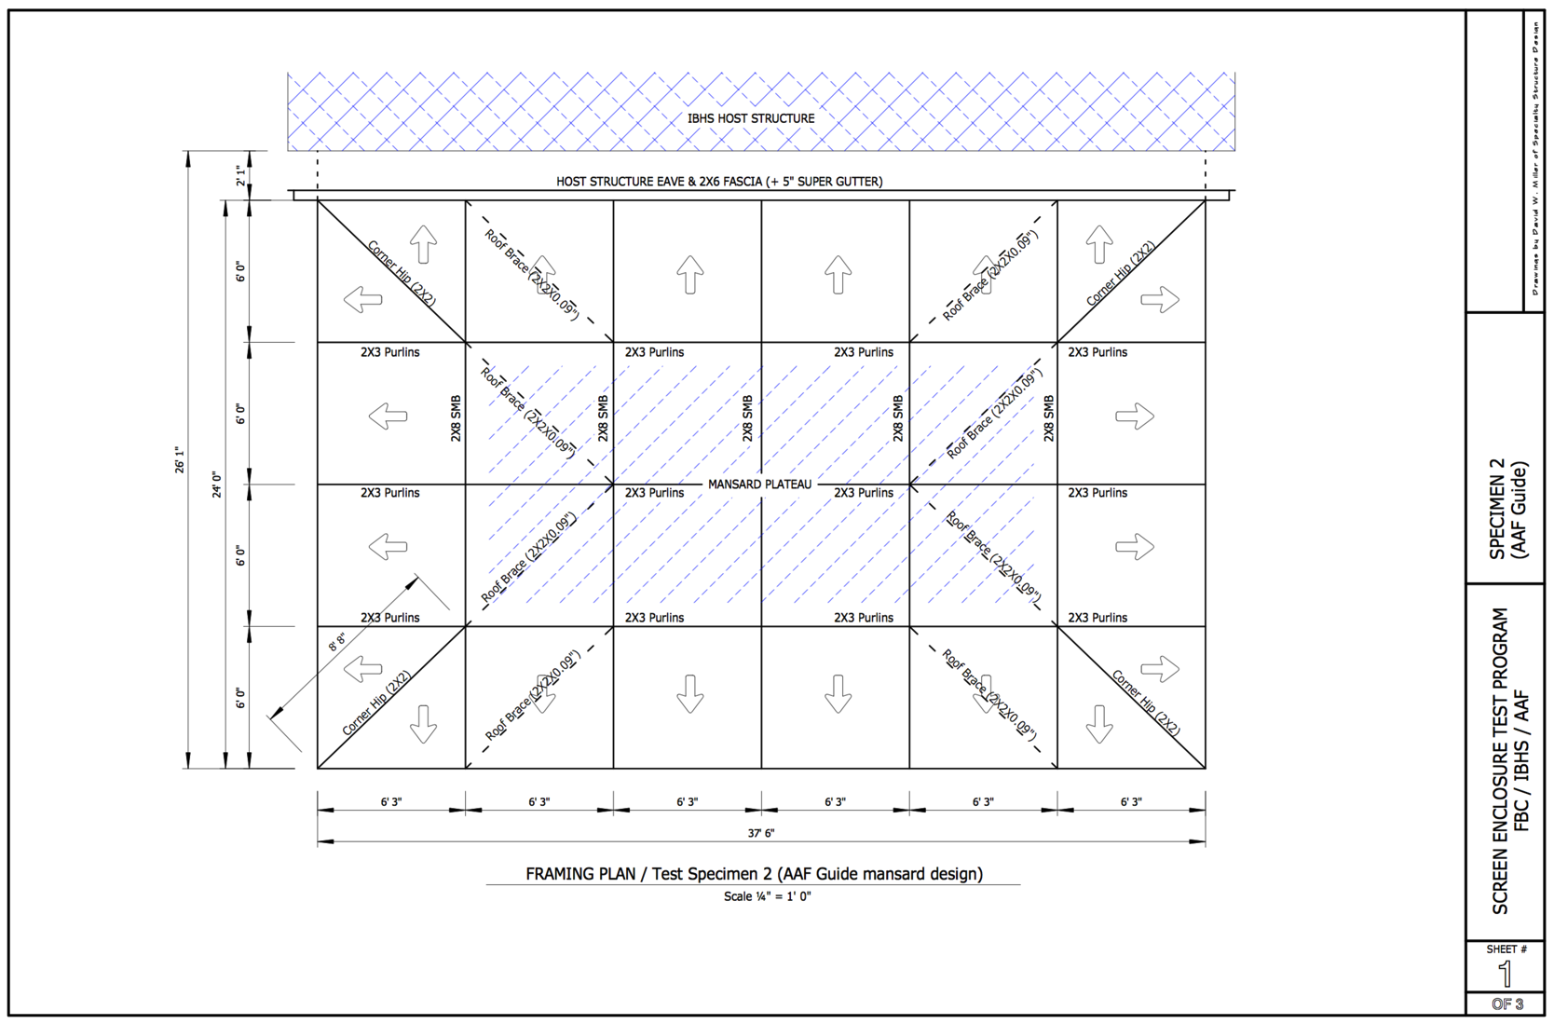
AAF Specimen

Slide 8
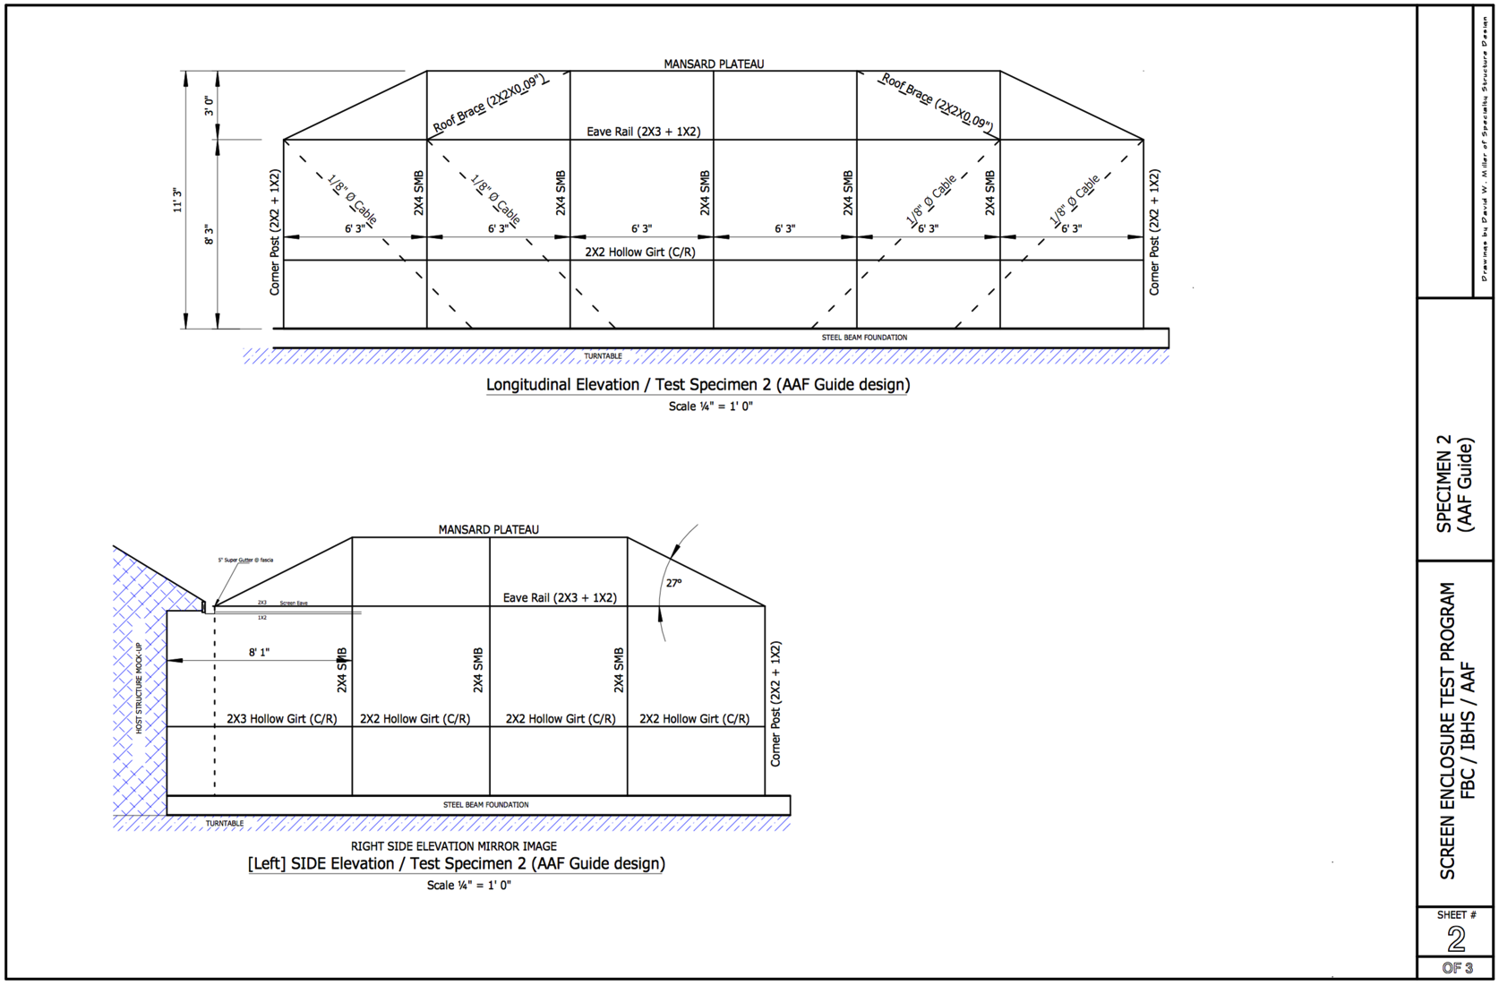
AAF Specimen

Slide 9
Preparation for the Testing
Hartshorn Custom Contracting is fabricating both specimens
AAF and FSU performed structural analysis to identify high anticipated-to-allowable stress ratio and high tension. Visual Analysis and SAP2000 were used (sample results: next slide)
The information was forwarded to IBHS to install strain gauges

Slide 10
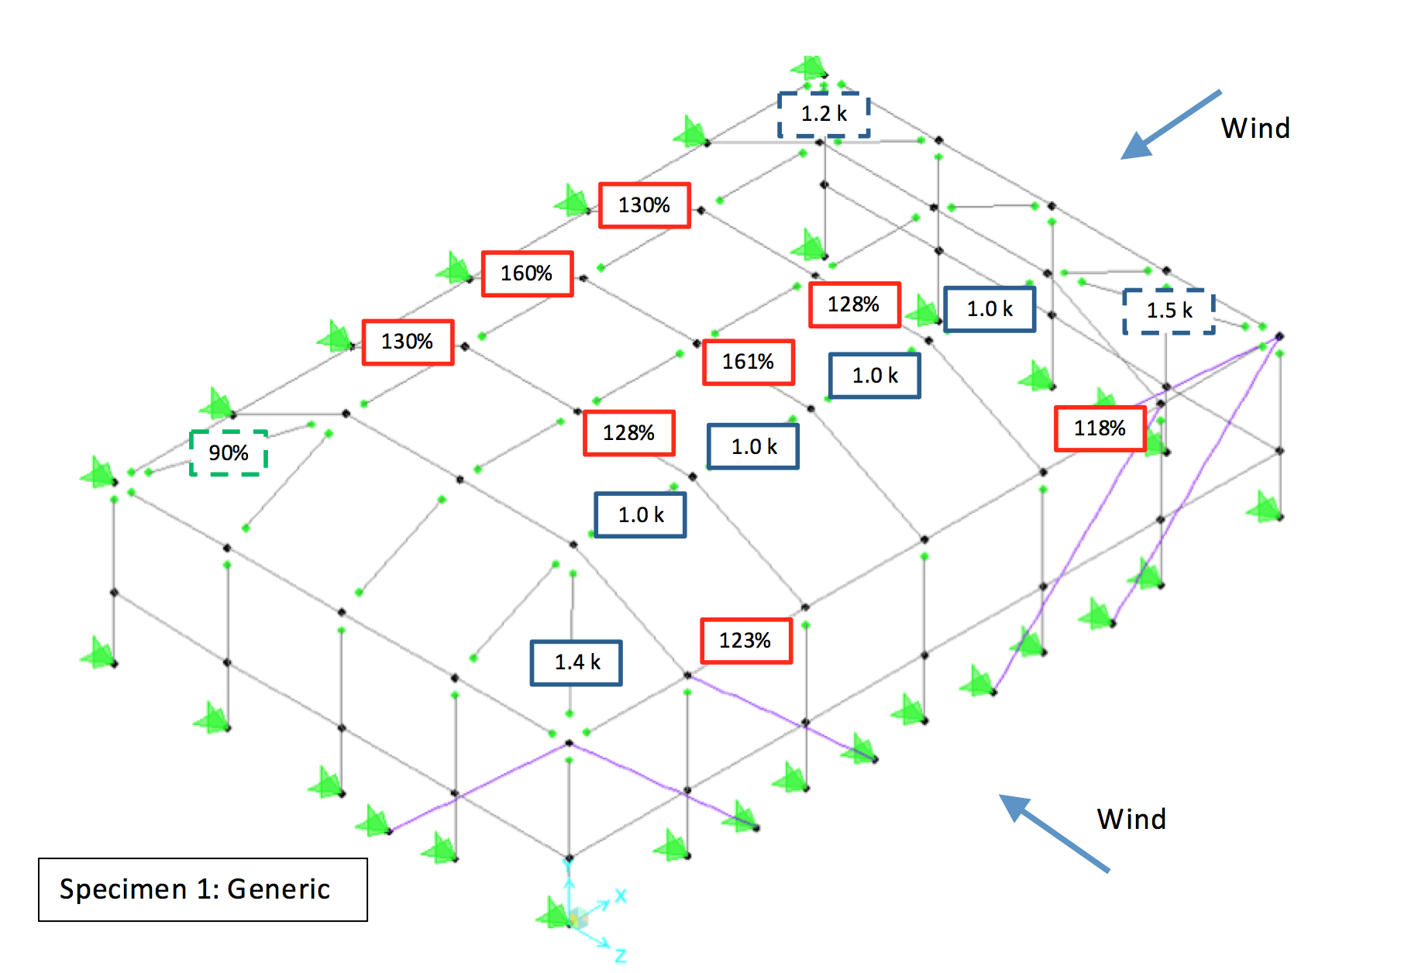
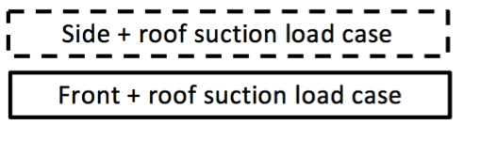

Slide 12
Test Set Up
Tests were conducted at the IBHS Research Center
Generic specimen: assembled in April 23, tested in April 24
AAF specimen: assembled in April 25, tested in April 26
Both specimens used 18 ×14 × 0.013" fiberglass mesh

Slide 13
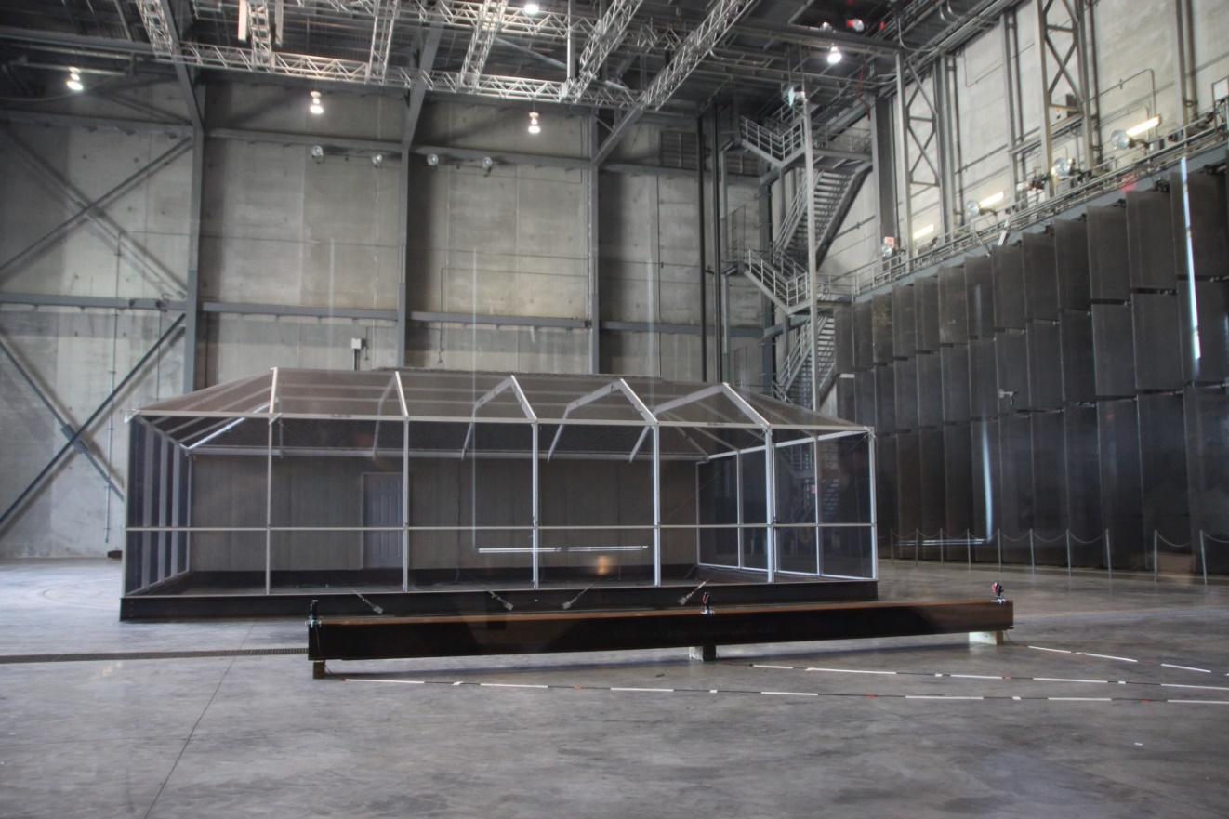

Slide 14
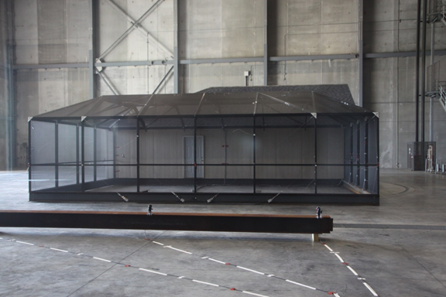

Slide 15
Sensors: Generic
Sensors: AAF
(A: axial, M: moment, C: cable)

Slide 16
Experimental Procedure
Static pull tests (single point axial force) were conducted before wind tests. Results were used for finite element model calibration.
Wind tests: angle definition

Slide 17
Experimental Procedure (cont’d)
Wind tests
  Series I: 90 degree case over three wind speed intensities with and without turbulence (Runs 1 to 6)
  Series II: repeated most of Series I across a range of wind angles (Runs 7 to 24)
  Series III: gradually increased the wind speed for 0 degree and 90 degree wind angles (Runs 25 to 30)
  Series IV: tests at maximum wind speed for various scenarios (Generic: Runs 31 to 33, AAF: Runs 31 to 40)

Slide 18
Design vs. Applied Wind Loading
The following figures compare design wind loading (FBC) and applied wind loading (IBHS)
  FBC: 120 mph, exposure B were used for both specimens
  IBHS: 90 mph, assumed a factor of 0.7 (includes gust effect, drag, screen)
In principle, no failure should have occurred in the test

Slide 19
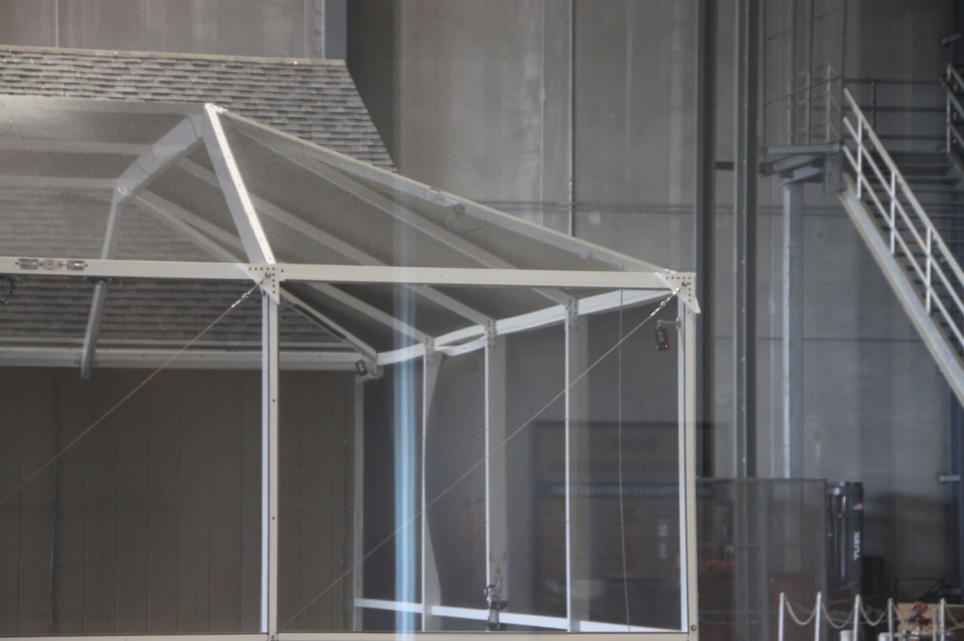
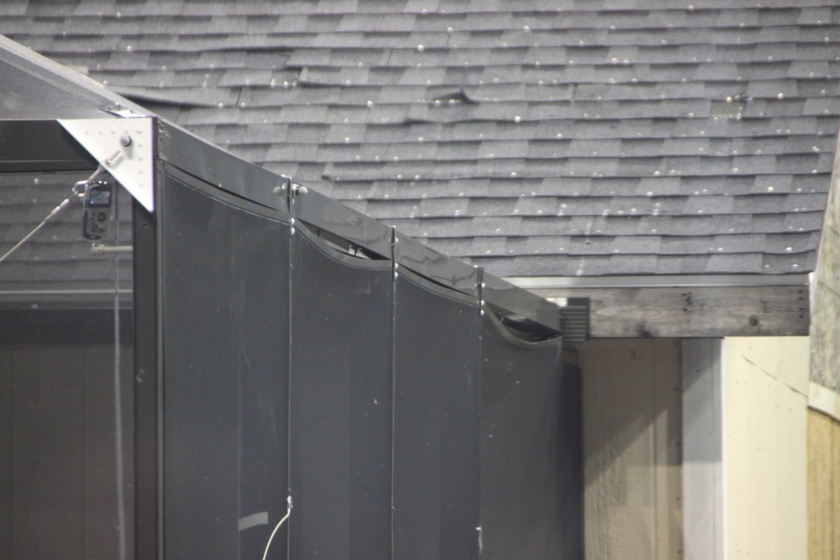
Key Observations During the Test
Screens/attachments began to fail at 80 mph
Generic, max V = 80 mph
AAF, max V = 80 mph

Slide 20
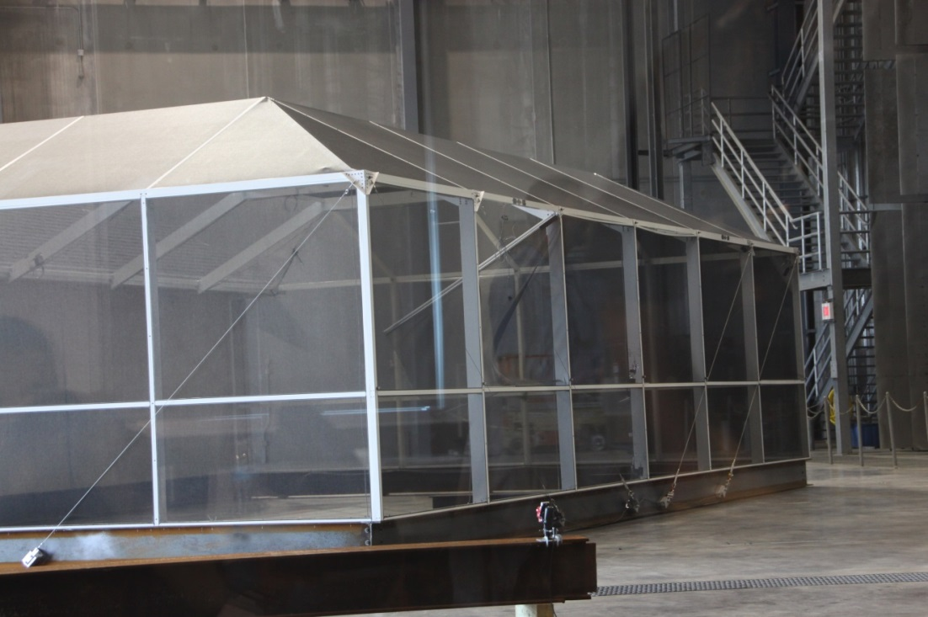
Key Observations (cont’d)
Several screen attachments failed at 90 ~ 100 mph
Generic, max V = 90 mph
Failed screens and/or screen attachments (fully failed ones only), after all 90 mph tests

Slide 21
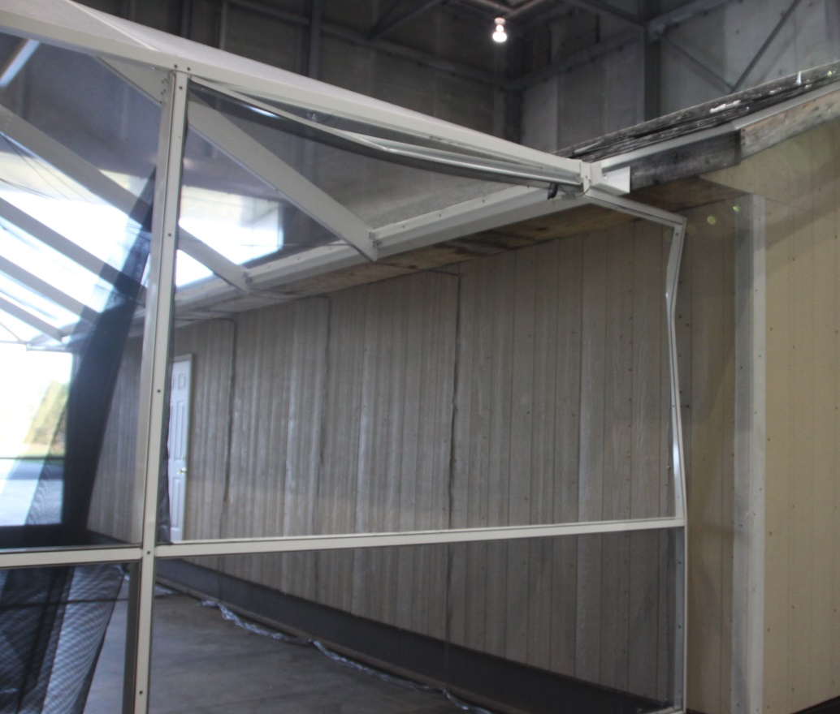
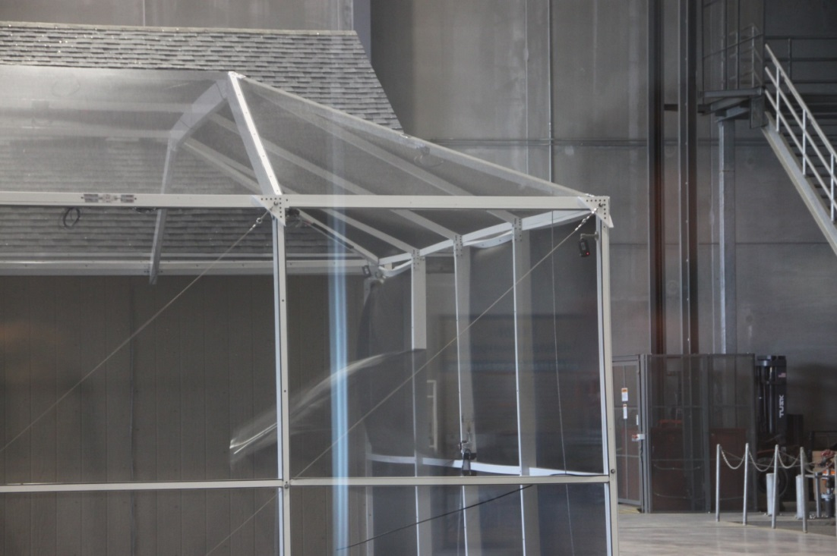
Key Observations (cont’d)
Generic specimen lost one corner post at 90 mph

Slide 22
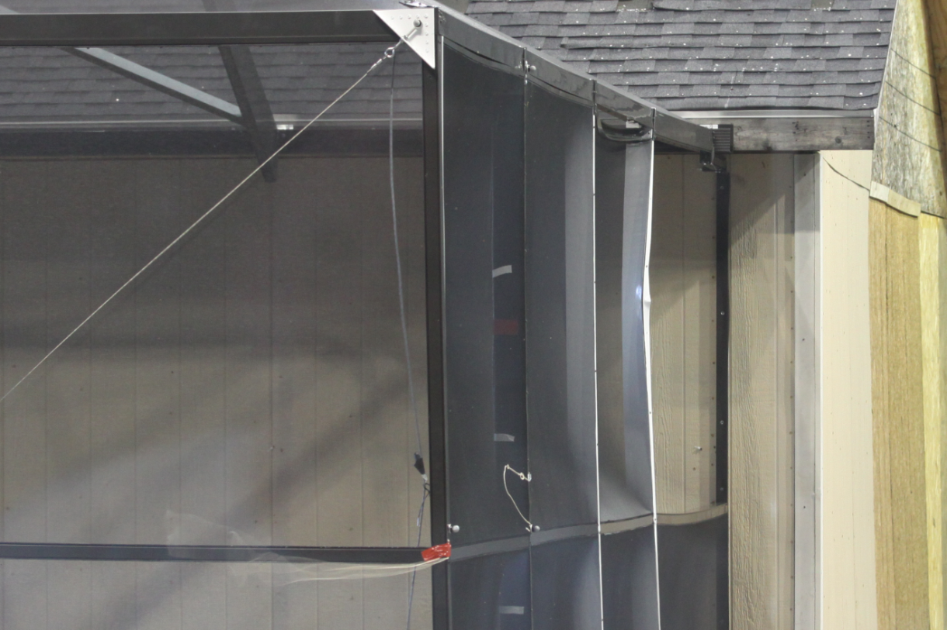
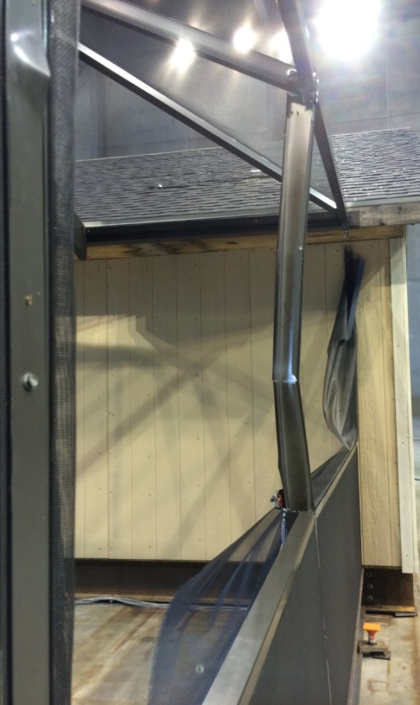
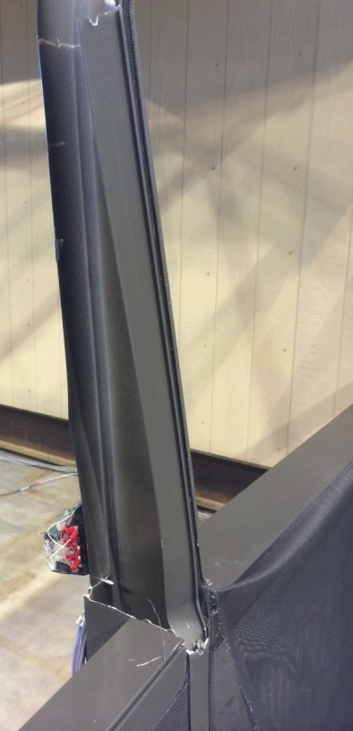
Key Observations (cont’d)
AAF specimen lost two corner posts at 100 mph
The failure was due to the unbalanced loading (& failed attachment)

Slide 23
Summary of the Tests

Slide 24
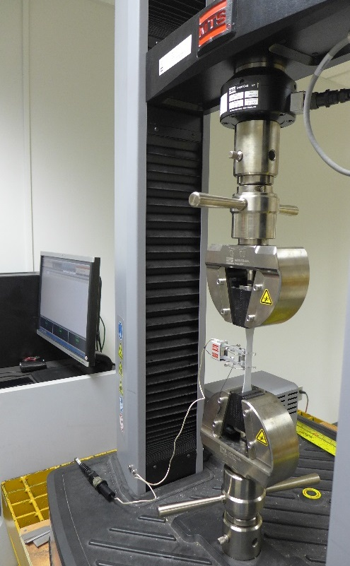
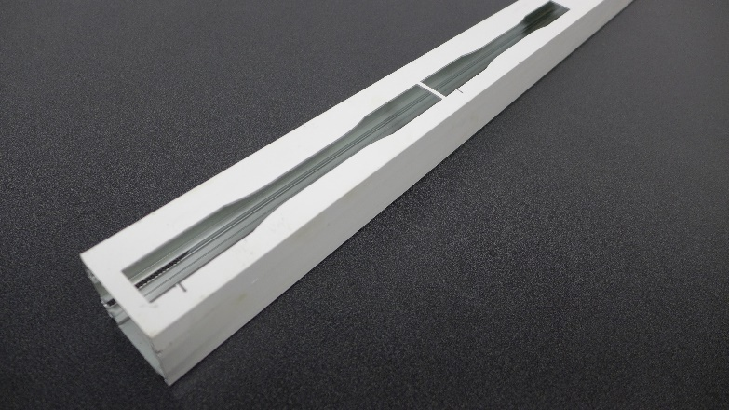
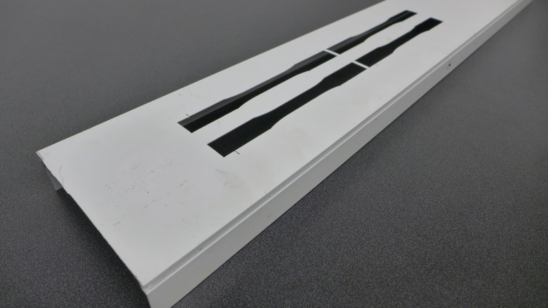
Material Testing
Material testing was conducted to confirm the material performance

Slide 25

Material Testing (cont’d)
Specified: 6005-T5 (E = 10,100 ksi, $σ_{y}$ = 35.0 ksi, $σ_{u}$ = 38.0 ksi)
Actual performance: E = 9,300 ksi, $σ_{y}$ = 27.8 ksi, $σ_{u}$ = 34.0 ksi
  $σ_{y}$ and $σ_{u}$ are estimated statistically
  $σ_{y}$: N = 12, mean = 32.3 ksi, standard deviation = 1.2 ksi
  $σ_{u}$: N = 12, mean = 37.5 ksi, standard deviation = 0.9 ksi

Slide 26
Model Calibration
Using the results from pull tests, three different modeling assumptions were compared

Slide 27
Model Calibration (cont’d)
Finite element results were compared to sensor readings
Model C was chosen for further analysis
Sample results on the right: axial forces, AAF, pull 01
Perfect Correlation

Slide 28
Comparison of Design vs. Test
For 80 mph and 90 mph tests, test results (x-axis) were compared to the analysis results (y-axis)
Analysis used FBC loading. Therefore, in principle, all test results should be lower than analysis results.
Marked notable locations (a sample comparison is shown on the right)
Data Lower Than Analysis
Data Higher Than Analysis
Perfect Correlation

Slide 29
Summary of Notable Members: Generic
One corner bracing exceeded the allowable stress
High moment correlated well with screen attachment failure

Slide 30
Summary of Notable Members: AAF
Two posts exceeded the allowable stress (one of which actually failed during the testing)

Slide 31
Implications to the Code
Although the wind loading did not exceed the design loading, failures were observed:
  Screens began to fail at 80 mph
  Some screen attachments failed at 90 to 100 mph
  Some of the failed screen attachments fluttered while attached to the structural member, contributing failure of it
  One vertical post failed due to the unbalanced loading (one side had screen but the other side lost the screen)

Slide 32
Implications to the Code (cont’d)
The failure of screen attachments and unbalanced loading have direct implications on the rule on removing the screen (Rule 61G20-1.002). If some screens are cut but not others, unbalanced loading may accelerate the failure of the post. Code changes should be considered to either require removal of all screens above the chair rail, or, devise a more secure fastening of screen attachments to prevent partial failure and unbalanced loading.

Slide 33
Implications to the Code (cont’d)
The tensile ultimate strength and tensile yield strength of the aluminum extrusions, based on the testing of coupons harvested from the specimens, were lower than the specified values. To ensure that the aluminum meets or exceeds the specified performance levels, the building code should require that material certification be submitted to the building official.

Slide 34
Implications to the Code (cont’d)
The tested specimens received very thorough inspection and quality control. However, it is well known that the real-world plan review and inspection may not reach such a level, and therefore, likely experience much more severe failure due to the hurricane. The code requirement on this issue would greatly reduce potential failure of screen enclosures due to the hurricane.

