Slide 1
EVALUATION OF DRAFTSTOPPING WITHIN TYPE V COMBUSTIBLE CONCEALED ATTIC SPACES
Prepared by:
Steve Welsh
June 27, 2014

Slide 2
Outline
Literature Review
Field Assessment
Discussion
Gap Assessment

Slide 3
Current Code
Group R-2 Apartments:
Required if three or more dwelling units
subdivide into areas not exceeding 3,000 sq ft or above every two dwelling units, whichever is smaller

Slide 4
Material Requirements
Draftstopping materials must not be less than:
0.5-inch gypsum board
0.375-inch wood structural panel
0.375-inch particleboard
1-inch nominal lumber
cement fiberboard
batts or blankets of mineral wool or glass fiber
other approved materials adequately supported.

Slide 5
Material Requirements
Must extend to the underside of the roof sheathing.
The integrity of draftstops must be maintained.
Openings in the partitions must be protected by self-closing doors with automatic latches.

Slide 6
Penetrations and Joints
No specific requirements for draftstopping

Slide 7
Pedestal Buildings
Type VA construction (1-hr rated) allows four stories.
Additionally, IBC Section 510.4 allows a Group S-2 parking garage beneath Group R if the parking garage is open or constructed of Type I (noncombustible) construction.

Slide 8
Legacy Code History
1927 Edition of the Uniform Building Code (UBC), which was also the first edition of the code
Similar requirements to current codes

Slide 9
Non-IBC Approaches
Similar requirements to IBC
Fill space with noncombustible materials

Slide 10
Technical Materials
Limited

Slide 11
Technical Materials – Calculated Ratings
0.375-inch particleboard
5 minutes
0.5-inch gypsum board
10 minutes
20 minutes with Type X

Slide 12
Incident Data
Limited
Florida
Lightning Strikes
NFPA

Slide 13
Firefighting
Limited Information

Slide 14
Firefighting
More challenging to access for manual suppression
Hidden fire resulting in delayed detection
Increased fuel load
Rapid fire spread
Accumulation of fire gases
Increased backdraft potential
Direct degradation to structure
Early structural failure

Slide 15
Firefighting
Indirect approaches to attacking fire

Slide 16
Field Assessment - Materials
Plywood (wood structural panel) is the most common draftstopping material
Most draftstopping was installed parallel to the trusses.

Slide 17
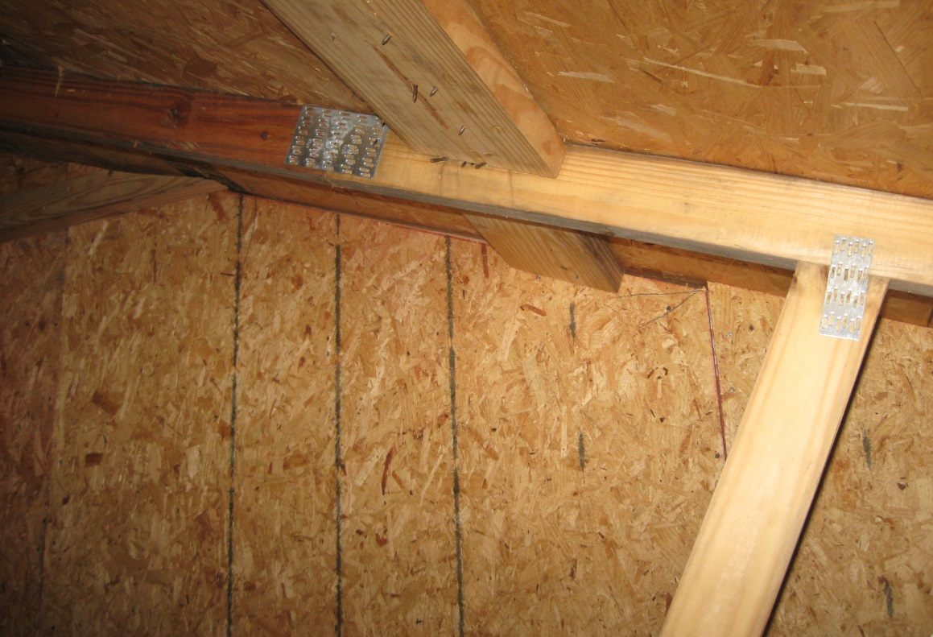
Field Assessment - Materials

Slide 18
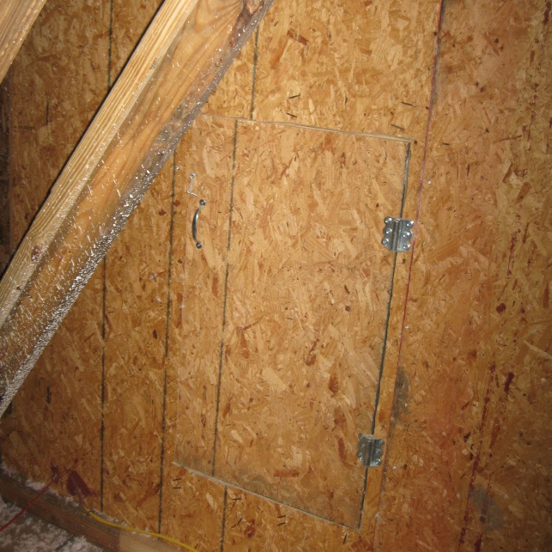
Field Assessment - Materials

Slide 19
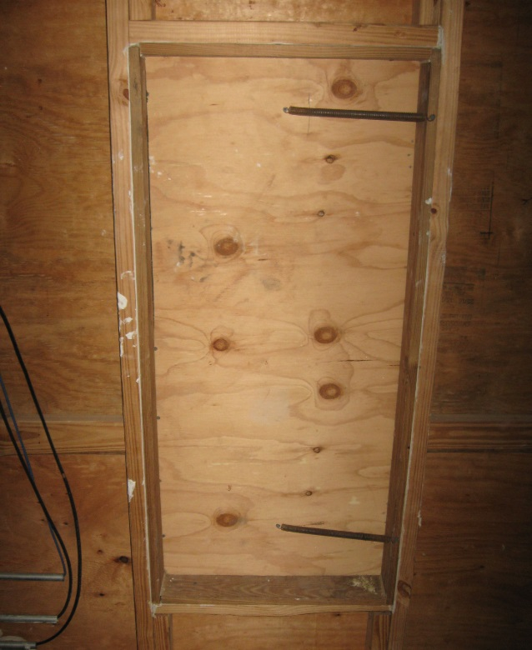
Field Assessment - Materials

Slide 20
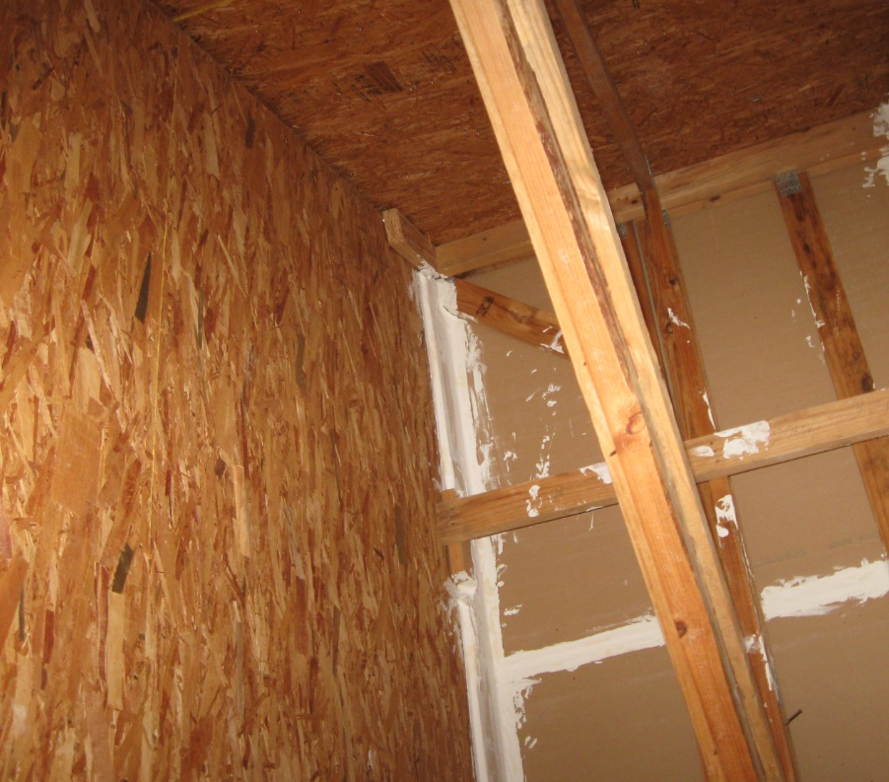
Field Assessment - Materials

Slide 21
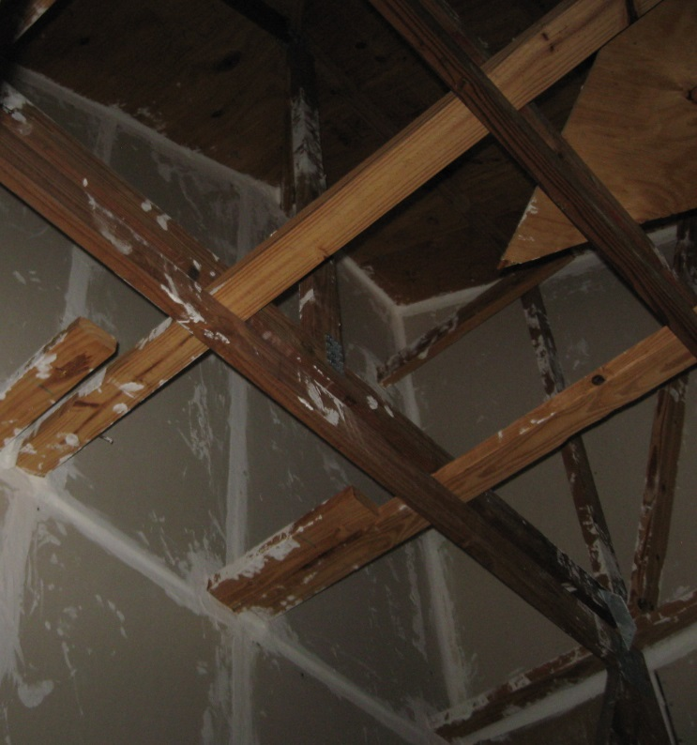
Field Assessment - Materials

Slide 22
Field Assessment - New
Only 1 of the 7 buildings under construction had draftstopping that was deficient.

Slide 23
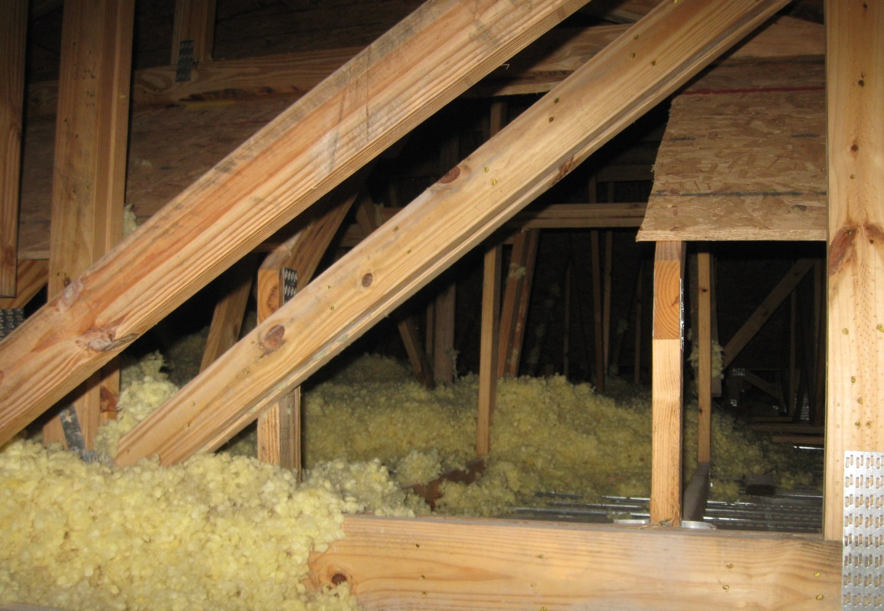
Field Assessment - New

Slide 24
Field Assessment - Existing
All of the existing buildings were draftstopped along every unit separation, even though this was historically not required.

Slide 25
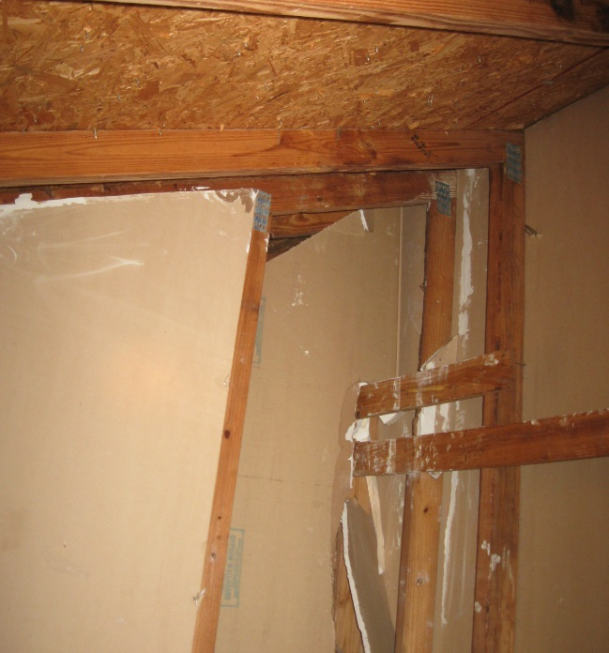
Field Assessment - Existing

Slide 26
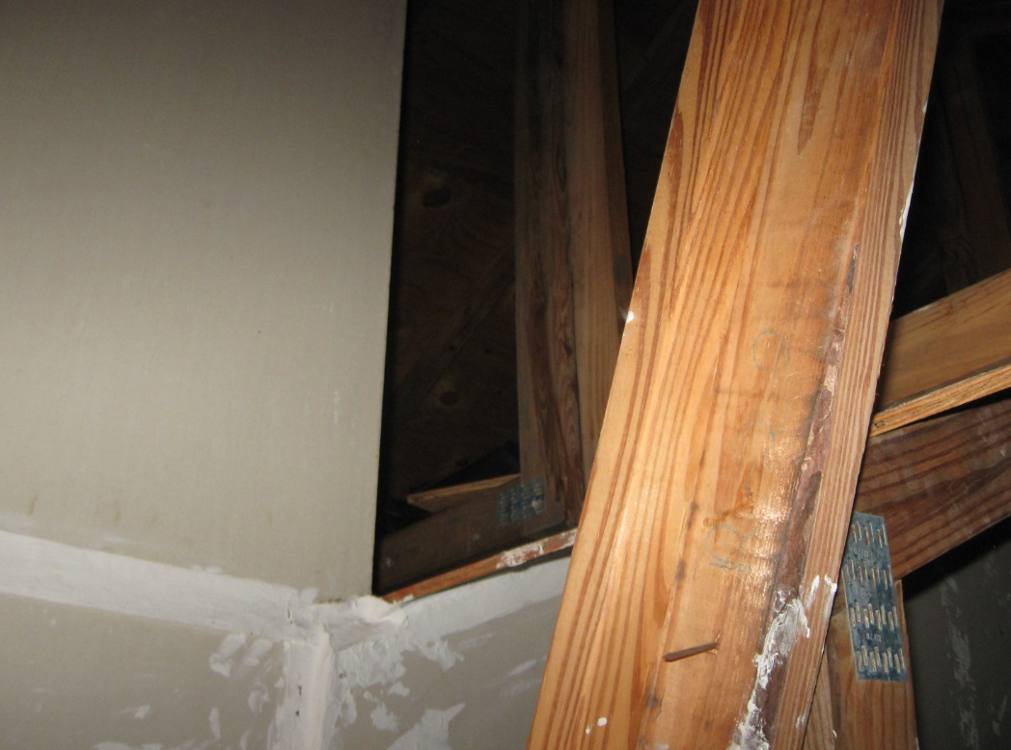
Field Assessment - Existing

Slide 27
Field Assessment - Hotels
The two existing R-2 Hotels were both sprinkler protected in the attics, though this is not required.
The two existing R-2 Hotels had draftstopping in the attics, though this was not required due to the sprinkler protection. However, it was not maintained in one of the properties.

Slide 28
Field Assessment - Business
One of 2 Business buildings was observed without draftstopping.
The Business building with draftstopping had major deficiencies

Slide 29
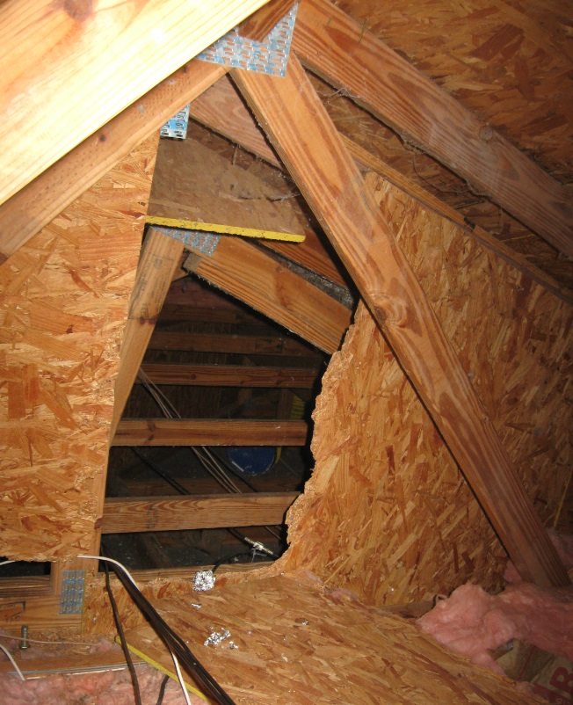
Field Assessment - Business

Slide 30
Field Assessment - Other
Draftstopping is often desired over unit separations to mitigate security concerns.
Lightning strikes can create both instantaneous fires and smoldering (slow-developing) fires.
There were few properties constructed before 1990 in the region where the surveys were conducted.

Slide 31
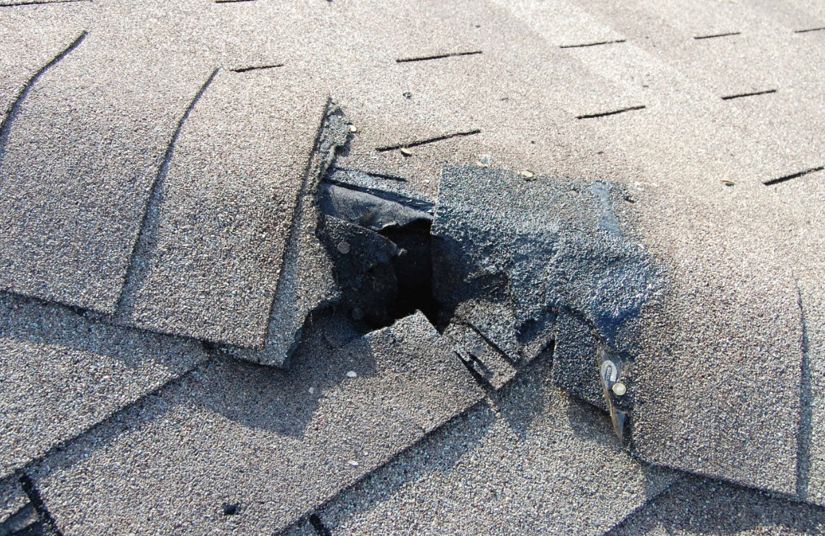
Field Assessment - Other

Slide 32
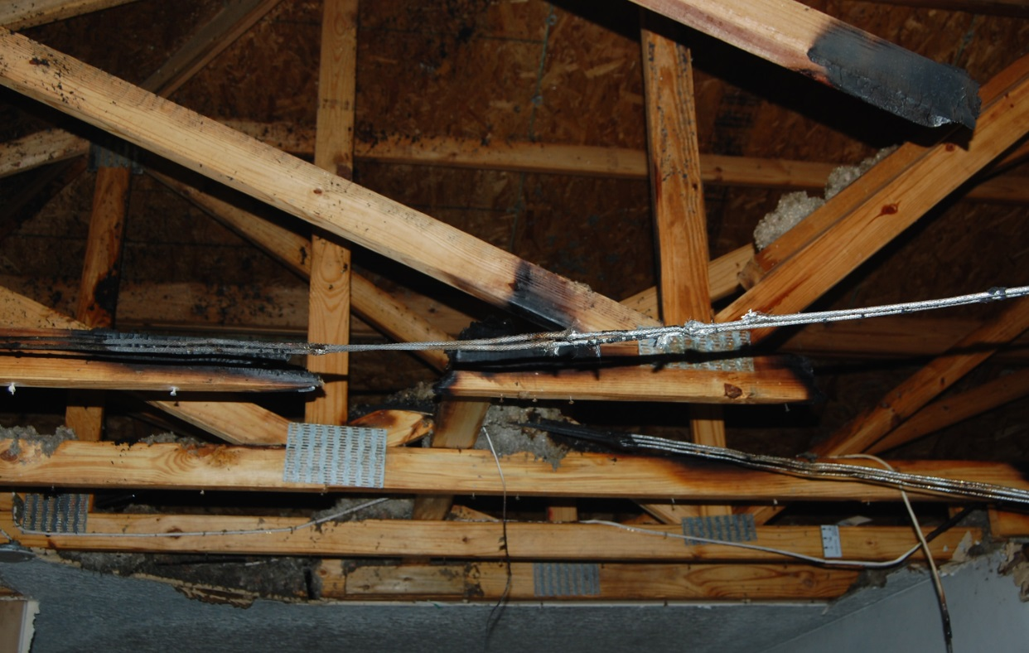
Field Assessment - Other

Slide 33
Field Assessment - Other
Type III construction with exterior walls of fire retardant-treated wood.
Interstitial sprinklers still require draftstopping.

Slide 34
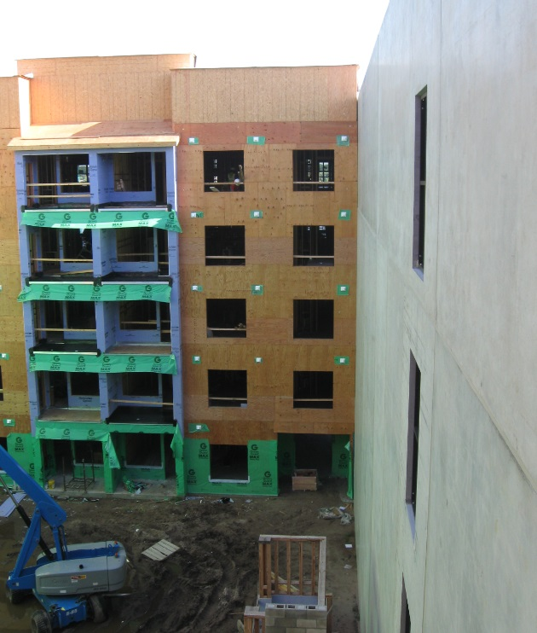
Field Assessment - Other

Slide 35
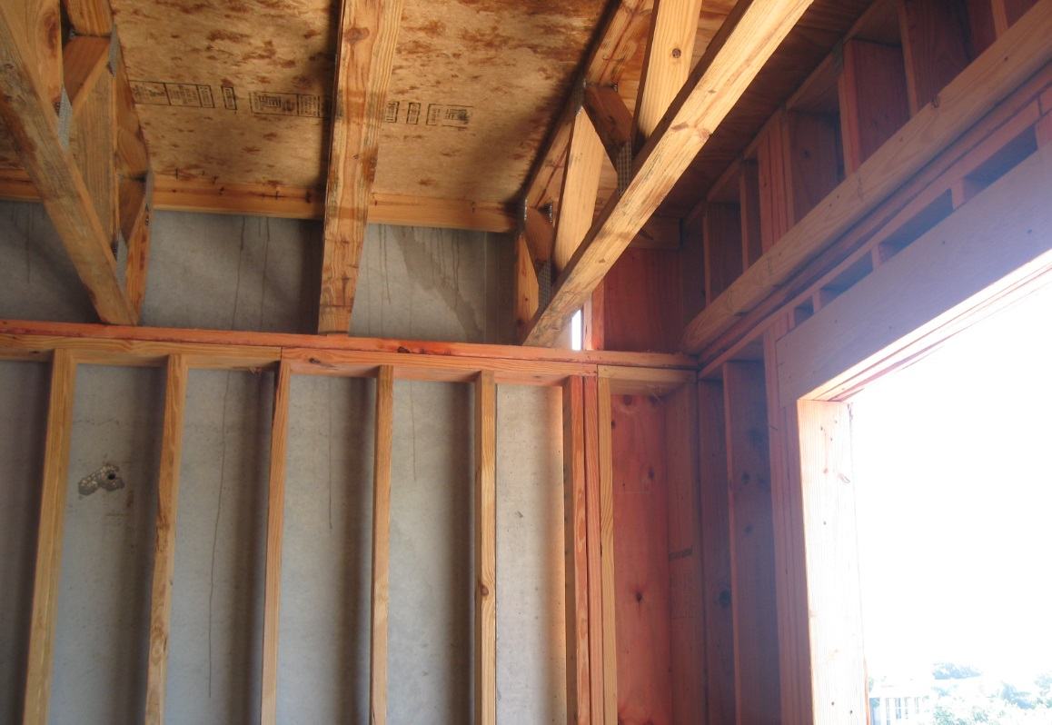
Field Assessment - Other

Slide 36
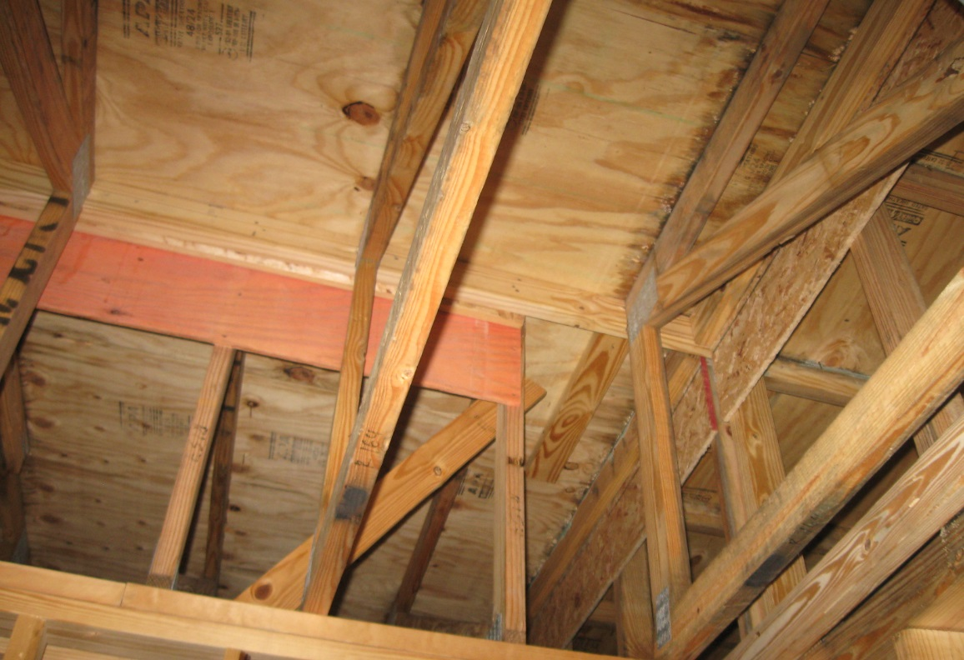
Field Assessment - Other

Slide 37
Discussion
The materials currently allowed to serve as draftstopping are common building materials.

Slide 38
Discussion
There is currently no documented basis for the legacy code requirements.

Slide 39
Discussion
NFPA 13R versus NFPA 13 sprinkler protection for five-level pedestal buildings should be clarified in the next edition of the Florida Building Code if the Florida Building Commission wants to deviate from the national code.

Slide 40
Gap Assessment
Prepare a code change to allow only gypsum (Type X).

Slide 41
Gap Assessment
Prepare a code change as follows: “Draftstopping must be installed parallel to the trusses and aligned with the unit separation walls unless provided above a corridor wall.”

Slide 42
Gap Assessment
Surveying buildings in a more established and dynamic urban area.

Slide 43
Gap Assessment
Research options for a limited sprinkler system in attic in lieu of draftstopping.
Full-scale fire testing

Slide 44
Questions?
Steve Welsh, P.E.
(Registered in MD, DE)
swelsh@koffel.com
Koffel Associates, Inc.
8815 Centre Park Drive, Suite 200
Columbia, MD 21045-2107
410-750-2246
www.koffel.com
Follow us on LinkedIn

