Slide 1
7th Edition (2020) Florida Building Code Update Florida
FLORIDA BUILDING COMMISSION
MO MADANI TECHNICAL DIRECTOR
JOE BIGELOW DESIGNER
CODES & STANDARDS
Florida Department of Business & Professional Regulation
License efficiently. Regulate fairly.

Slide 2
Evolving Process
Triennial Update
Step 1 – Review of the 2018 I-Code changes (total mods 1452)
Step 2 – Review proposed changes (Foundation Code + Commission Approved I-Code Changes) (Total mods – 1059)
Total mods considered 2,511

Slide 3
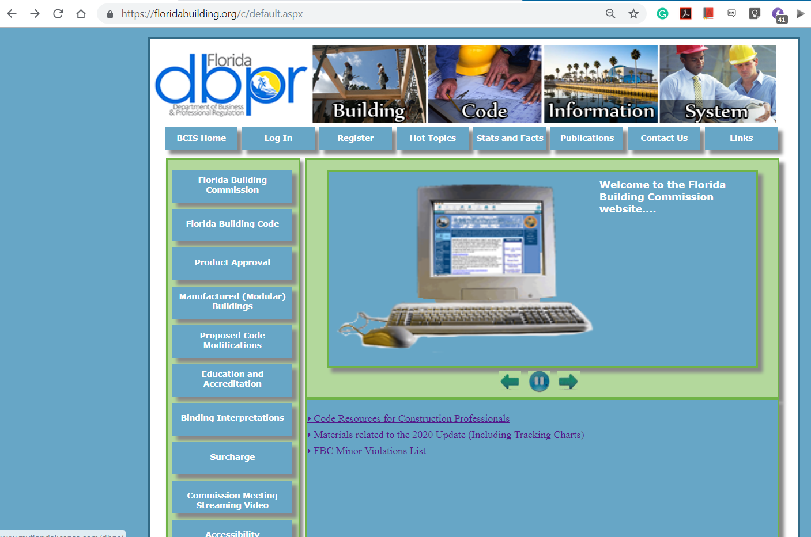
Building Code Information System @ www.floridabuilding.org

Slide 4
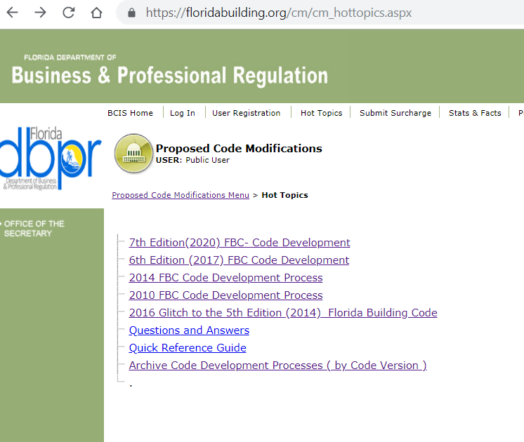
Building Code Information System @ www.floridabuilding.org

Slide 5
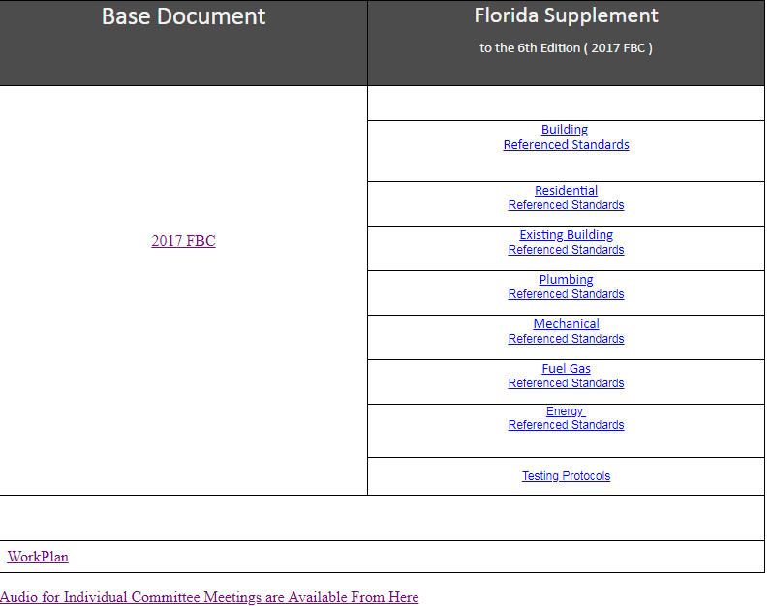
Supplements = Approved code mods from Step 1 and Step 2
Building Code Information System @ www.floridabuilding.org

Slide 6
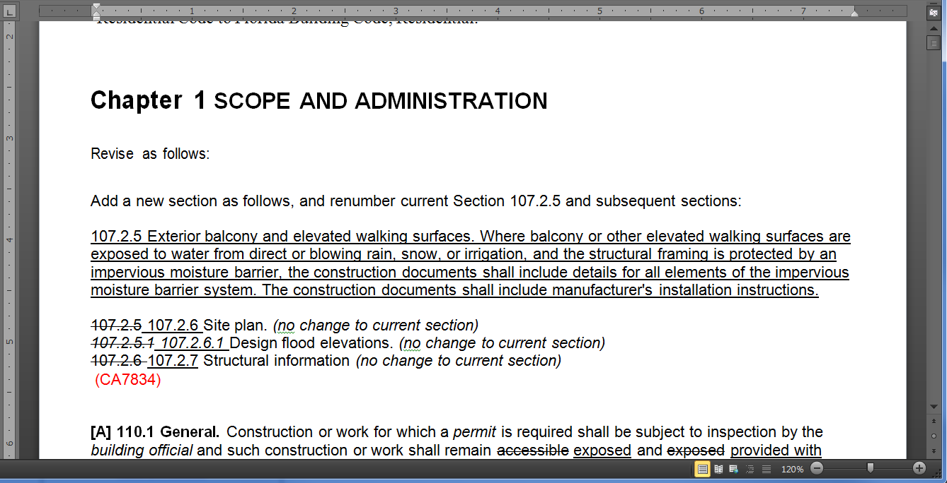
Building Code Information System @ www.floridabuilding.org

Slide 7
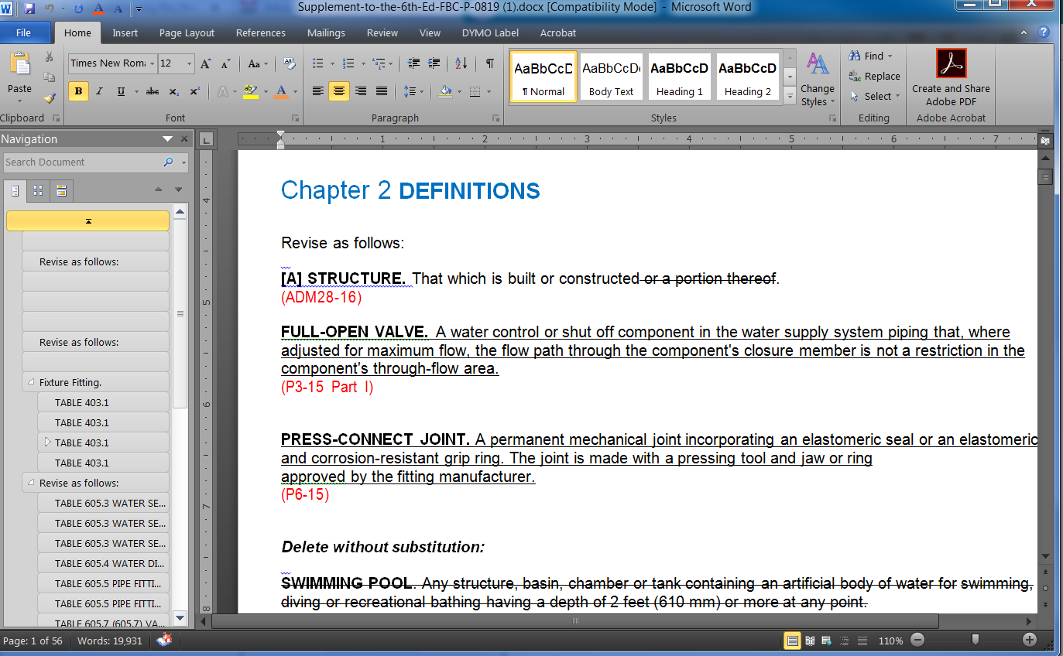
Building Code Information System @ www.floridabuilding.org

Slide 8
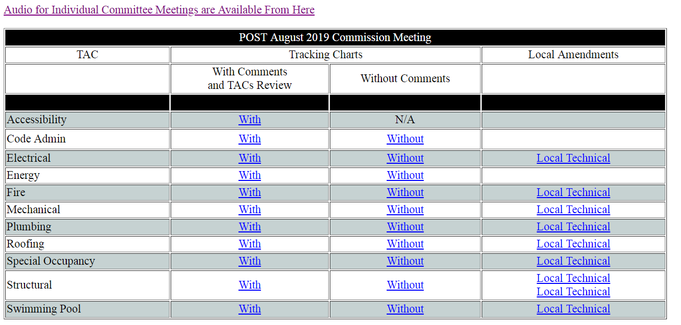
Step 2 - Outcome
Step 2 = Review proposed changes (Foundation Code + Commission Approved I-Code Changes)

Slide 9
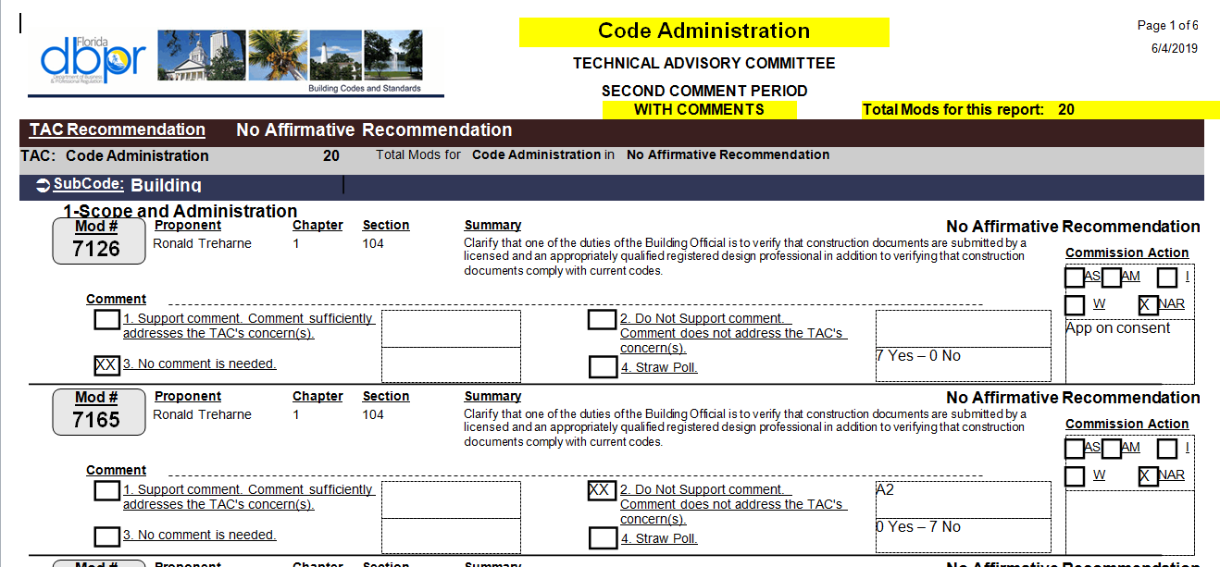
Building Code Information System @ www.floridabuilding.org

Slide 10
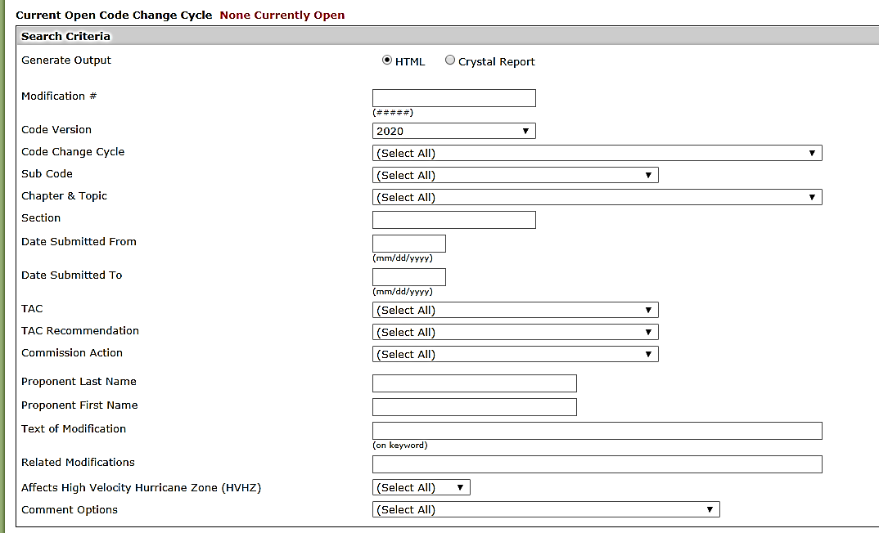
Mod Search
Building Code Information System @ www.floridabuilding.org

Slide 11
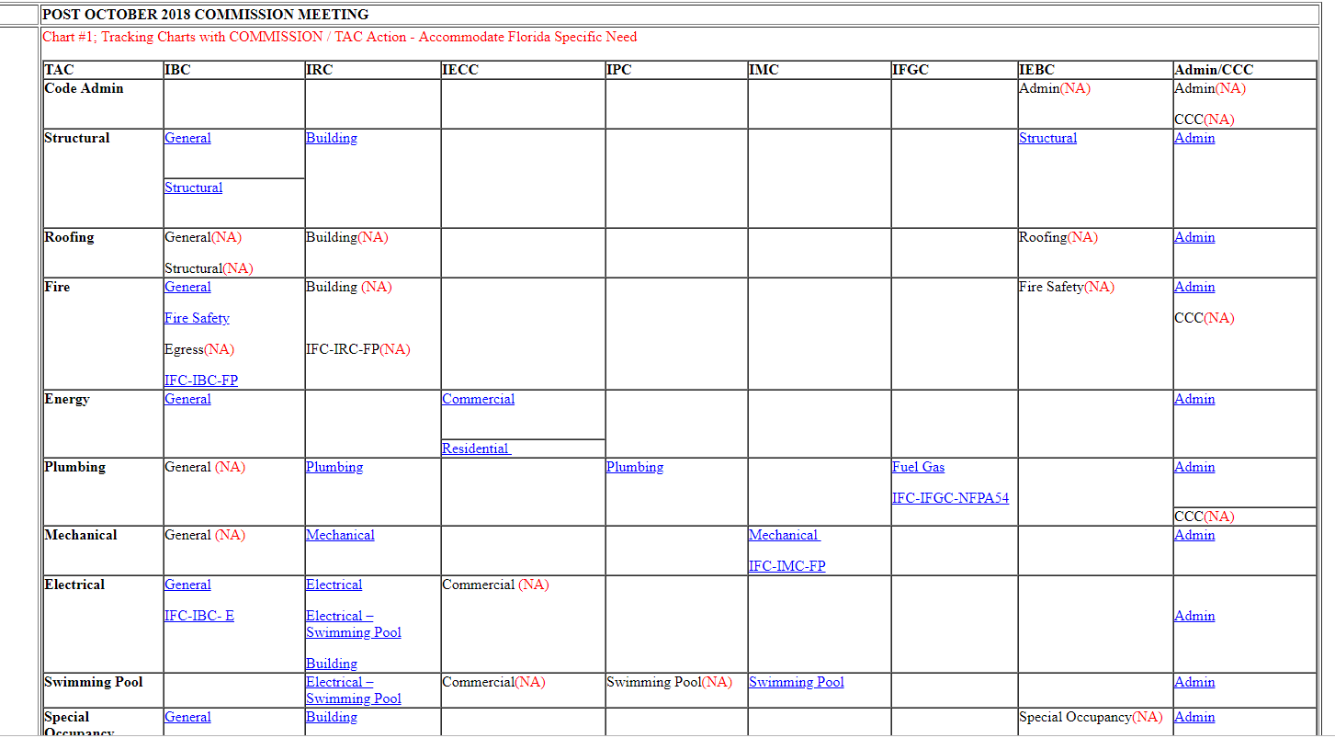
Step 1
Step 1 = Review of the 2018 I-Code changes
Building Code Information System @ www.floridabuilding.org

Slide 12
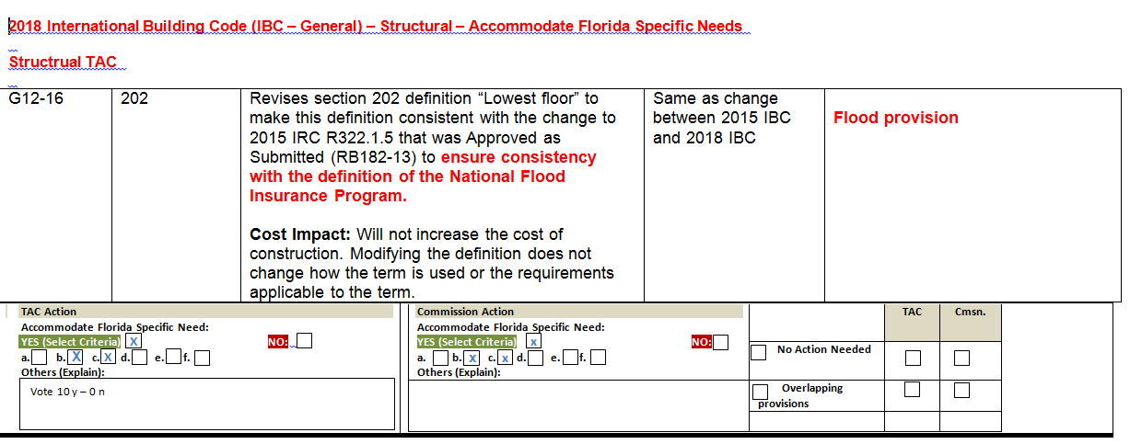
Tracking Chart
Building Code Information System @ www.floridabuilding.org

Slide 13
Code Printing/Publishing
Integration 7th Edition (2020) FBC
Florida Supplement (9/19/2019)
Workshop (2/11/2020)
Workshop (4/7/2020)
Integrated (4/20/2020) (ICC)
Rulemaking Hearing (6/2/2020)
Code takes effect no sooner than 6 months after publication
Effective Date (12/31/2020)
Step 1
+
Step 2
2017 FBC
7th Edition (2020) FBC

Slide 14
Questions?
Call us @ 850-487-1824
Or visit this link https://www.floridabuilding.org/c/c_about.aspx
Thank You Codes and Standards
License efficiently. Regulate fairly.

