Slide 1
Code Modification Navigation
FBC August 2 0 1 8
Codes and Standards
Mo Madani, CBO, Technical Unit Director
Joe Bigelow, Training Design
“Stronger Codes Through Science and Consensus”

Slide 2
1

Slide 3
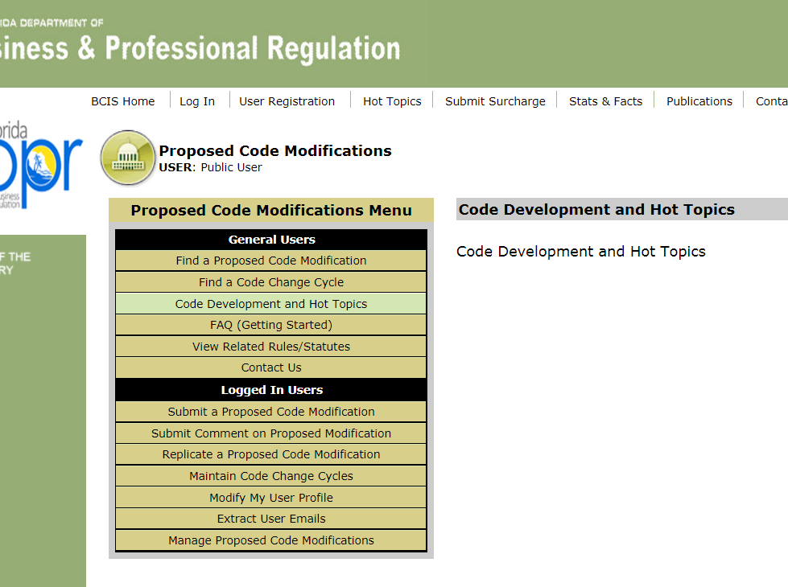
2

Slide 4
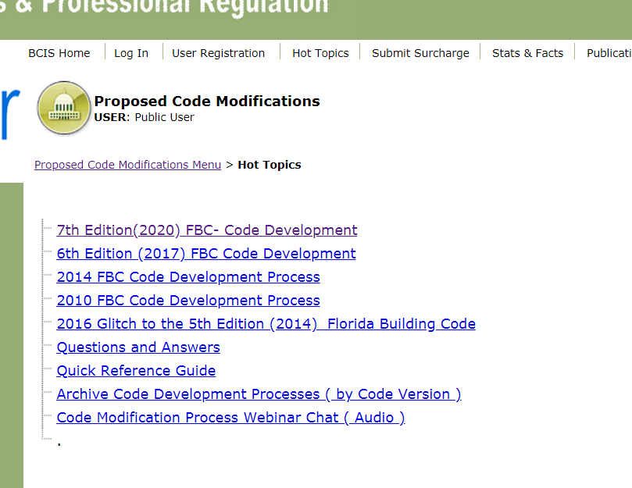
3

Slide 5
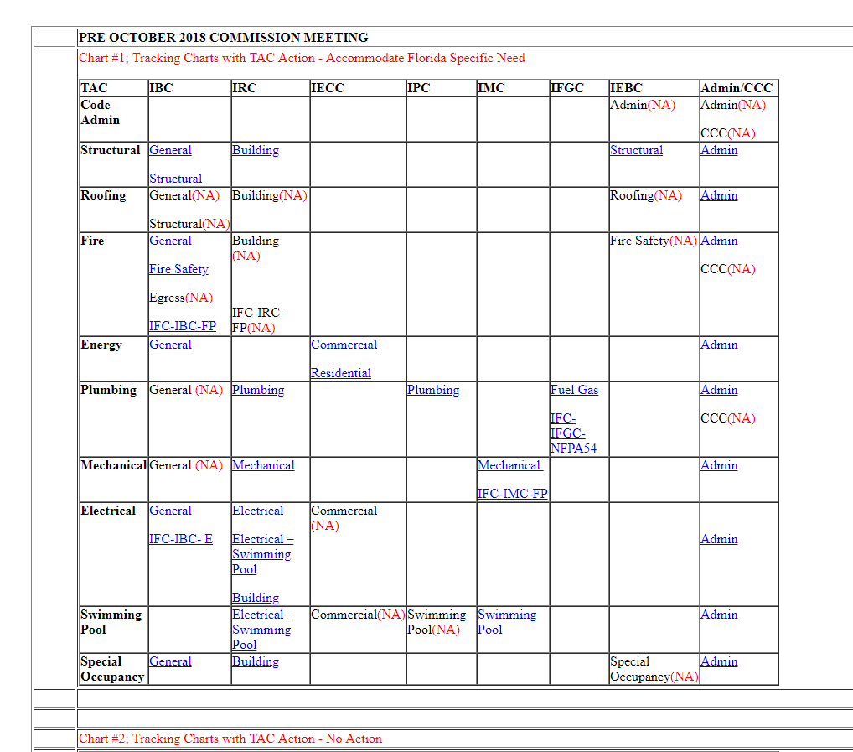
Accommodate Florida Specific Need – Chart 1
4

Slide 6
Accommodate Florida Specific Need– Chart 1
Chart Example
5

Slide 7
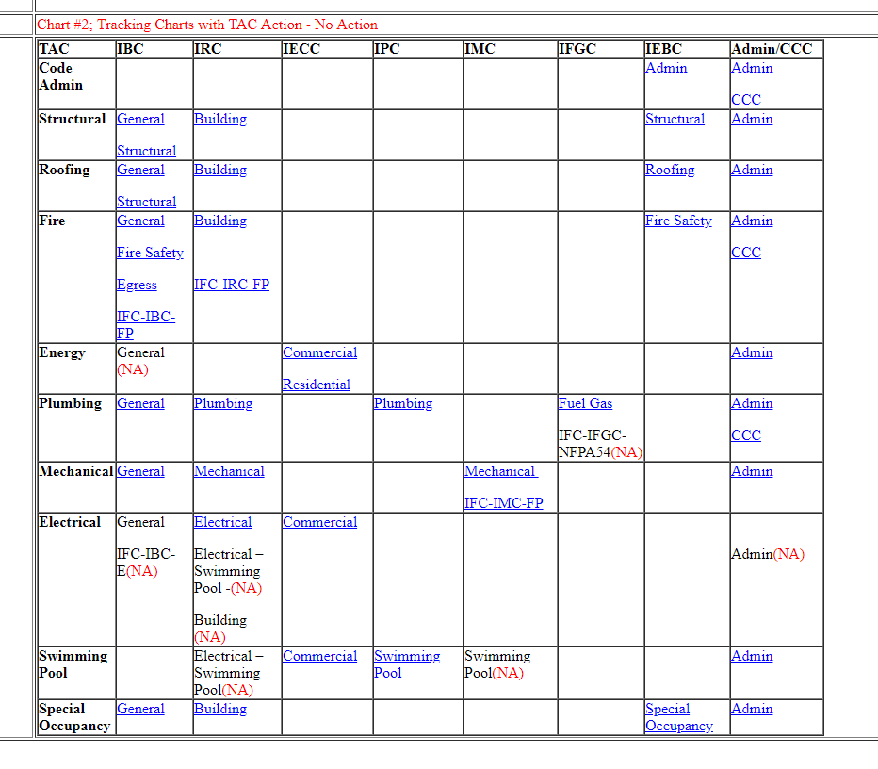
No Action– Chart 2
6

Slide 8
No Action– Chart 2
Chart Example
7

