Slide 1
House Bill 535 : 2016 Florida Legislature
July 1, 2016

Slide 2
HB 535 Section 32
The Florida Building Commission shall define the term "fire separation distance" in Chapter 2, Definitions, of the Florida Building Code, 5th Edition (2014) Residential, as follows:
FIRE SEPARATION DISTANCE. The distance measured from the building face to one of the following:
1. To the closest interior lot line;
2. To the centerline of a street, an alley, or a public way;
3. To an imaginary line between two buildings on the lot;
or
4. To an imaginary line between two buildings when the exterior wall of one building is located on a zero lot line.
The distance shall be measured at a right angle from the face of the wall.

Slide 3
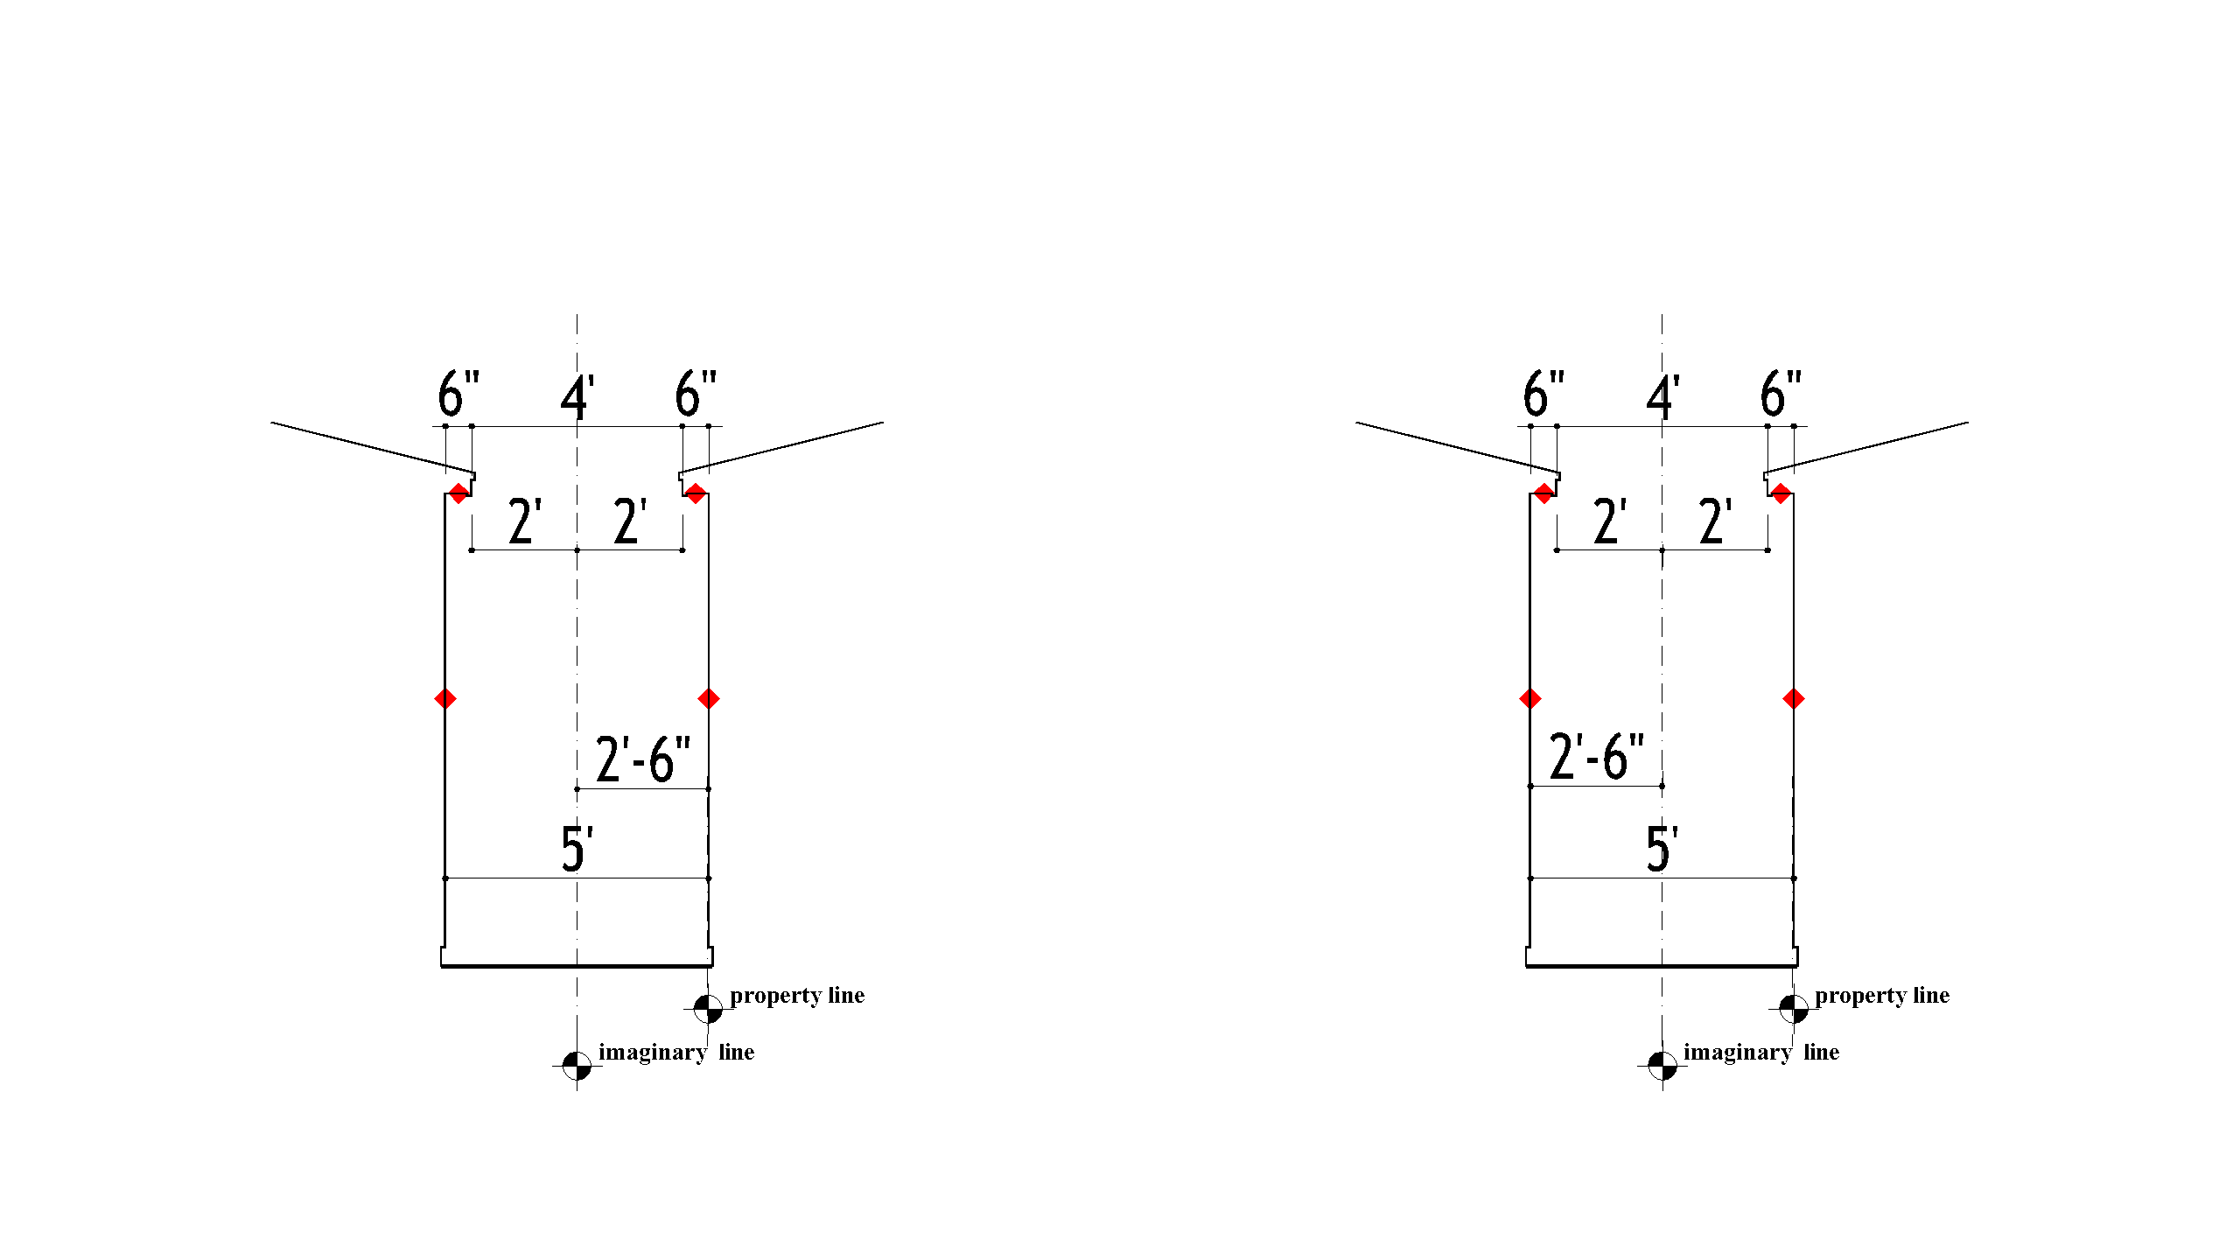
HB 535 Section 32
FIRE SEPARATION DISTANCE. 4. To an imaginary line between two buildings when the exterior wall of one building is located on a zero lot line.
Base Code Table R3021(1)
HB535:36 Code Table R3021(1)

Slide 4
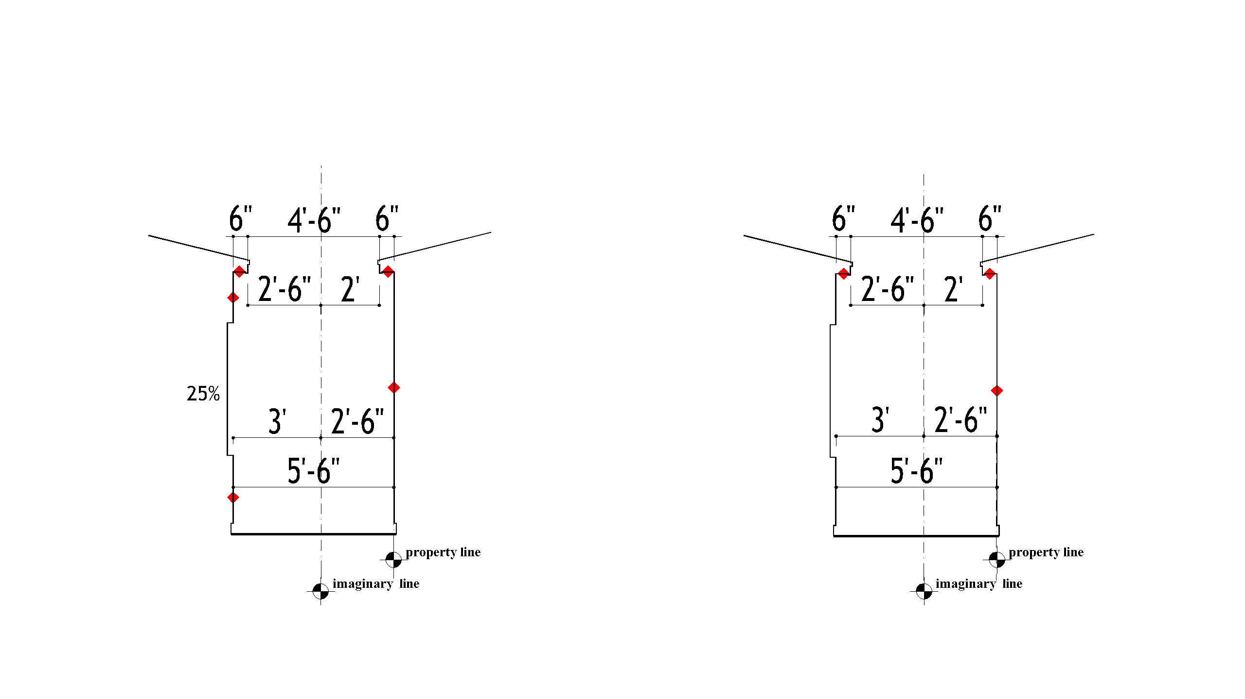
HB 535 Section 32
FIRE SEPARATION DISTANCE. 4. To an imaginary line between two buildings when the exterior wall of one building is located on a zero lot line.
Base Code Table R3021(1)
HB535:36 Code Table R3021(1)

Slide 5
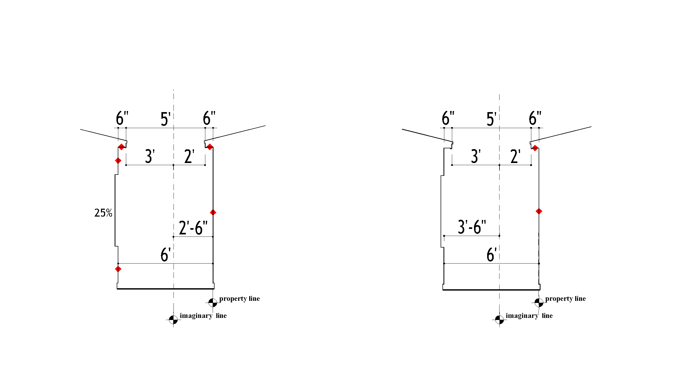
HB 535 Section 32
FIRE SEPARATION DISTANCE. 4. To an imaginary line between two buildings when the exterior wall of one building is located on a zero lot line.
Base Code Table R3021(1)
HB535:36 Code Table R3021(1)

Slide 6
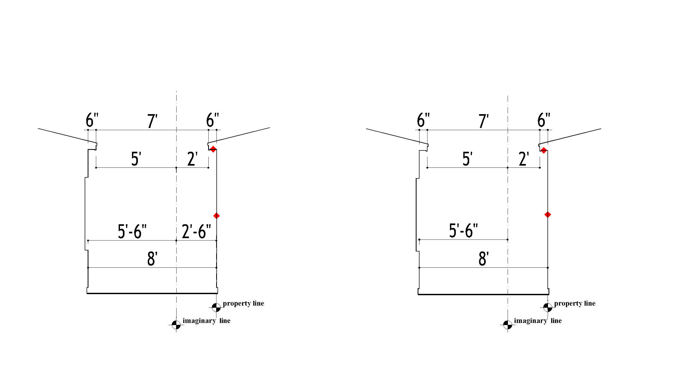
HB 535 Section 32
FIRE SEPARATION DISTANCE. 4. To an imaginary line between two buildings when the exterior wall of one building is located on a zero lot line.
Base Code Table R3021(1)
HB535:36 Code Table R3021(1)

Slide 7
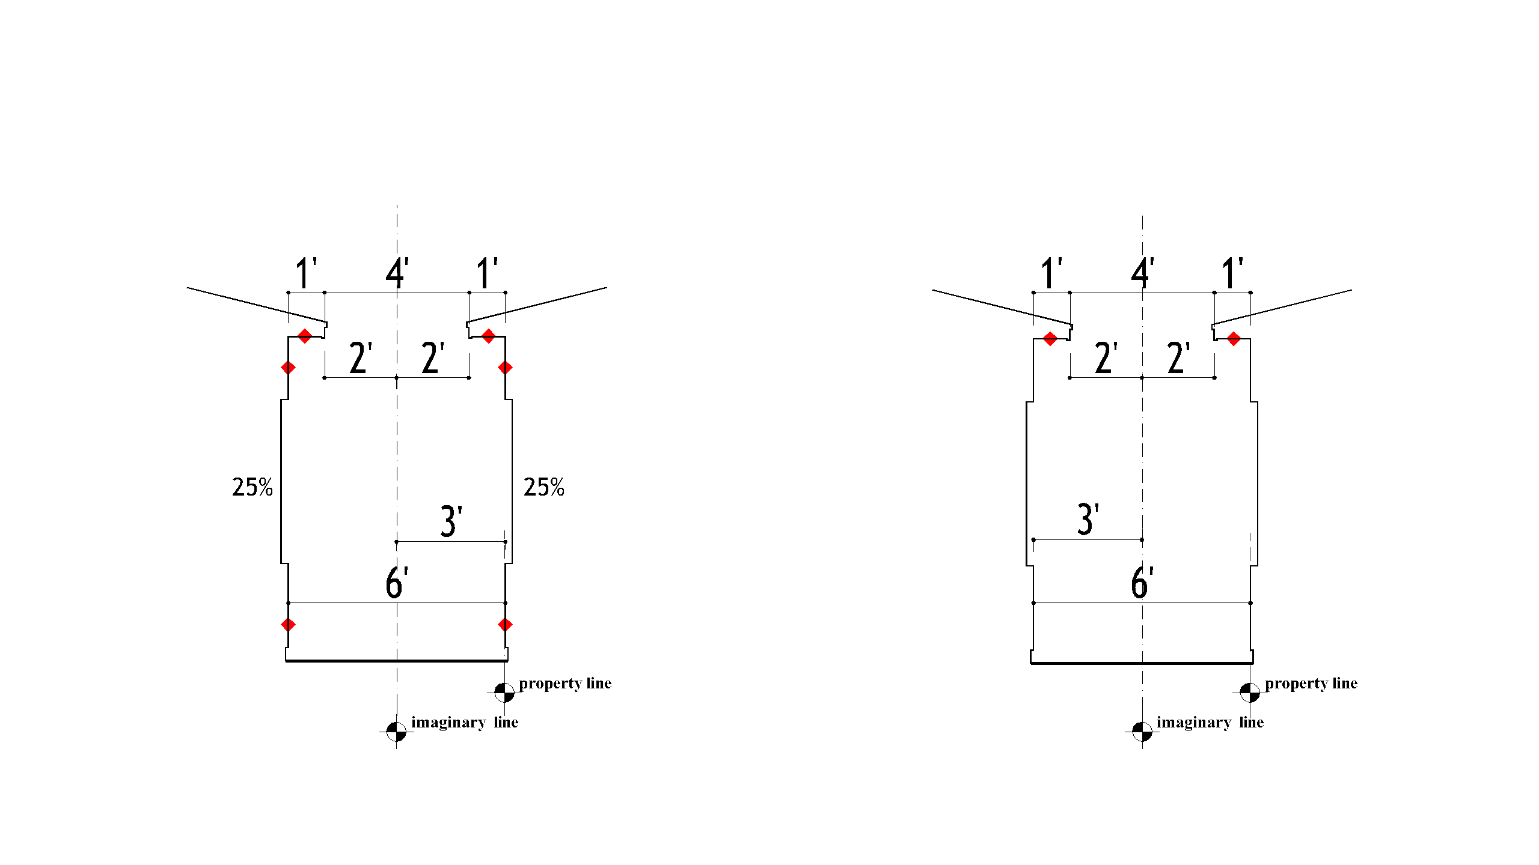
HB 535 Section 32
FIRE SEPARATION DISTANCE. 4. To an imaginary line between two buildings when the exterior wall of one building is located on a zero lot line.
Base Code Table R3021(1)
HB535:36 Code Table R3021(1)

Slide 8
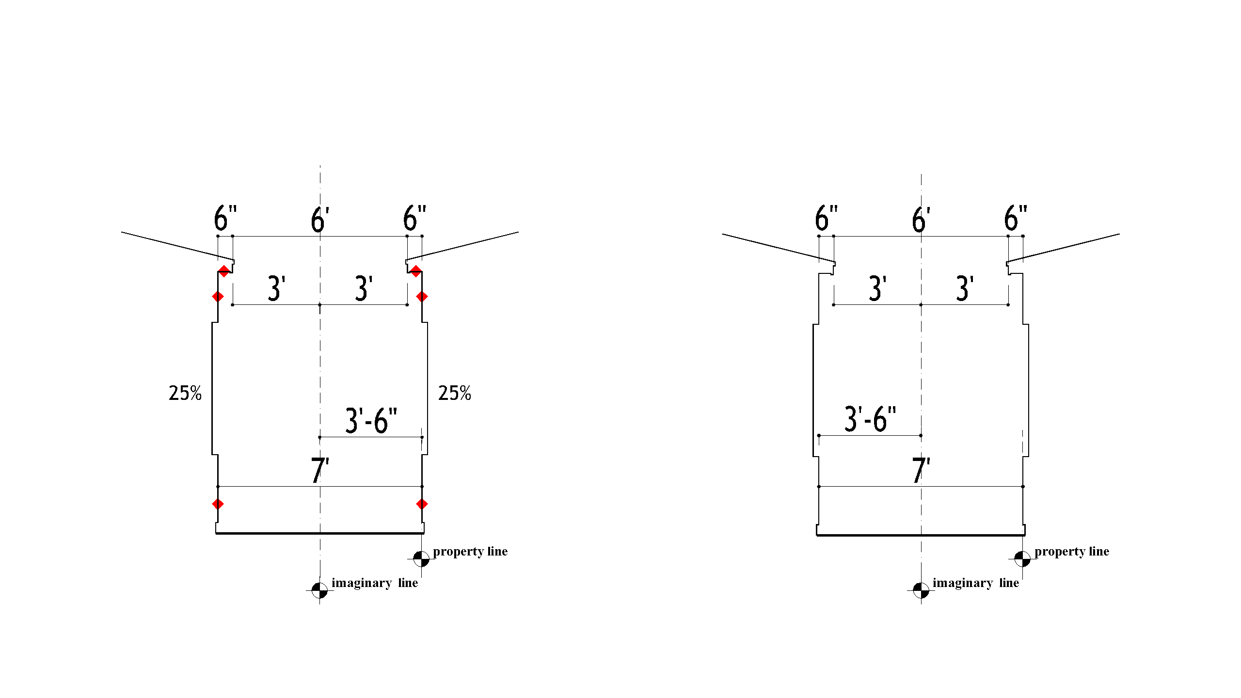
HB 535 Section 32
FIRE SEPARATION DISTANCE. 4. To an imaginary line between two buildings when the exterior wall of one building is located on a zero lot line.
Base Code Table R3021(1)
HB535:36 Code Table R3021(1)

Slide 9
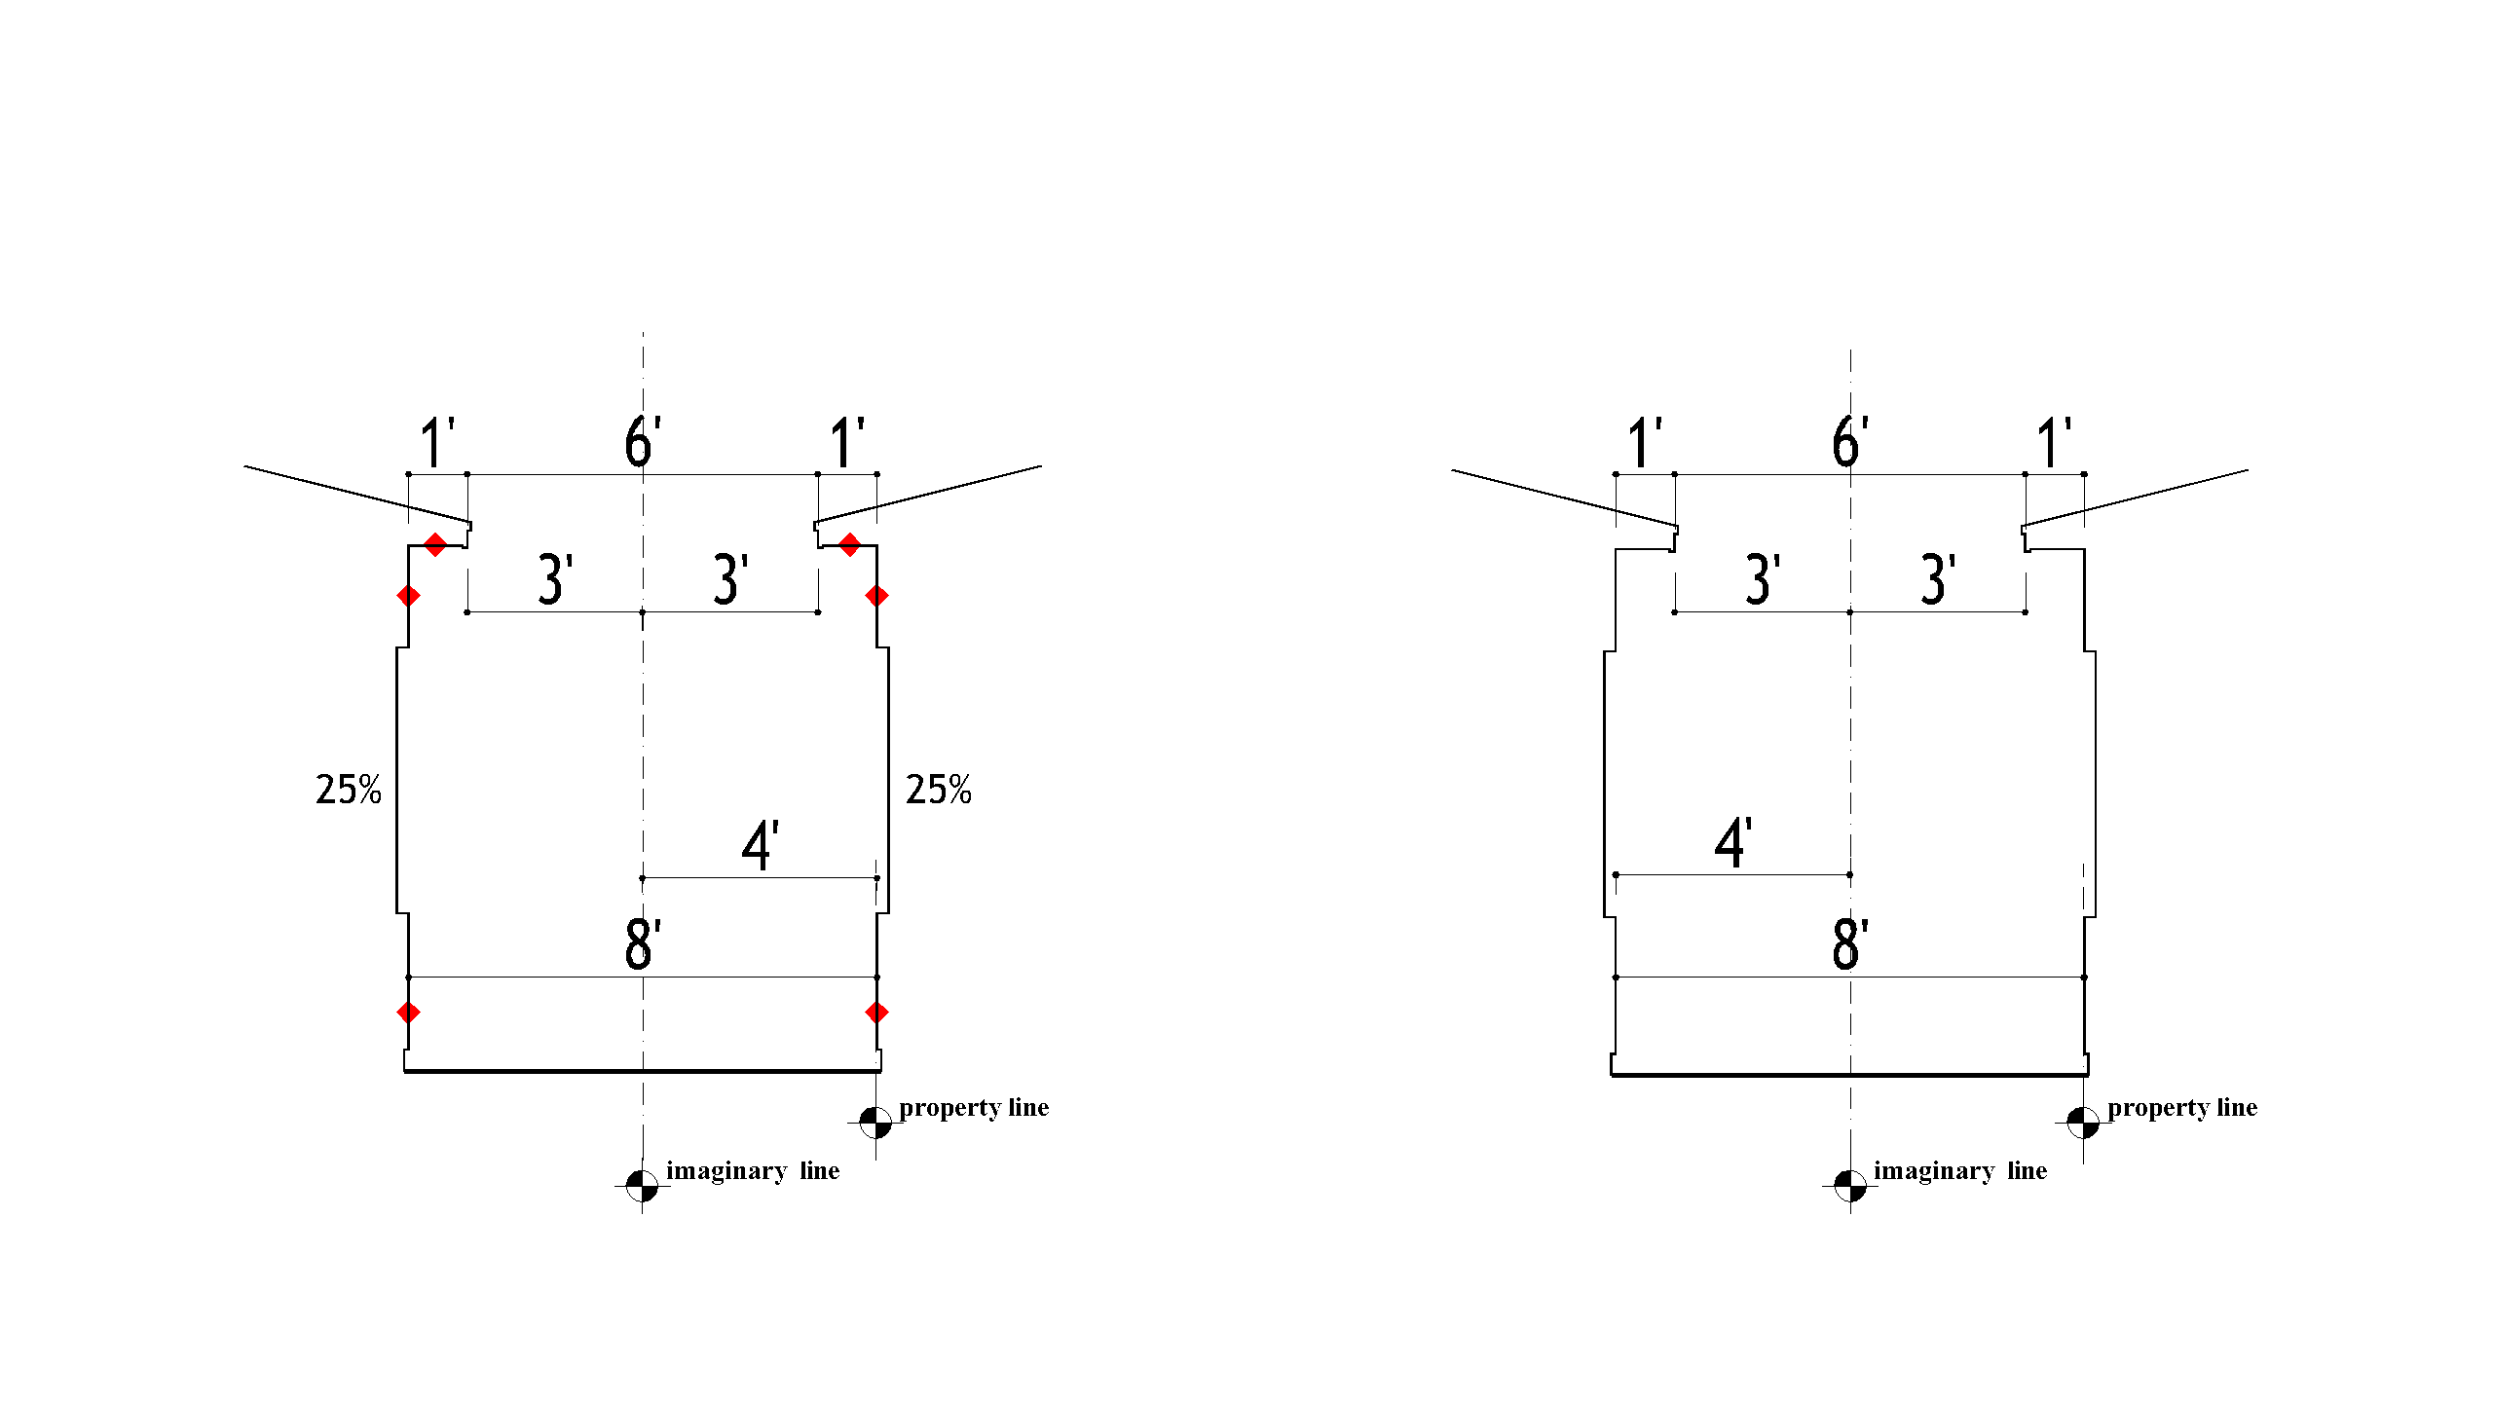
HB 535 Section 32
FIRE SEPARATION DISTANCE. 4. To an imaginary line between two buildings when the exterior wall of one building is located on a zero lot line.
Base Code Table R3021(1)
HB535:36 Code Table R3021(1)

Slide 10
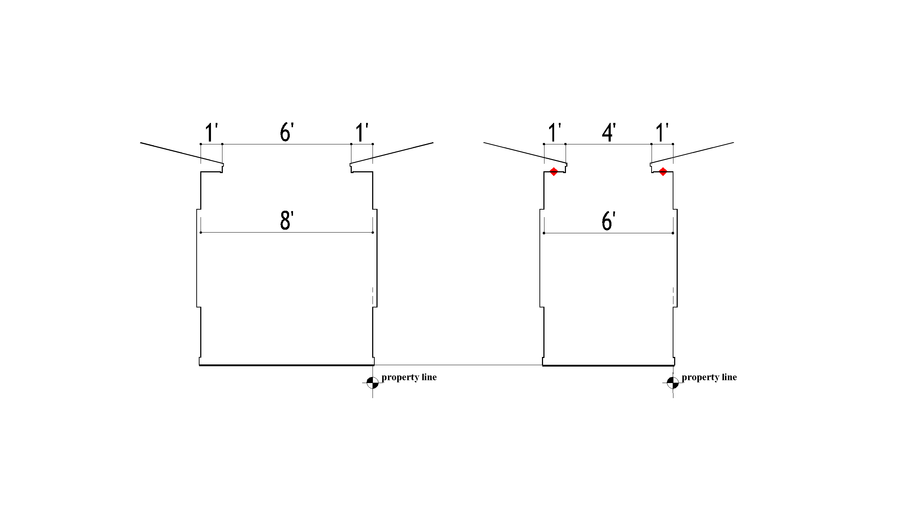
HB 535 Section 33
The Florida Building Commission shall amend the Florida Building Code, 5th Edition (2014) Residential,
to allow openings and roof overhang projections on the exterior wall of a building located on a zero lot line, when the building exterior wall is separated from an adjacent building exterior wall by a distance of 6 feet or more and the roof overhang projection is separated from an adjacent building projection by a distance of 4 feet or more, with 1-hour fire-resistive construction on the underside of the overhang required, unless the separation between projections is 6 feet or more.

Slide 11
HB 535 Section 36
The Florida Building Commission shall amend the Florida Building Code, 5th Edition (2014) Residential,
to provide that the minimum fire separation distance for non-fire resistant rated exterior walls shall be 3 feet or greater and non-fire resistant rated projections shall have a minimum fire separation distance of 3 feet or greater. Projections within 2 feet and less than 3 feet shall include a 1-hour fire-resistance rate on the underside. Projections less than 2 feet are not permitted. Penetrations of the exterior wall within less than 3 feet shall comply with Dwelling Unit Rated Penetration. Penetrations 3 feet or greater are not required to have a fire resistance rating. Openings in walls shall be unlimited with a fire separation distance of 3 feet or greater.

Slide 12
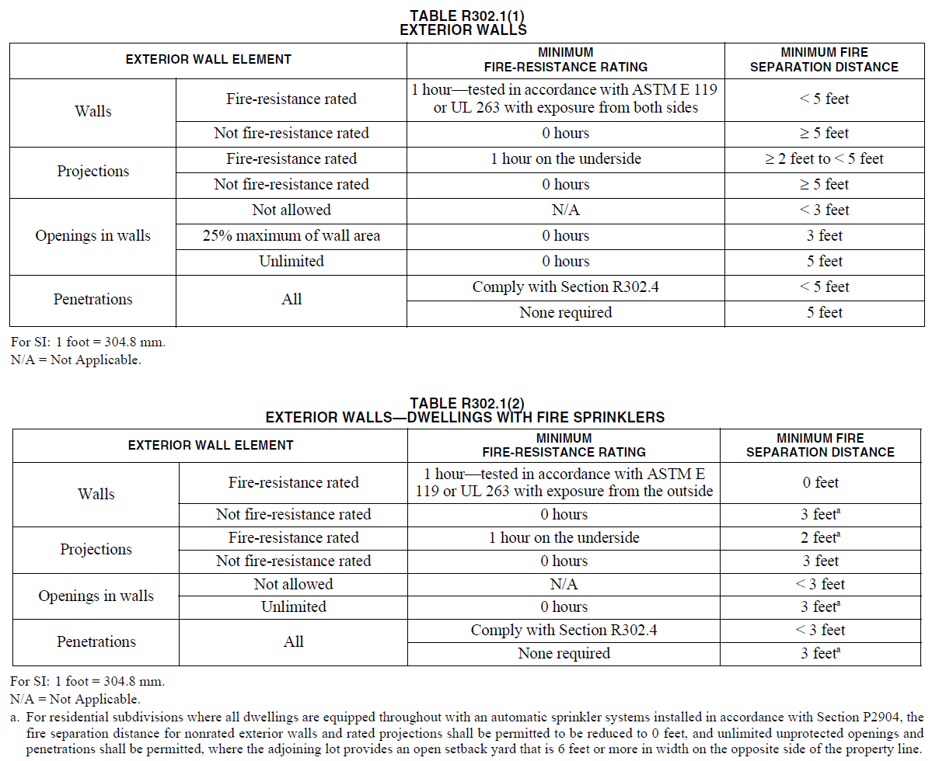

Slide 13
HB 535 Section 36
------ 3 feet
------ 3 feet
------3 feet
------3 feet
------------------------------
--------------
--------------------
------3 feet
------3 feet
------3 feet

