Slide 1


Accessibility Analysis
format of the staff analysis of waiver applications.
Mo Madani - Technical Director
May 22, 2019
-Codes and Standards
-Florida Building Commission

Slide 2
Florida Statutes 553.512 :
Criteria for granting waiver
Florida Specific requirements
Determination of unnecessary, unreasonable, or extreme hardship.
Waivers shall not violate federal accessibility laws and regulations and shall be reviewed by the Accessibility Advisory Council.
If an applicant for a waiver demonstrates economic hardship in accordance with 28 C.F.R. s. 36.403(f)(1), a waiver shall be granted.

Slide 3

Grounds for Approval:
Economic Hardship
Historic Nature
Technical Infeasibility

Slide 4
Economic Hardship /Disproportionality (20%) :
The accessible path of travel is required to the extend it is not “disproportionate” to the total cost.
Disproportionate defined as exceeding 20% of the total cost of alterations to the primary function area.
The 20% cap applies only to the costs associated with the accessible path of travel, including an accessible route to the primary function area from site arrival points, entrances and retrofits to restrooms, telephones, and drinking fountains.

Slide 5
Economic Hardship :
  Does the cost of providing vertical accessibility meet or exceed 20% of the cost of the alteration to the primary function area?
  If the 20% threshold is met, the waiver SHALL be granted.
  Does not apply to new construction.

Slide 6
Historic Nature - Historic Facilities :
Definition: Buildings or facilities that are “listed in - eligible for listing in the National Register of Historic Places or designated as historic under an appropriate State or local law.
Consideration – circumstances where compliance with the standards would threaten or destroy the historic integrity or significance of a facility as determined by the appropriate authority having jurisdiction.

Slide 7
Historic Nature :
  Has the applicant provided documentation of the historic significance of the building?
  Would the historic significance of the structure be negatively impacted by the alterations applicant would have to make to provide accessibility?
Can be combined with Technical Infeasibility or Economic Hardship

Slide 8
Technical Infeasibility:
Determination: requires a site-specific assessment of constraints or complications that prohibit compliance.
Examples include work that impact a facility’s structural frame or that would conflict with applicable codes or building requirements.

Slide 9
Technical Infeasibility cont.:
  Is the structure built in a way that would otherwise place unnecessary, unreasonable, or extreme hardship on the applicant, if they were required to provide accessibility?
    Has the applicant provided comments from a licensed design professional?
    Would have to rebuild, demolish, encroach on property lines, etc.

Slide 10
Format :
GROUNDS FOR APPROVAL
Economic Hardship
Historic Nature
Technical Infeasibility

Slide 11
Format cont:
Issue:
Project Type:
Project Progress:
Compliance estimate:
Project Construction Cost:
Analysis:
Uploaded Documents:
STAFF RECOMMENDATION:
Items to be waived:

Slide 12
Format cont:
MOTIONS
I move to recommend that the Florida Building Commission approve this request for waiver on the grounds of _________________.
  Economic Hardship
  Historic Nature
  Technical Infeasibility

Slide 13
Format cont:
I move to recommend that the Florida Building Commission deny this application.
  No rationale necessary.
I move to recommend that the Florida Building Commission defer this request for waiver to the next meetings of the Council and the Commission for the purpose of allowing the applicant to _________________:
  Submit requested information
  Contact building official or building department
  Etc.

Slide 14
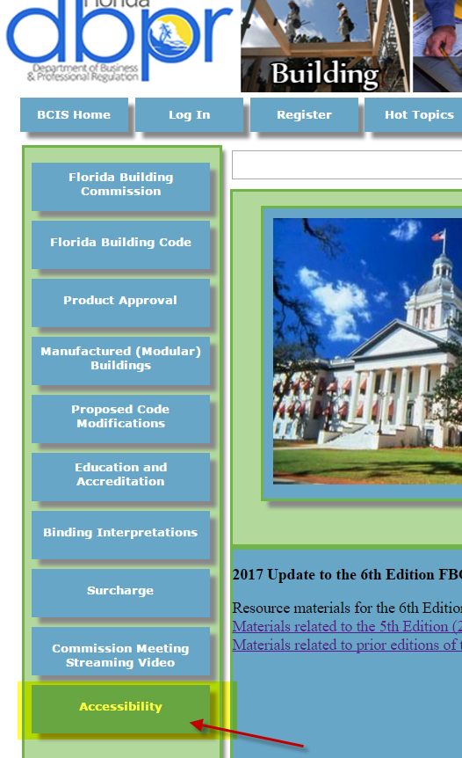
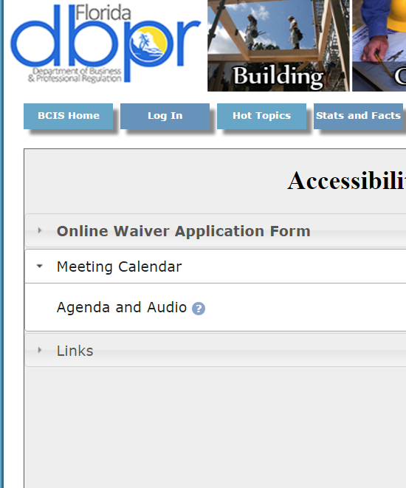
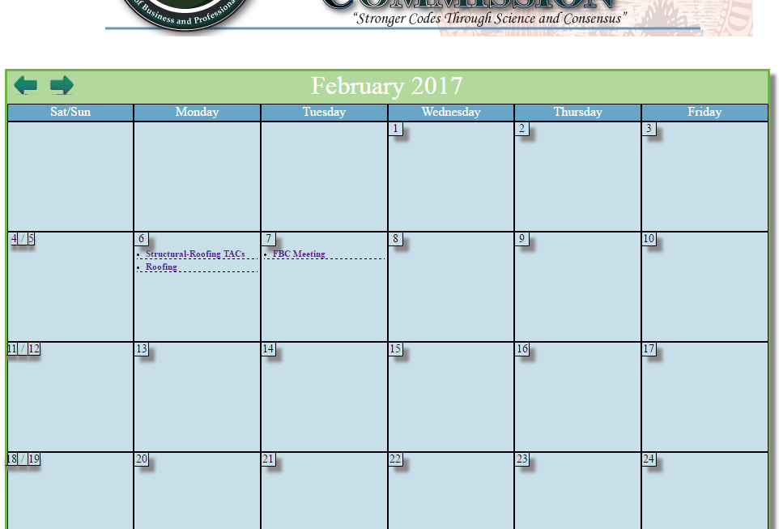
Meetings and Agendas
Also upcoming meetings are displayed on the bottom of the homepage in the meeting calendar near the bottom of the page. Agenda’s can be found by clicking the associated link.

Slide 15
Questions?
Please contact staff at 850-717-1825

