Slide 1
Investigation of the Effectiveness and Failure Rates of Whole-house Mechanical Ventilation Systems in Florida
Final Report
FBC Mechanical Technical Advisory Committee Teleconference Meeting
June 22, 2015

Slide 2
Research Purpose and Goal
Investigate the effectiveness and failure rates of whole-house mechanical ventilation systems installed in Florida homes over the last 15 years and seek to determine the reason(s) for any issues identified.

Slide 3
Air Tightening and Ventilation
Air tightening allows control over where and how much outside air enters a house
Measured 2009 Florida Code home average airtightness is 5.6 ACH50 (31 home sample)
As homes become tighter, mechanical ventilation becomes more important

Slide 4
Air Tightening and Ventilation
2014 FEC requirement is <= 5 ACH50 (which will tend to make Florida homes more airtight)
2014 FMC requires mechanical ventilation for any home with an ACH50 < 5
Combination of Energy and Mechanical Code requirements means that (if these sections of the 2014 Code go into effect in the coming months) most new Florida homes will require mechanical ventilation

Slide 5
What Can Occur if Mechanical Ventilation Fails in Very Tight Houses?
Decrease in indoor air quality
Moisture issues– elevated indoor humidity and mold growth during certain times of year
Combustion safety problems from unbalanced air flow
Depressurization of interior space
Spillage or back-drafting of combustion devices
Introduction of combustion gases including CO
Flame roll-out and fire possible in extreme cases

Slide 6
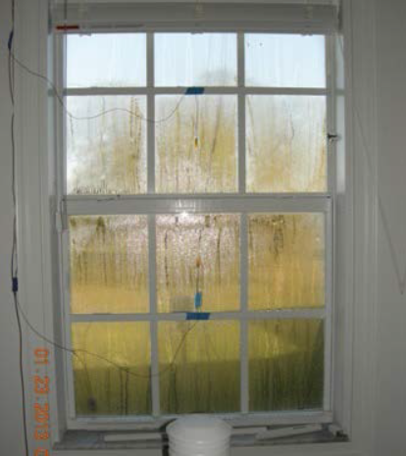
What Can Occur if Mechanical Ventilation Fails in Very Tight Houses?
Condensation on inside of window in tight unventilated FSEC lab house January 2013¹
¹Vieira, R.; Parker, D.; Fairey, P; Sherwin, J.; Withers, C.; Hoak, D. (2013). Flexible Residential Test Facility: Impact of Infiltration and Ventilation on Measured Heating Season Energy and Moisture Levels. Cocoa, FL: Florida Solar Energy Center.

Slide 7
What Can Occur if Mechanical Ventilation Fails in Very Tight Houses?
Example combustion safety problem caused by mechanical ventilation failure:
In one house, the supply fan was not functioning. The homeowners were not aware of the problem because they still heard the sound of the exhaust fan. The result was backdrafting of the fireplace and the potential for backdrafting of other combustion appliances.
“Field Survey of Heat Recovery Ventilation Systems.” (1999). Canada Mortgage and Housing Corporation (CMHC). Accessed July 2014: http://www.cmhc-schl.gc.ca/publications/en/rh-pr/tech/96215.htm

Slide 8
Study Importance
Airtightness moving in a direction that makes mechanical ventilation more important:
Do occupants maintain these systems?
What happens when a system fails?
Do occupants repair it?
Are failures a common enough problem in Florida that this is a concern?

Slide 9
SOW Research Approach
Field study in 20 homes around the state that had whole-house mechanical ventilation systems installed in the last 15 years to include:
A homeowner survey for each home to assess awareness of the ventilation system and its purpose and maintenance practices
Inspection and testing of each home’s ventilation system to assess its operational status, level of ventilation it is currently providing and likely reason(s) for any issue discovered

Slide 10
Research Approach
Recruiting postcard and web site

Slide 11
Research Approach (cont.)
Postcards sent to 937 addresses from Energy Rating database that have controllable ventilation type
Second mailing to 264, 2-year old or older homes to try to make sure older homes represented
47 responses received / 21 homes eventually included in study

Slide 12
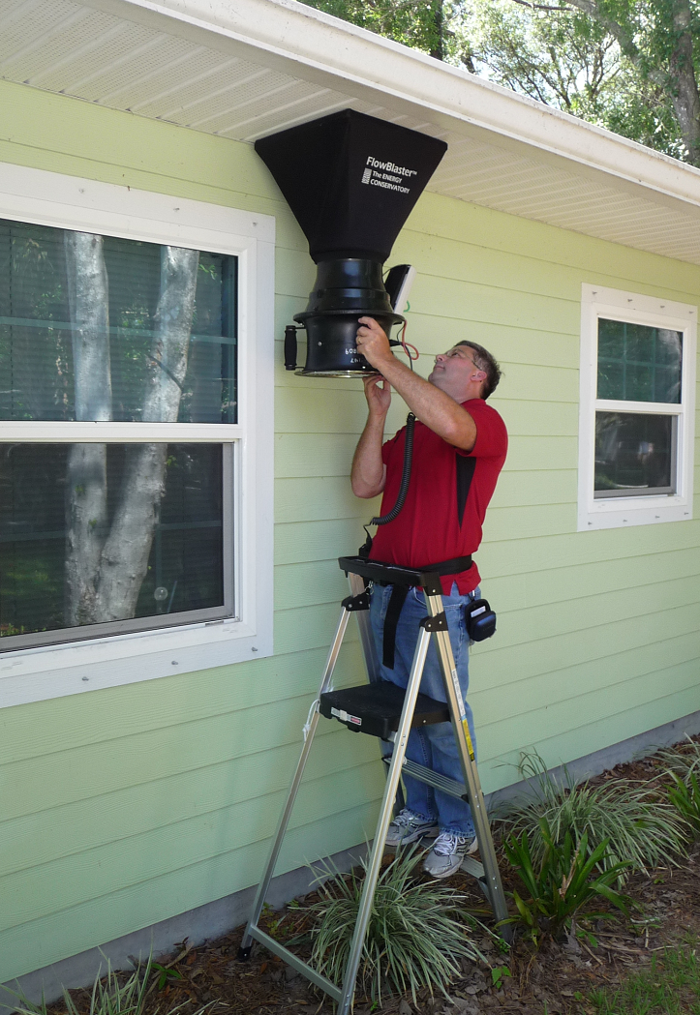
Research Approach (cont.)
House visits included:
Administering 27-question
homeowner survey
Ventilation system testing
according to the study’s testing
protocol
Photo documentation

Slide 13
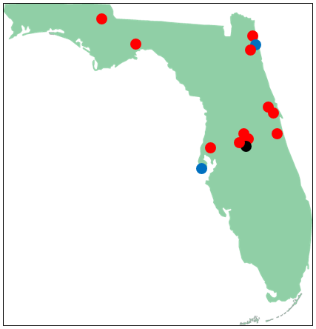
Results
The 21 project houses ranged
in size from 1,251 sq. ft. to
5,014 sq. ft.
Central and North Florida
Above-Code homes
Built between 1987 and 2014
(12 after 2012)
Average ACH50 = 3.8 (Rater #s)
Study home locations:
Red dot = 1 home
Blue dot = 3 homes
Black dot = 4 homes

Slide 14
Survey Results
Nineteen of the 21 homeowners feel ventilation is important for health but mixed knowledge about systems and their operation
Surveyor often had to help homeowner differentiate between ventilation and AC/heat
Two homeowners removed their ERVs; one had not used their runtime vent system in 2.5 years

Slide 15
Survey Results (cont.)
Most of the homeowners (15) left their system to run “hands-off” as originally installed
Most stated that they clean or change out filters, but none indicated they maintain or inspect the outdoor air grill or vent cap
Ten homeowners are satisfied with the overall performance of their systems; eight didn’t know and one was not satisfied

Slide 16
Testing Results
Only three of 21 homes (14.3%) were found to have ventilation air flow close to the design level with type of ventilation system specified
In two of the above three homes, vent systems were turned off by the homeowner, so only one of the 21 homes (4.8%) actually had the expected ventilation delivered
Only 12 of the 21 homes (57.1%) had ventilation systems capable of operating

Slide 17
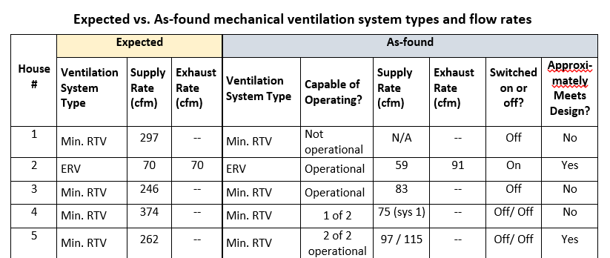
Testing Results
(from Table 2 of Report)

Slide 18
Testing Results (cont.)
Nine (43%) of 21 homes have ventilation systems that are not operational for various reasons:
System removed or disconnected (2)
Controller failure (2)
Damper failure (1)
Runtime vent expected but not installed (1)
ERVs not functional (1 house / 2 ERVs)
Inoperable as intended; AH not controllable (2)

Slide 19
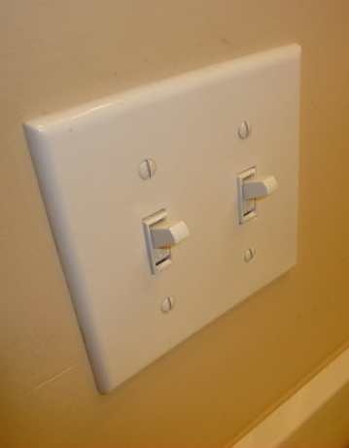
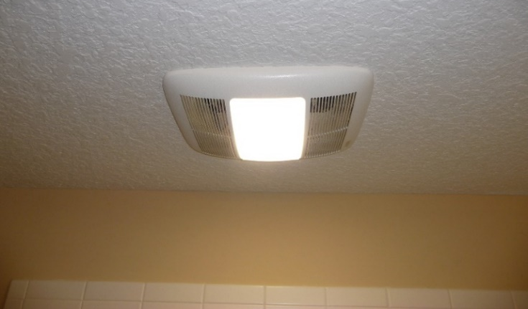
Testing Results (cont.)
One system (and likely three
others) relies on an air handler
closet located standard on/off
switch to turn on a bathroom
exhaust fan to provide
continuous whole house
ventilation even though the
switch can be overridden by a
bathroom on/off switch
Bath fan with light used as
whole-house vent fan

Slide 20
Testing Results (cont.)
Of the systems that are functional, six systems (in five homes) were deemed to have significant performance issues:
Dirty filters (2) and dirty outdoor air intake (1)
Partially disconnected ducts (2)
Outdoor air intakes installed directly over the air conditioning condenser unit hot air discharge (2)

Slide 21
Testing Results (cont.)
Additional identified performance issues included:
Partially crushed ducts (4)
Uninsulated outdoor air ducts in unconditioned attic (2)
Rooftop outdoor air intake terminations (3)
2nd floor outdoor air intake terminations (8)

Slide 22
Pressure Measurements
Tested house pressures (wrt outdoors) with house under various operating conditions
Provided evidence for the importance for make-up air relief in very tight homes with high flow kitchen exhaust equipment
1.7 ACH50 study home with high capacity kitchen exhaust fan on high (likely ~450 cfm) depressurized the home to -43 Pascals

Slide 23
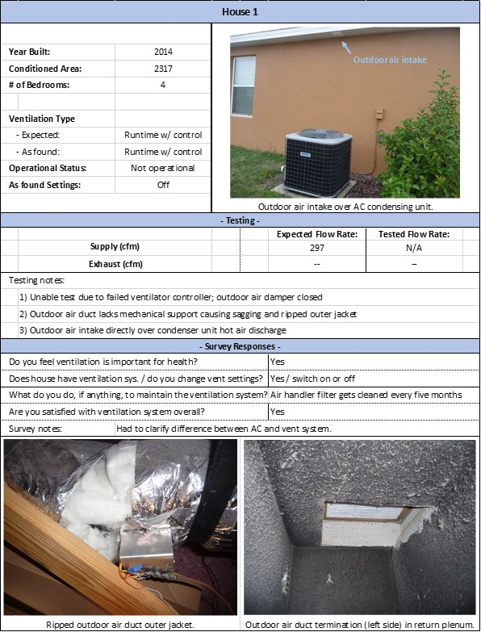
Summary 1-Pagers

Slide 24
Discussion
Issues include:
Likely majority not using ventilation systems as intended / in some cases choosing not to use them at all
Access to ventilation system equipment and controls / maintenance implications
Homeowners being able to determine if ventilation systems are operating properly

Slide 25
Discussion (cont.)
Issues (cont.):
Controller wiring / operability
Ductwork installation (restrictions, disconnects and insulation)
Actual vs. specified ventilation rates

Slide 26
Discussion (cont.)
House tightness:
EnergyGauge modeled total annul energy use comparison for sample two-story, 2400 sq. ft., 3 bedroom, 2014 FL Code house in Tampa (1 Watt/cfm ERV)
ACH50 | No ventilation |  | 2014 FL Code Ventilation Requirement |  | ASHRAE 62.2-2013 Ventilation Requirement
 | cfm | kWh | cfm | kWh | cfm | kWh
3 | 0 | 12,146 | 60 | 12,855 | 72.8 | 13,003
5 | 0 | 12,315 | 60 | 13,008 | 53.3 | 12,933
7 | 0 | 12,464 | 60 | 13,140 | 34.0 | 12,851

Slide 27
Discussion (cont.)
House tightness:
Relatively small benefit from air tightening in Florida
With range of ventilation issues found in this study, allowing some additional infiltration may reduce risks at relatively low energy penalty

Slide 28
Recommendations
Require general labeling that:
Indicates the home has a ventilation system
Provides labels on key components of the ventilation system
Ducts labeled as ventilation system duct (including flow direction indication preferred)
Grilles noted as vent system intake or discharge
Dampers noted as ventilation system dampers
Key ventilation fan components labeled as appropriate (ERV as ERV, supply vent fan as such, etc.)
Ventilation controllers

Slide 29
Recommendations
Require general summary documentation written for occupants that:
Describes what a ventilation system is and how it differs from the air conditioning system
Describes how to tell if the vent system is operable, and suggested frequency of verification (may require improvement in some systems currently on the market)
Describes the location of ducts, dampers, ERV, fan units, filters, and control(s)
Indicates recommended filter and intake/discharge grille(s) service frequency

Slide 30
Recommendations
Require alarm indication that covers failure of every component of the ventilation system:
Alarms could be visual, audio or both and should signal on the event of fan failure, damper failure, or when loss of control /communication occurs
One example of a visual alarm notice (if occupant is educated) can even be the absence of an “operational” green light in the case where local low voltage or system voltage is lost due to failed transformer or a tripped circuit breaker

Slide 31
Recommendations
Require intake grille or other vent collar heights to be at least 2 inches, mechanically attached to grille or vents, with seams and joints sealed with mastic or other code approved duct sealant
Disallow filter locations that require ladders to access; consider exception to this if an alarm feature is implemented indicating a need for service

Slide 32
Recommendations
Do not require houses to become tighter than already specified by code; consider increasing allowed leakage to 7 ACH50 in climate zones 1 and 2 (all of Florida)
Require either damper controlled passive or mechanical make-up air relief air to any home with high capacity kitchen exhaust fan with flow rates capable of 400 cfm or more regardless of combustion equipment; indoor house pressure with reference to outdoors should be tested (with kitchen exhaust fan running at is maximum flow rate) not to exceed -3 Pascals

Slide 33
Recommendations
The builder must submit a test report for the mechanical ventilation system that indicates:
the location of the system
any air intake location
any filter locations
the control status as designed
the tested cfm flow

Slide 34
Deliverables
Interim status / progress report submitted on time, February 13, 2015
Interim report presentation made to the TAC on February 25, 2015
Final report detailing project activities, ventilation system effectiveness and failure findings and recommendations submitted on time, June 1, 2015
Final report presentation made to the TAC today

Slide 35
Thank You

