Slide 1
Approval Request for EnergyGauge USA
June 11, 2015

Slide 2
Overview
Presents key findings
Methods handled by software
Compliance results
Test report is in two volumes
1st volume has overall descriptions and performance method results
2nd volume has prescriptive method results
Other files required by the FBC Technical Assistance Manual were provided
Input files
Spreadsheet results

Slide 3
Methods of Code Compliance
Cover sheet for request for approval by the Florida Building Commission as a Compliance Software tool
EnergyGauge USA
Version Number: 4.0
This software calculate Residential Energy Efficiency Code Compliance:
☑ Prescriptive R-value Method
☑ Prescriptive Total UA Alternative Method
☑ Performance Method
Prescriptive U-factor Alternative Method not part of EnergyGaugeUSA

Slide 4
Performance Method Testing
The performance tests consist of:
FL e-Ratio algorithms
Two suites of building load tests, referred to as ASHRAE Standard 140 and Florida HERS BESTEST developed by the National Renewable Energy Laboratory
A Standard Reference Design Auto-generation test suite developed by the State of Florida
Three test suites developed by RESNET to test
Heating, Ventilating and Air Conditioning (HVAC) equipment algorithms,
Distribution System Efficiency (DSE) algorithms,
Domestic Hot Water (DHW) algorithms.

Slide 5
Performance Method Testing (cont’d)
Each of the performance Method Tests was passed.
Directions for anyone wanting to test the software for themselves are included in the report.
Submission includes a series of subdirectories, which include all of the specific information for the given series of verification tests, as follows:
Input – contains the EnergyGauge input files for each test
Output – contains PDF copies of the output files generated by EnergyGauge for each test
Procedures – contains the written procedures for each test suite
Results –completed spreadsheets provided by the Florida Building Commission for reporting results.

Slide 6
ASHRAE 140 Test Heating
Annual Heating Loads: Colorado Springs, CO
 | Heating | range max | range min | Result | pass/fail
 | L100AC | 79.48 | 48.75 | 55.79 | pass
 | L110AC | 103.99 | 71.88 | 77.14 | pass
 | L120AC | 64.30 | 37.82 | 42.57 | pass
 | L130AC | 53.98 | 41.82 | 45.65 | pass
 | L140AC | 56.48 | 43.24 | 48.41 | pass
 | L150AC | 71.33 | 40.95 | 49.38 | pass
 | L155AC | 74.18 | 43.53 | 51.63 | pass
 | L160AC | 81.00 | 48.78 | 57.62 | pass
 | L170AC | 92.40 | 61.03 | 69.31 | pass
 | L200AC | 185.87 | 106.41 | 131.51 | pass
 | L202AC | 190.05 | 111.32 | 139.95 | pass
 | L302XC | 90.52 | 52.66 | 55.62 | pass
 | L304XC | 75.32 | 43.91 | 47.15 | pass
 | L322XC | 118.20 | 68.35 | 73.93 | pass
 | L324XC | 80.04 | 44.01 | 48.97 | pass

Slide 7
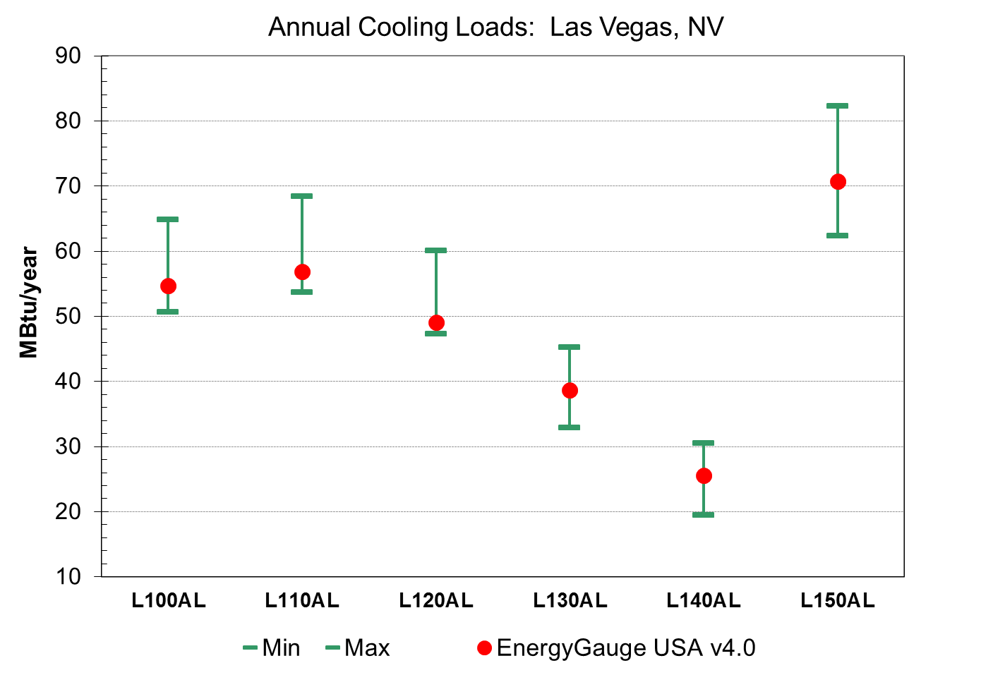
ASHRAE 140 Test Cooling
Annual Cooling Loads: Las Vegas, NV
 | Cooling | range max | range min | Result | pass/fail
 | L100AL | 64.88 | 50.66 | 54.71 | pass
 | L110AL | 68.50 | 53.70 | 56.82 | pass
 | L120AL | 60.14 | 47.34 | 49.07 | pass
 | L130AL | 45.26 | 32.95 | 38.63 | pass
 | L140AL | 30.54 | 19.52 | 25.62 | pass
 | L150AL | 82.33 | 62.41 | 70.78 | pass
 | L155AL | 63.06 | 50.08 | 56.55 | pass
 | L160AL | 72.99 | 58.61 | 64.42 | pass
 | L170AL | 53.31 | 41.83 | 43.29 | pass
 | L200AL | 83.43 | 60.25 | 67.10 | pass
 | L202AL | 75.96 | 52.32 | 54.98 | pass

Slide 8
Florida BESTEST Heating Results

Slide 9
Florida BESTEST Cooling Results

Slide 10
DHW Test

Slide 11
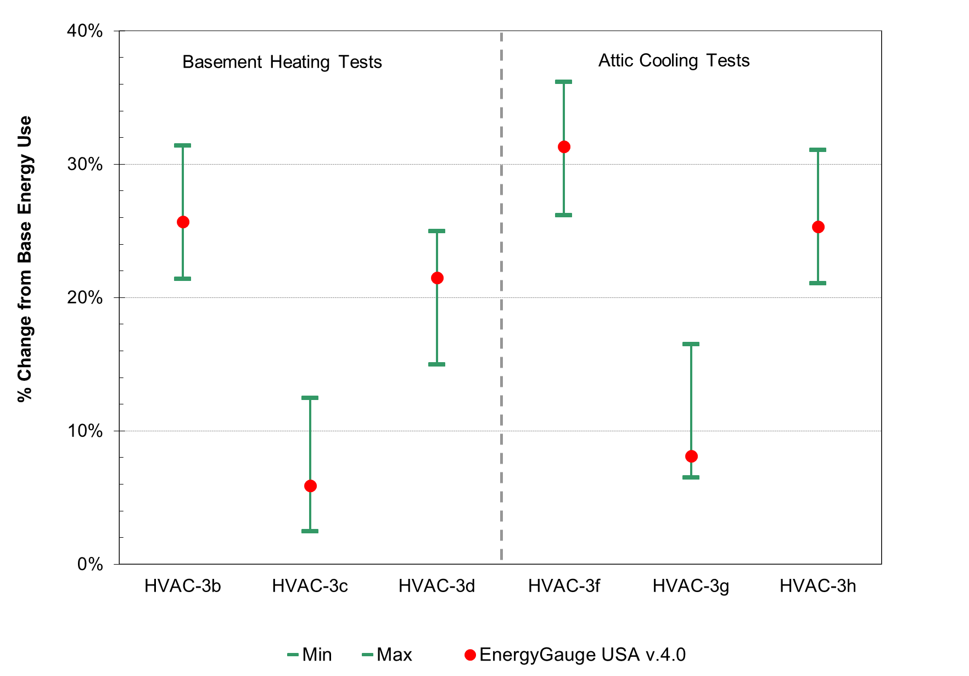
DSE Test

Slide 12
E-Ratio Tests
Test result fields indicated by green
Test Case | eRatio | Baseline Home End Use Loads (REUL)
 |  | Winter | Summer | Hot Water
 |  | (MBtu) | (MBtu) | (MBtu)
L130AO-01 | 152.37 | 6.18 | 29.83 | 3.88
L130AO-02 | 142.14 | 6.18 | 29.83 | 3.88
L130AO-03 | 151.52 | 6.18 | 29.83 | 3.88
L130AO-04 | 118.53 | 6.18 | 29.83 | 3.88
L130AO-05 | 145.88 | 6.18 | 29.83 | 3.88
 | REUL Tests: | PASS | PASS | PASS
eRatio Tests
PASS
PASS
PASS
PASS
PASS

Slide 13
FL Auto-Gen Tests
All 4 Standard Reference homes were generated accurately
All 4 tests generated e-ratios of 1.0 (PASS)

Slide 14
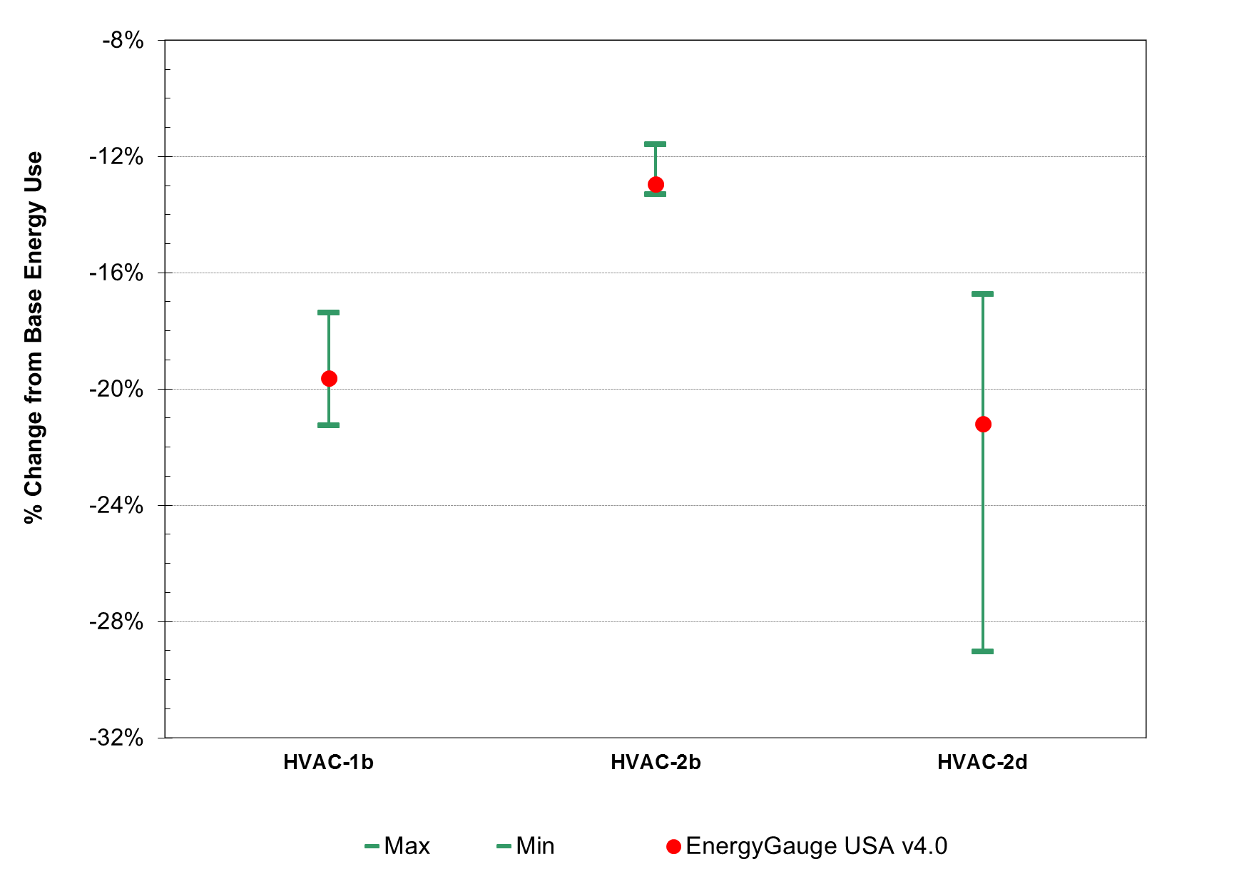
HVAC Tests

Slide 15
Prescriptive Compliance
Test House | R-Value Method | Notes | Total UA Alternative Method | Notes
Tampa01 | PASS |  | PASS
Tampa02 | PASS |  | PASS
Tampa03 | PASS |  | PASS
Miami-1 | PASS |  | PASS
Miami02 | PASS | Steel Frame Walls not allowed | PASS
Miami03 | PASS |  | PASS

Slide 16
Conclusions
All requested tests have been completed and passed
Vendor has submitted documentation requested in Technical Assistance Manual
EnergyGauge USA 4.0 complies with the 5th Edition (2014) Florida Building Code Energy Conservation

