Slide 1

FBC Code Development
6th Edition (2017)

Slide 2

Part 1
  6th Edition
  (2017) Florida
  Building Code
  - Update

Slide 3
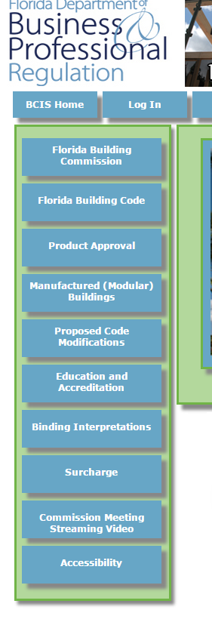
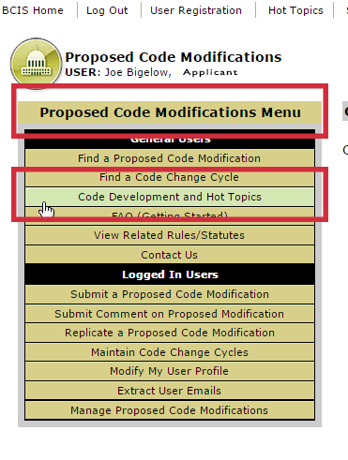
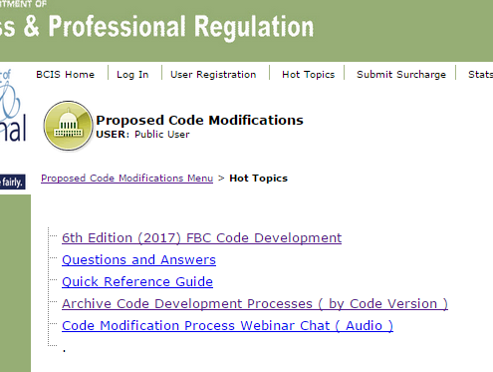
Code development

Slide 4
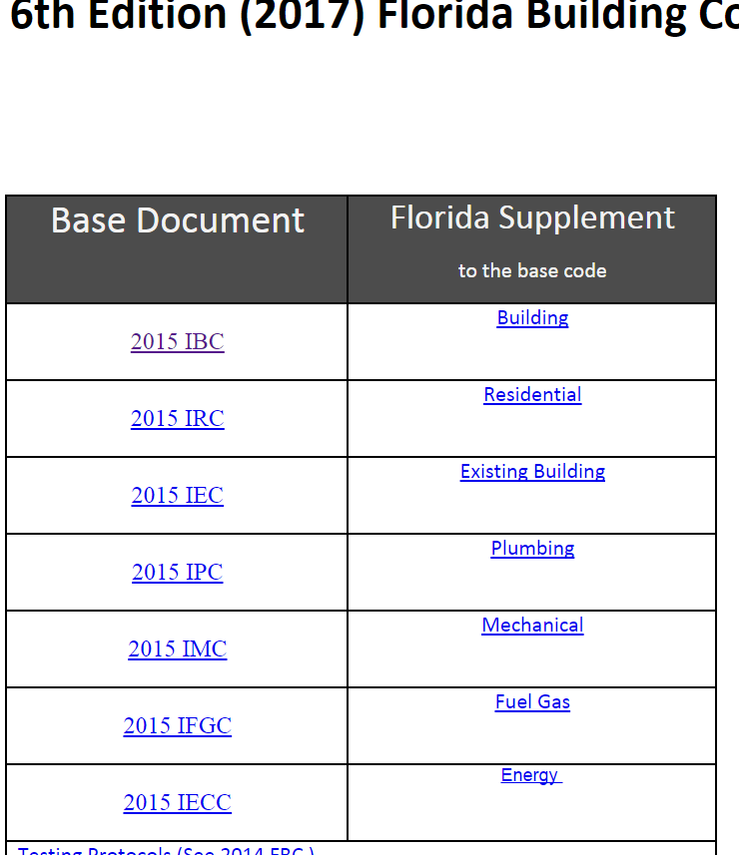
Copy and paste both parts to add to the “Text of Mod” field.

Slide 5
6th Edition (2017) FBC
July 1 2015
10 Months
Triennial
April 2016
5 Months
Glitch
October 1 2016
9 Months
Finish Glitch
May 1 2017
6 Months
Generate integrated Code
December 30 2017
Rule Hearing Held end of May
Effective Date
FBC

Slide 6
Primary Code Development Phase:
2014 NEC published and available to the public; | 08/2013
2015 International Codes published and available to the public; | 05/2014
Commission selects 2015 I Codes and 2014 NEC as foundation for 6th Edition (2017) FBC | 04/14/2015 Done
Staff evaluates Florida amendments resulting from direction of the Legislature and Commission initiatives to propose for inclusion in the 6th Edition (2017) FBC and publish “Preliminary Supplement”. | 3/2015 – 6/2015
2015 I Codes plus the Preliminary Supplement – posted online | 6/30/2015
Period for public to propose modifications to the 2015 I Codes and the Preliminary Supplement | 7/1/2015 – 8/3/2015
TACs consider proposed modifications (1st 45 day comment period) TACs meetings - 4-day on-site meetings in conjunction with the October Commission meeting | 10/12-16/2015
TACs consider public comments on their actions on the proposed mods TACs meetings – 4-day meetings [2-day on-site (Gainesville) and 2 – day via conference/webinar] | 1/4-8/2016
Commission considers TAC recommendations (2nd 45 day comment period) Commission – 2-day meeting | 2/9-10/2016
Draft 6th Edition (2017) FBC (Florida Supplement plus I Codes) posted online | 3/15/2016

Slide 7
Glitch Correction Phase:
Period to propose glitch modifications to draft 6th Edition (2017) FBC | 4/1/2016 – 5/3/2016
Post Tracking/Detail reports online | 6/28/2016
TACs consider proposed glitch modifications and develop public comment via conference call/Webinars | 7/18-22/2016
Commission considers proposed glitch mods and TAC comments (Rule Development Workshop) Commission – 2-day meeting | 8/22-23/2016
Draft 6th Edition (2017) FBC posted online Provide Supplements to ICC for integration into the 2015 I-Code | 10/20/2016
Final Rule Hearing on 6th Edition (2017) FBC/Commission approves final version of Code 6th Edition (2017) Florida Fire Prevention Code available in final format | 6/8/2017 Generate integrated Code.
Rule Submitted to Secretary of State and Supplement/Integrated posted online – subject to addressing all JAPC’s concerns | TBD
Printed Code available - subject to negotiation with ICC | TBD
2017 FBC (6th edition) effective date (6 – months after publication) | 12/31/2017
553.73(7)(e) A rule updating the Florida Building Code in accordance with this subsection shall take effect no sooner than 6 months after publication of the updated code. Any amendment to the Florida Building Code which is adopted upon a finding by the commission that the amendment is necessary to protect the public from immediate threat of harm takes effect immediately.

Slide 8
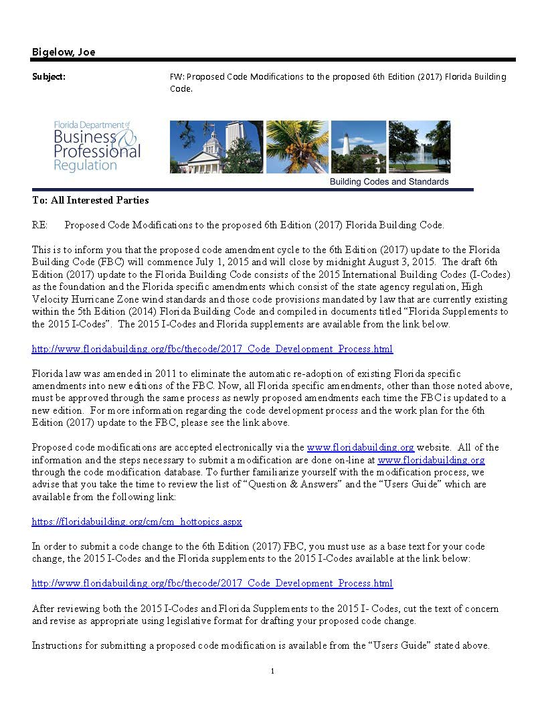

Slide 9
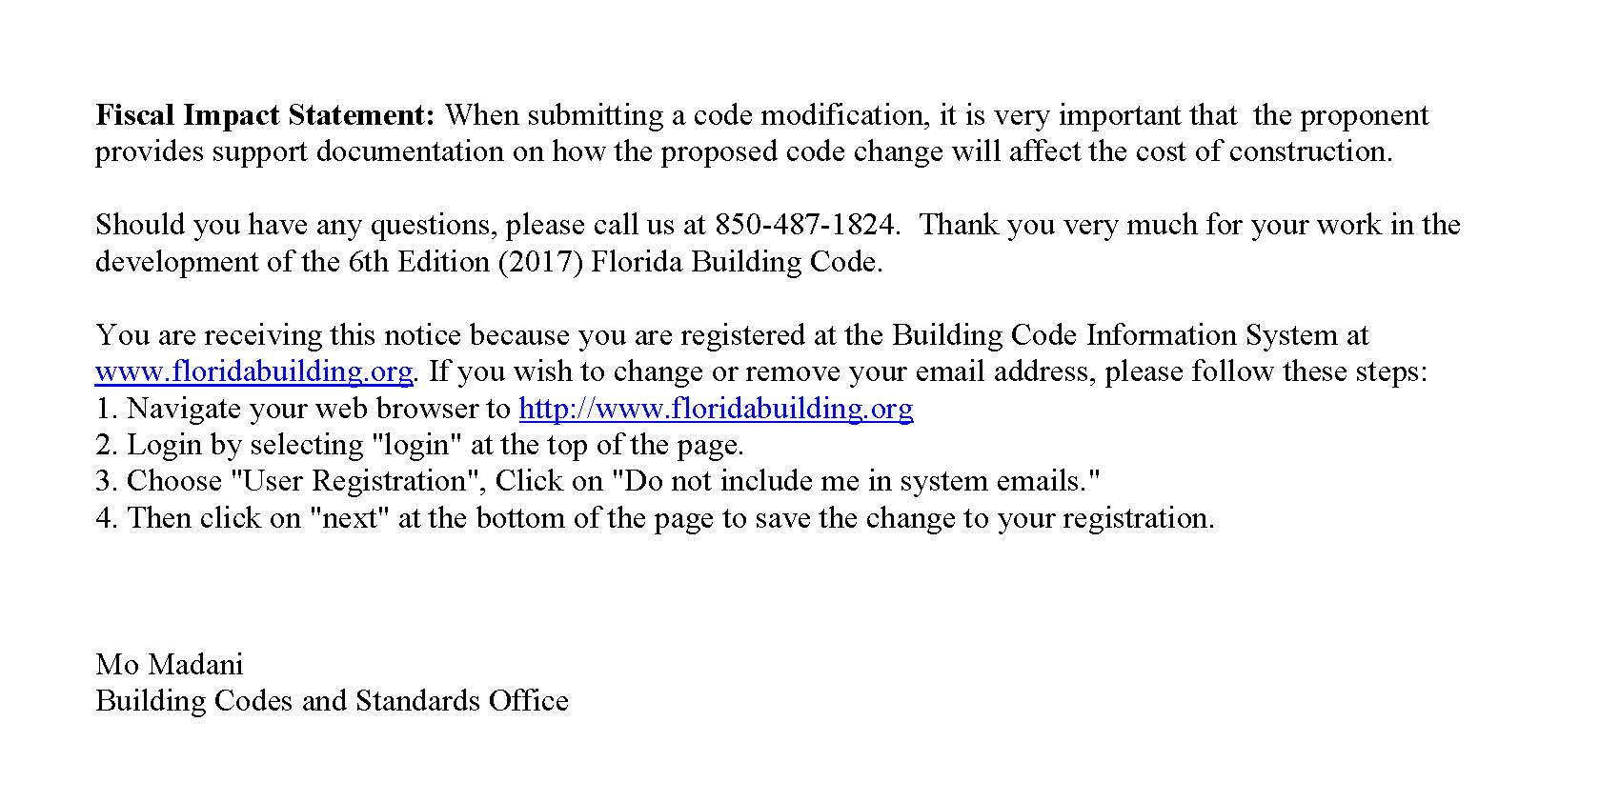

Slide 10
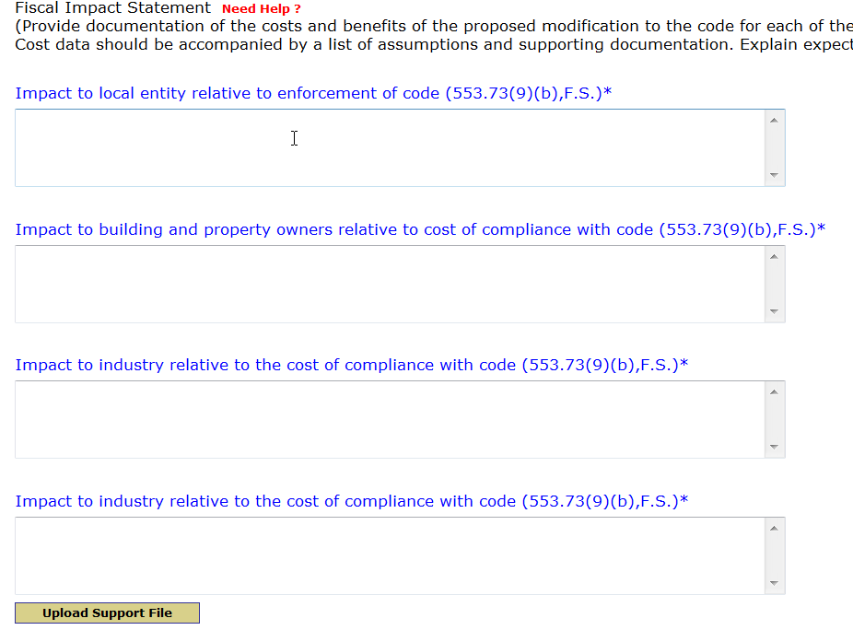
Triennial Form

Slide 11
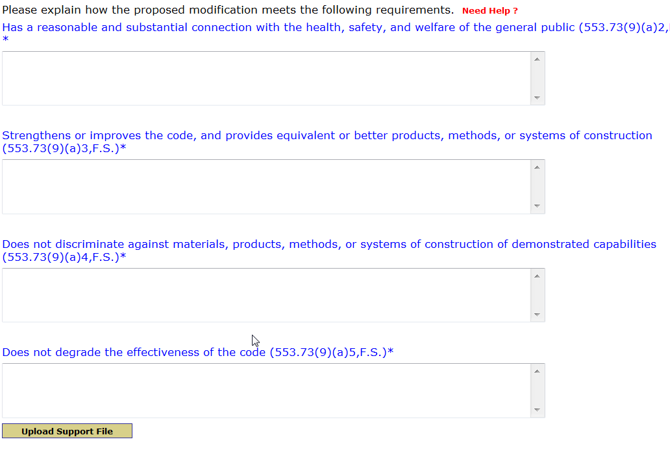
Triennial Form cont

Slide 12
I I I I I
Part 2 -
FBC Editions to Date

Slide 13
Effective Dates
2001 FBC
2004 FBC
2007 FBC
2010 FBC
5th Edition (2014) FBC
6th Edition (2017)
FBC
Original
Original
2003 Supplement
2006
Supplement
Original
Original
2005 Supplement
2007
Supplement
2nd 2009 Supplement
2012 Supplement
1st 2009 Supplement
Original
Dec 16, 2005
March 1, 2009
March 15, 2012
Tentative Date
December 30, 2017
July 1, 2007
Oct 1, 2009
April 15, 2012
Oct 1, 2005
Dec 8, 2006
March 1, 2009
June 30, 2003
June 30, 2015
March 1, 2002
Effective Date

Slide 14
Questions?
www.floridabuilding.org
850-487-1824

