Slide 1
WARNING
Asking questions or providing feedback regarding the Invitation to Negotiate (ITN) will preclude the individual and their organization from participation in the ITN.
WARNING

Slide 2
Invitation To Negotiate
Administrative Service for the State Product Approval System
For the Florida Building Commission

Slide 3
Florida Product Approval System Administrator Invitation to Negotiate prepared by:
Ila Jones – Program Administrator Codes and Standards
Mo Madani - Senior Technical Manager
Sandy O’Connor- Product Approval
Barbara Bryant– Contracts
Joe Bigelow – Codes

Slide 4
Part 1:
Process

Slide 5
Objectives
1. Overview/Background
2. Entity Application Review
3. Product Application Review
4. Review of Specific Application

Slide 6
Information included in the Overview/Background
Effective October 1, 2003
Optional to local approval
Relies on national standards and entities
Web-site www.floridabuilding.org for
processing applications
Complementary to the FBC
Two step review process
Validation
Spot Check review by Administrator

Slide 7
Entity applications review process
Product entity application review (two step review process):
1. Review/validation by accreditation body
2. Spot check information submitted by the Administrator:
- Confirm accreditation certificate is valid
- Application is within the scope of accreditation

Slide 8
Application Review Process
Two Review Processes:
Three months
Test report,
Evaluation report
Or:
Ten (10) days
-For Certification

Slide 9
Application Review Process *Excludes Certification – 3 Months
Application process include:
Applications must be validated by COMPLETION DEADLINE
Applicants work at their own pace to complete applications by the posted deadline date.
Early submittals will have more correction time if needed.
Only those applications that are complete by the Completion Deadline are recommended to the Product Oversight Committee (POC) and listed on the meeting agenda

Slide 10
Review Timeline April 9-10, 2013 Commission Meeting
FEB 22 - Midnight - Preliminary Review FEB 28 - Midnight - Completion Deadline MAR 8- Report Posted for public comment (Includes DBPR Approvals ) MAR 15 - NOON -Deadline for public comments to be mailed to the Administrator MAR 21 - Final Report Posted

Slide 11
Application Review Process for All Methods *Except Certification

Slide 12
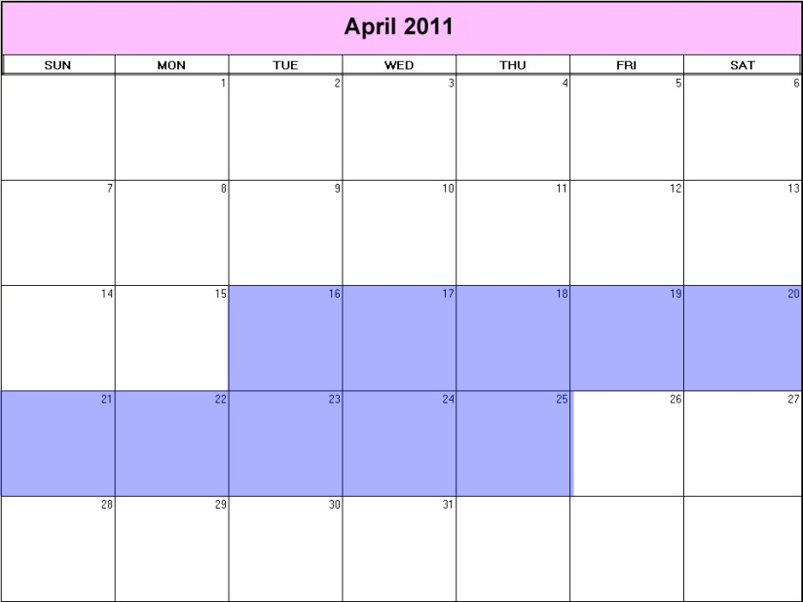
Review Process For Certification:
10 days review
process.
Applicable to Product applications that rely upon a product certification mark or listing from an approved certification agency

Slide 13
Application Review Process for Certification Method
Apply On BCIS
New Product
Upload Accreditation Certificate
Application
Application Complete
?
Administrator
Review
10 Business Days
Validator
Approved DBPR
YES
NO
Good Cause to Review
?
List on BCIS
POC (FYI Only)
YES
Commission Approval
NO
YES
POC Vote Approves
Approved

Slide 14
The Key to Getting Approval in 10 days
Complete Application
Complete and correct Validation
ü
ü

Slide 15
New Entity
Apply on BCIS
Upload Accreditation Certificate
Application
Application Complete
?
Administrator
Review
Accreditor
POC Vote
YES
NO
Approval
State Product Approval Entity Application Process

Slide 16
Product application review process
Two step review process:
1. Validation by independent third parties “validators” – using validation checklist
2. Spot check review of applications by the Administrator – no specific checklist required for review.

Slide 17
Apply On BCIS
Upload Installation instructions and Compliance Documents
Validator
Complete
Online Application
New Product
Application Complete
?
YES
POC Vote
Administrator Review
NO
Approval

Slide 18
Product application review by the Administrator
Administrative – No technical analysis or evaluation
Perform a spot check (inspection by observation)
Determine whether the application complies with the
Rule
Code
Determine whether the application and support documents are consistent.
Determine whether the validator performed his or her service.

Slide 20
Review of specific application
Certification method
Evaluation method
Entity
Engineer/architect
Test report method

Slide 21
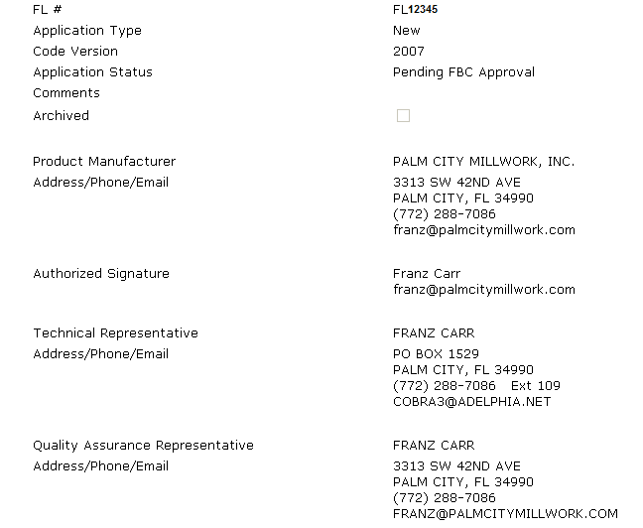
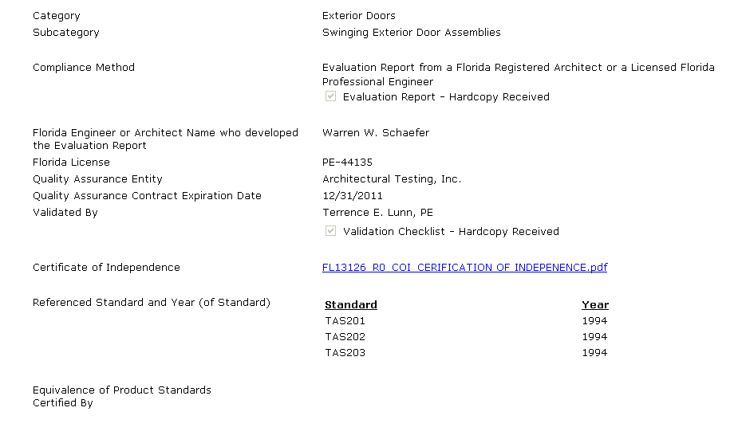
ü
Step 1 Code Version
Application Review
Architect and Engineer
ü
Step 2 Compliance
Method
Rule Compliance
ü
Step 3 QA valid
ü
Step 4 Standards
Code Compliance

Slide 22
Application Review
Architect and Engineer
ü
Step 5 Checklist
Rule Compliance

Slide 23
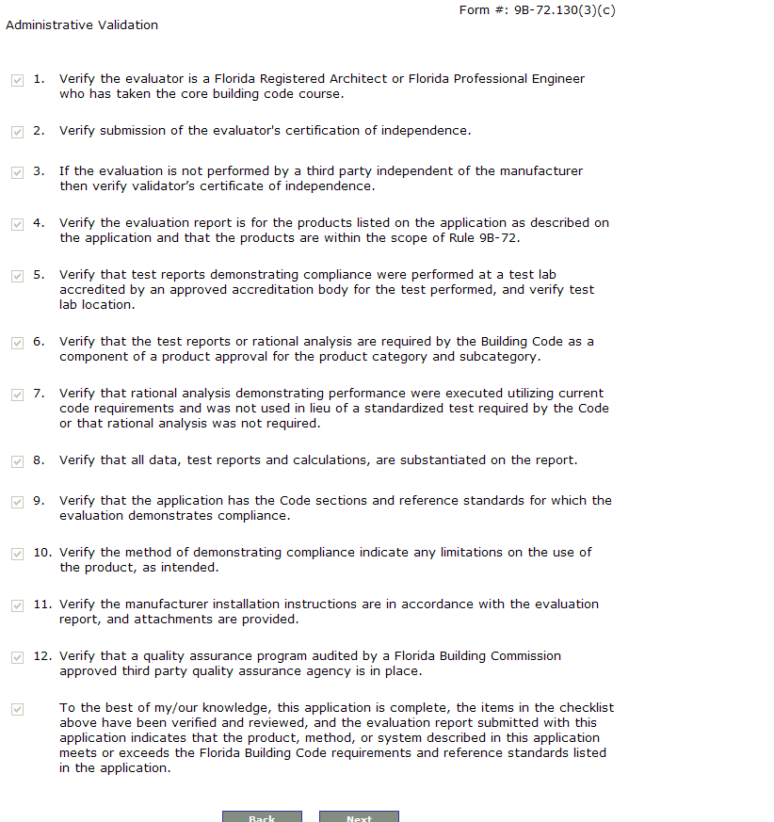
Application Validation Checklist
On BCIS
All Checked
Application Review
Architect and Engineer
ü

Slide 24
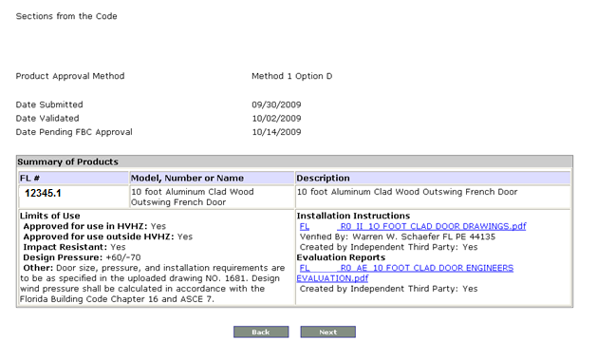
Application Review
Architect and Engineer
Continued
Step 6 Check for consistency with supporting documents
Design Pressures

Slide 25
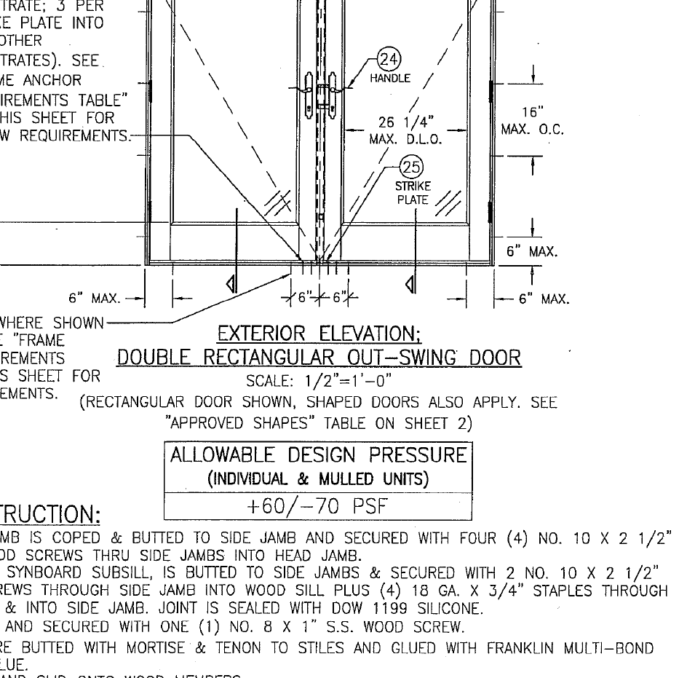
Installation Instructions
Aplication Review
Architect and Engineer
Design Pressures

Slide 26
Part 2:
ITN

Slide 27
ITB vs RFP vs ITN
Three formal procurement options
available for acquisition of
commodities/services:
(1) INVITATION TO BID (ITB)
(2) REQUEST FOR PROPOSAL (RFP)
(3) INVITATION TO NEGOTIATE (ITN)
3 Options

Slide 28
ITB vs RFP vs ITN
INVITATION TO BID (ITB) –
<Lowest price is determining factor>
Scope of work clearly defined
All contractual terms and conditions are known and clearly defined
ITB

Slide 29
ITB vs RFP vs ITN
REQUEST FOR PROPOSAL (RFP) –
Scope of work clearly defined
All contractual terms and conditions are known and clearly defined
Criteria to be used in determining acceptability of bid, which can include but is not limited to price
RFP

Slide 30
INVITATION TO NEGOTIATE
The ITN secures a highly qualified administrator at a price that matches needed services and available funds.

Slide 31
ITN Format & Structure
Section 1 – Introductory Materials (p.5)
Section 2 – Special Instructions to Responders. (p. 25)
Section 3 – Technical Specifications (p. 29)
Section 4 – Special Instructions to Responders. (p.31)
Section 5– Form Instruction and Information

Slide 32
Qualifications/Experience Requirements
Solicit an administrator with the following minimum qualifications:
1. Active license- (468, 471 or 481 (Part I))
2. Extensive knowledge in the structural provisions of the FBC,
and
3. Including one or more of the following:
- 5 years experience in building code enforcement and application, or
- 5 years experience in building code product approval, or
- 5 years experience in State Product Approval Program.
4. Past Performance
-Three (3) references describing work experience within past 5 years
5. Current contract/employment
-Two (2) contracts of similar scope and size within past 5 years
6. Review of provided sample product applications (one per each method, through access via BCIS)

Slide 33
Scope of Work
The Department of Business and Professional Regulation invites interested parties to submit responses to provide the Department with a contractor “Program System Administrator” qualified to review and process product approval and product entity documentation for compliance with Rule 61 G20-3, Florida Product Approval, F.A.C., and Chapter 120, Florida Statutes.

Slide 34
Scope of Work (Cont.) (p.19)
1.10 Description of Additional Requirements:
(1) Contractor must cease performing any other Rule 61 G20-3, F.A.C., functions if selected to perform this administrative service. Fees will be paid directly to the Contractor by the manufacturer, either via the Building Code Information System at www.floridabuilding.org or other means, as determined by the Department and Contractor.
(2) If the BCIS is used to process payments, Contractor shall comply with all relevant security standards and specific payment credit card industry requirements that maintain data security and compliance throughout the contract.

Slide 35
Scope of Work (Cont.) (p.19)
(3) Contractor shall provide a Statement of independence attesting that no conflict of interest exists between the Contractor and the Florida Building Commission (FBC) approved certification agencies, test laboratories, quality assurance entities, evaluation entities or Florida architects or engineers conducting product evaluations.
(4) The Contractor shall agree to any changes to the scope of work subsequently approved by the Commission.

Slide 36
Scope of Work (Cont.) (p.19)
(5) The Contractor shall establish an office in Florida to provide this service.
(6) The Contractor shall investigate product complaints and serve as expert witness for the Commission, as directed by the Commission.
(7) The Contractor shall coordinate with the Department to provide recommended BCIS enhancements on the Product Approval Module.
(8) The Contractor shall conduct all communications with the product approval and entity applicants through a specified dialogue in-box designated on the BCIS. (The BCIS will be enhanced with this function)

Slide 37
Scope of Work (Cont.) (p.19)
(9) Contractor shall provide annual certified financial statements sufficient to determine the efficacy of the program until a threshold of $300,000 in revenue is reached; thereafter, annual financial audits by a certified auditing firm, to be selected by the Contractor and approved by the Commission within 60 days after the contract is awarded, shall be provided. The annual financial audits shall be provided to the Department by November 1 of each fiscal year.
(10) Contractor shall, at a minimum, develop and conduct on-site validator training sessions at contractor’s expense every six months. The contractor shall communicate electronically (emails or telephone conference) to all validators the common validation mistakes discovered during each application cycle within ten (10) calendar days following each scheduled Commission meeting.

Slide 38
Scope of Work (Cont.) (p.19)
(11) Contractor shall comply with all applicable portions of Chapter 119, Florida Statutes.
(12) Contractor shall track, research and report on all revocations.
(13) Contractor shall be available and provide services during normal business hours, i.e., 8:00 a.m. through 5:00 p.m.

Slide 39
Anticipated Timeline
DATE | Time
May 1, 2013 |  | Release of Solicitation
May 8, 2013 | 12:00 pm | Questions Due
May 15, 2013 |  | Anticipated Date Answers to questions are posted on the Vendor Bid System
May 24, 2013 | 4:00 pm | Closing Date for Receipt of Proposals
June 3, 2013 |  | Anticipated Dates of Evaluations
June 10, 2013 |  | Anticipated Date to Post List of Vendors with which the Department will Negotiate
June 18-20, 2013 |  | Anticipated Dates of Negotiations
July 1, 2013 |  | Public Meeting Recommended Award
July 3, 2013 |  | Anticipated Posting of Intended Award on Vendor Bid System
October 1, 2013 |  | Anticipated Contract Start Date

Slide 40
Evaluations
Evaluation and Negotiation Team:
Assistant Secretary or Designee
General Counsel or Designee
Ila Jones, Manager,
Codes and Standards
Mo Madani, Technical Planning Manager,
Codes and Standards
Florida Building Commission members appointed by the Chair
Note: Evaluation and Negotiation teams must be the same members

Slide 41
Scoring: Distribution of Points– 100 points possible
A. Qualifications/Performance/References
(Maximum 50 Points)
1. Qualifications and Experience (15 Points)
(Up to 5 points for each bulleted item)
2. Past Performance References (10 Points)
3. Current Contracts/Employment (5 Points)
4. Application review (20 Points)
(Up to 5 points for each bulleted item)
B. Scope of Work (Maximum 30 Points):
(Up to 6 points for each bulleted item)
C. Price (Maximum 20 Points)

Slide 42
Negotiation
1. Evaluate and rank responses
2. Negotiate with one or more respondents serially or concurrently
3. Agency requests a Best and Final Offer from selected respondents
4. Select vendor

Slide 43
Recommendations
Approve the ITN
And
Evaluation and Negotiation teams must be the same, select one (1) or two (2) POC members to serve.

Slide 44
Questions?
Questions?
Questions?

Slide 45
mo.madani@myfloridalicense.com
850.717.1825 (p) 850.414.8436 (f)

