Slide 1
Corrosion of Residential Fasteners
Interim Report
March 3, 2017
Kurtis Gurley, PhD,
Professor of Civil Engineering
Engineering School of Sustainable Infrastructure & Environment
University of Florida

Slide 2
2015 – 2016 Work
Goals:
Test-1: Determine whether ASTM A641 and TAS 114 Appendix E certified fastener performance exceeds the baseline electrogalvanized results from the 2014 – 2015 study
Test-2: Investigate the influence of installation on hot dipped nails
Test-3: Investigate the corrosion performance of screen enclosure fasteners (concrete, SMS and SDS: stainless, ceramic coated)
Approach: Apply TAS 114 Appendix E testing (Section 2.6.1) to evaluate the degree of corrosion resistance of fasteners

Slide 3
2015 – 2016 Work
Findings:
All EG fastener samples tested exhibited at least partial light surface corrosion on both the head and shaft, and most samples displayed significant heavy corrosion. This was true for ASTM A641 and Miami Dade approved samples

Slide 4
2015 – 2016 Work
Findings:
The hot dipped, mechanically galvanized and stainless steel ceramic coated specimens demonstrated little or no corrosion
The corrosion resistance of hot dipped specimens does not appear to be influenced (damaged) by installation. However, due to a relatively small sample size and the inclusion of only two specimen types, this conclusion is indicative rather than definitive

Slide 5
2015 – 2016 Work
Findings:
Ceramic coated SS screen enclosure fasteners: The test results revealed some degradation to the ceramic coating on the stainless steel specimens. The exposed stainless steel did not exhibit significant corrosion. However, unlike metal reactions due to loss of the coating barrier were not evaluated since these specimens were tested out of the box and not in an installed configuration.

Slide 6
2016 – 2017 Work
Ceramic coated SS screws installed in aluminum prior to corrosion testing in order to investigate the implications of loss of coating
Additional tile fastener testing
Hot dipped fasteners conforming to the ASTM A153 hot dipped standard and the ASTM A641 minimum coating standard will be tested for relative performance.
HVAC and metal panel clips and fasteners will be tested

Slide 7
2016 – 2017 Work
Ceramic coated SS screws installed in aluminum prior to corrosion testing in order to investigate the implications of loss of coating
Additional tile fastener testing
Hot dipped fasteners conforming to the ASTM A153 hot dipped standard and the ASTM A641 minimum coating standard will be tested for relative performance.
HVAC and metal panel clips and fasteners will be tested

Slide 8
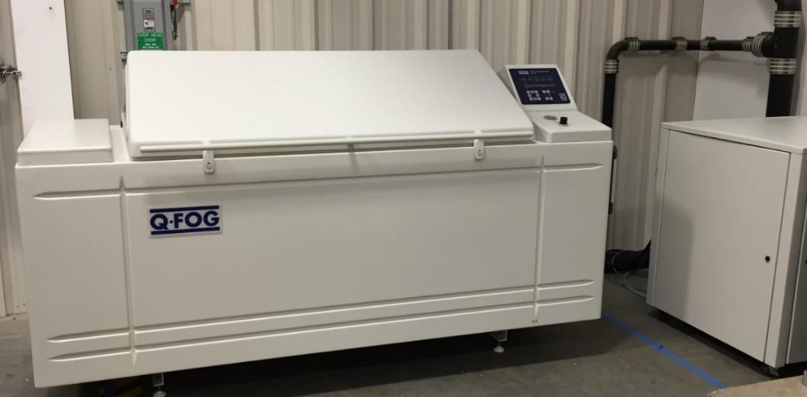
Testing: 2016 - 2017
The test protocol followed TAS 114 Appendix E
An integer scale of 1 – 8 was created to classify the degree of corrosion observed on the fasteners

Slide 9
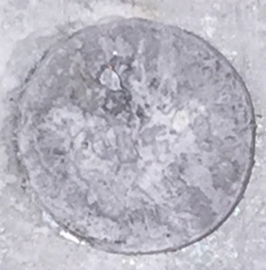
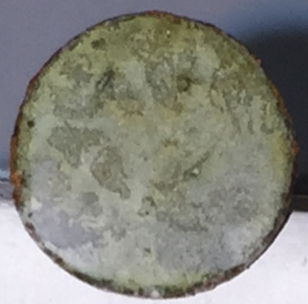
1: no corrosion observed
2: Edge corrosion only

Slide 10
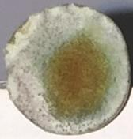
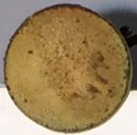
3: Light partial surface corrosion
most scores of 3 would fail TAS criterion of > 5% surface corrosion
4: Light full surface corrosion

Slide 11
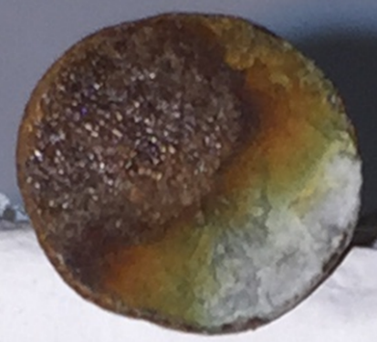
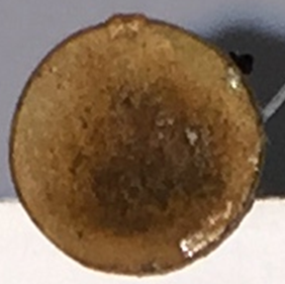
5: Partial heavy surface corrosion
6: Partial heavy and partial light full surface corrosion

Slide 12
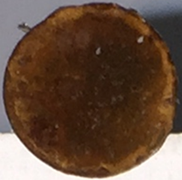
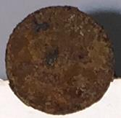
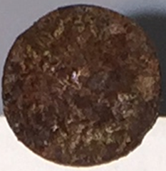
7: Heavy full surface corrosion without scaling
8: Heavy full surface corrosion with scaling

Slide 13
2015 – 2016 Work
Table 1: test-1: 15 specimen types, 10 samples each 5 samples out-of-the-box, 5 samples installed in substrate Status: completed 1000 hours (500 cycles)
Group number | Product type | Use | Certification | Coating
1 | Hex 3/8 x 5 304 Stainless white | Masonry | MDC Approved | Ceramic
2 | Hex 3/8 x 7 304 Stainless white | Masonry | MDC Approved | Ceramic
3 | Hex 1/4 x 3 ¼ 304 Stainless silver | Masonry | MDC Approved | Ceramic
4 | Hex 1/4 x 2 ¼ 304 Stainless silver | Masonry | MDC Approved | Ceramic
5 | Hex 1/4 10 x 2 SMS 316 Stainless bronze | Screen enclosure | MDC Approved | Ceramic
6 | Hex 1/4 12 x ¾ SDS 316 Stainless white | Screen enclosure | MDC Approved | Ceramic
7 | Hex 5/16 14 x 1 SDS 316 Stainless bronze | Screen enclosure | MDC Approved | Ceramic
8 | Hex 3/8 14 x 1 SDS 316 Stainless bronze | Screen enclosure | MDC Approved | Ceramic
9 | Hex 5/16 12 x 2 SDS 316 Stainless bronze | Screen enclosure | MDC Approved | Ceramic
10 | Hex 1/4 10 x 2 SDS Stainless white | Screen enclosure | MDC Approved | Ceramic
11 | #8 2 ½ mechanically galvanized ASTM B695 Class 55 2006 IRC Compliant | Tile screw | IRC | MG
12 | #8 2 ½ tile screw heavy zinc electroplated | Tile screw | unknown | EP
13 | #8 2 ½ mechanically galvanized ASTM B695 Class 55 2006 IRC Compliant | Tile screw | IRC | MG
14 | Hex 1/4 x 3 ¼ case hardened carbon steel blue Nylon cap applied post-install | Masonry | Unknown | Ceramic
15 | Hex 5/16 12 x 1 SDS case hardened carbon steel red, Nylon head | Screen enclosure | Unknown | Ceramic

Slide 14
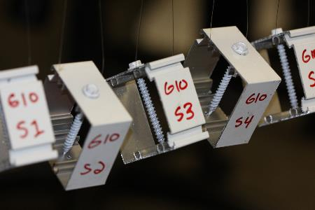
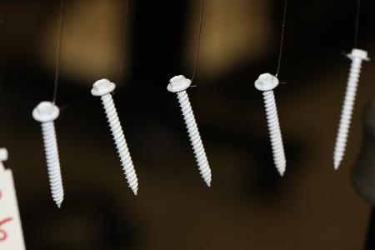
Test Configurations
15 groups, 10 samples each = 150 specimens tested @ 500 cycles
5 samples tested out-of-the-box
5 samples installed prior to testing
SMS, SDS, masonry screws through aluminum sample and tested
Tile screws driven through tile sample and removed prior to testing

Slide 15
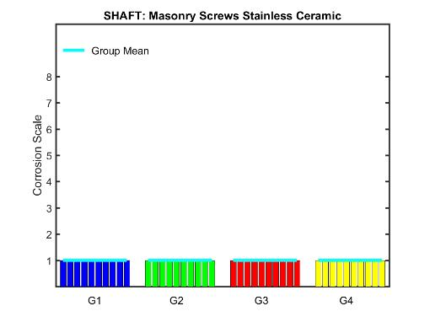
2016 – 2017 Results
Ceramic coated SS masonry screws
Installed
Out of the box

Slide 16
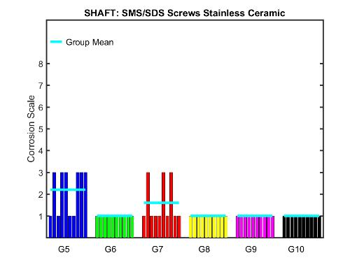
2016 – 2017 Results
Ceramic coated SS SMS/SDS screws
Installed
Out of the box

Slide 17
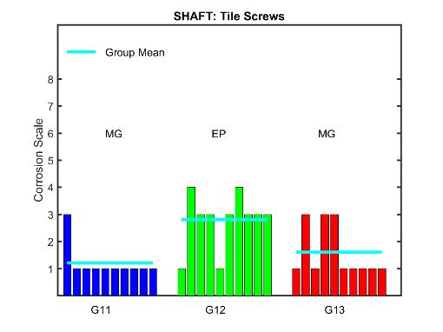
2016 – 2017 Results
Tile screws MG and EP
Installed
Out of the box

Slide 18
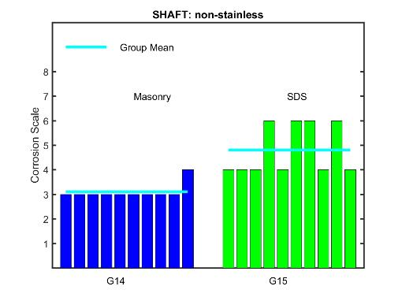
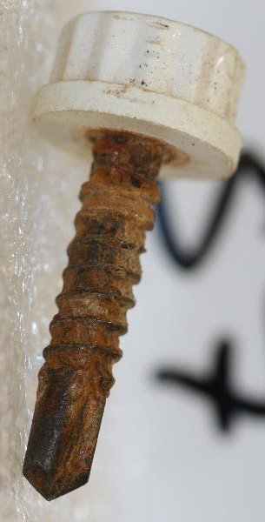
2016 – 2017 Results
Ceramic coated Case hardened carbon steel screws
Installed
Out of the box

Slide 19
2016 – 2017 Observations
Ceramic coated stainless steel screws
Loss of ceramic coating was common
No observed corrosion
Installation into aluminum did not influence results (non-like metal reaction not observed)
Ceramic coated non-stainless screws
Corrosion was present on most specimens. Install did not influence results
Roof tile screws
Mechanically galvanized (MG) screws performed better than EP screws, as advertised by the manufacturer. Install into tile did not influence results

Slide 20
2016 – 2017 Upcoming Work
Hot dipped fasteners conforming to the ASTM A153 hot dipped standard and the ASTM A641 minimum coating standard will be tested for relative performance
HVAC and metal panel clips and fasteners

