Slide 1
Improved Hot Water Code Calculation
Interim Progress Report
FBC Energy Technical Advisory Committee Teleconference Meeting
March 3, 2017

Slide 2
Research Purpose and Goal
Characterize hot water waste sources
Characterize implications of climatic differences on hot water use
Characterize energy impacts of hot water recirculation systems and controls with respect to energy consumption in Florida homes
Recommend Florida-specific methods to employ in the Florida Energy Code for residential hot water use and energy consumption calculations

Slide 3
Hot Water Systems Research
Principal factors not adequately considered by standard building energy code hot water calculations:
Variation in service water temperatures by climate location
Hot water system design significantly impacts both the quantity of hot water used and energy consumption
Hot water circulation pumps can reduce hot water use but also dramatically increase energy use

Slide 4
Expected Outcome and Impact
on the Code
Project report will include recommendations suitable for consideration by the FBC in determining the most appropriate Florida-specific methods, procedure and calculation for determining the energy use effectiveness of domestic hot water systems for the residential FEC.

Slide 5
Research Approach
Four project tasks:
Task 1: A “hot water” and “energy” search terms literature review
Task 2: Development of hot water energy use calculation procedures by month, climate, circulation design and hot water system type

Slide 6
Research Approach
Four project tasks (cont.):
Task 3: Compare hot water energy use for 2, 3, and 4-bedroom homes in Miami, Orlando and Jacksonville calculated with new procedures vs. use determined by current code calculation
Task 4: Using EnergyGauge simulations, determine and document the difference in overall energy code performance scores for two sample homes (hot water e-Ratios and total e-Ratios)

Slide 7
Progress to Date
Task 1 literature review listing provided with interim report
Task 2 calculation procedures developed (draft interactive Excel sheet and draft code modification language provided with interim report)

Slide 8
Progress to Date
Literature Review:
Searched on "hot water distribution" and "energy" terms in NREL, LBNL, ASHRAE and DOE BA databases + general search + other
40+ pertinent documents identified
Review to date shows:
Anticipated levels of waste
Anticipated use factors– including plumbing design, insulation, climate (time of year and location) and occupant demographics

Slide 9
Progress to Date
Calculation Procedure Development:
Starting point was ANSI/RESNET 301-2014 Addendum A-2015
Florida-specific adaptations include:
Calculation by month
Florida climate adjustment (T_{mains} and F_{mix})
FL climate examples: Tallahassee, Jacksonville, Daytona Beach, Orlando, Tampa and Miami

Slide 10
Progress to Date
Calculation Procedure Development:
Starting point was ANSI/RESNET 301-2014 Addendum A-2015
Florida-specific adaptations include:
Calculation by month
Florida climate adjustment (T_{mains} and F_{mix})
FL climate examples: Tallahassee, Jacksonville, Daytona Beach, Orlando, Tampa and Miami
Solar and HRUs addressed “upstream”

Slide 11
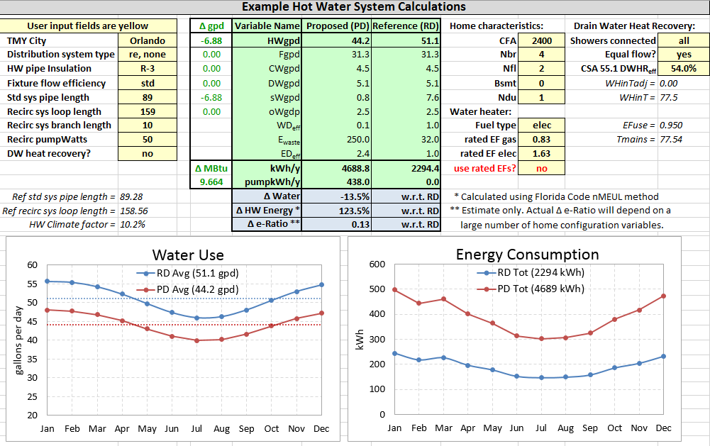
Progress to Date
Interactive Hot Water System Calculator (Draft)

Slide 12
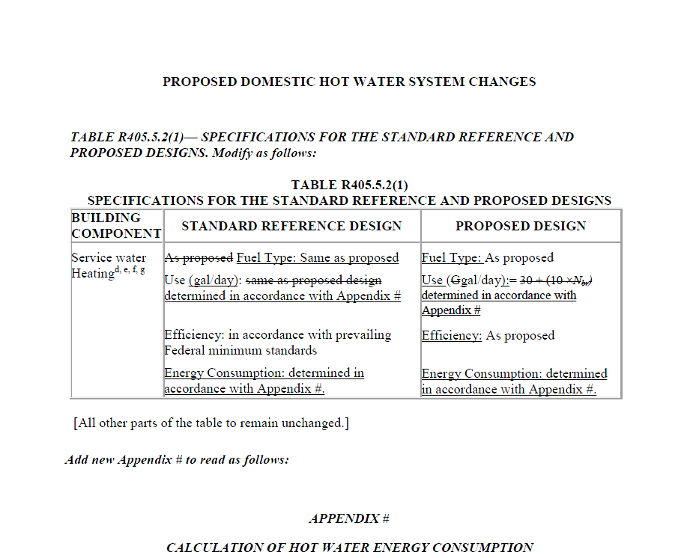
Progress to Date
Proposed Code Change Language (Draft)

Slide 13
Next Steps
Task 3: Compare hot water energy use for 2, 3, and 4-bedroom homes in Miami, Orlando and Jacksonville calculated with new procedures vs. use determined by current code calculation
Task 4: Using EnergyGauge simulations, determine and document the difference in overall energy code performance scores for two sample homes

Slide 14
Project Completion
Literature review summary
Document Task 3 and 4 results
Final report delivered by June 1st

