Slide 1
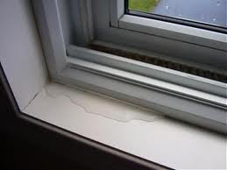

Study of Water Resistance Performance of Exterior Envelope Relating to Fenestration During Minimal High Winds
David O. Prevatt, Ph.D., PE (MA)
Associate Professor
Fenestration Water Resistance Workgroup
Florida Building Commission
18 February 2019
Hyatt Regency Jacksonville Riverfront, Jacksonville, FL

Slide 2


Acknowledgements
Dr. David O. Prevatt – Principal Investigator
Graduate Students
  Rodrigo Castillo-Perez
  Mariel Ojeda-Tuz
Dr. Jean-Paul Pinelli – Florida Institute of Technology
Support arranged by (Mo Madani) FBC through:
Building A Safer Florida (BASF)

Slide 3
Motivation and Objective
Following Hurricane Irma (2017), Workgroup Chair conducted forensic surveys of over 3,300 condo/apt units in 15 buildings 33xxx zipcode.
Observed water intrusion damage through/around fenestration, although Irma’s wind speed was much lower than design wind speed (170 mph) for area.
Question: Is there systemic problems within the Building Code that are not being addressed? Should FBC modify current provisions?

Slide 4
Scope of Work
Provide support to Workgroup deliberations and discussions
Review existing literature on water leakage through residential building envelopes by Univ. of Florida, FIU, FIT and others.
  Summarize the recommendations and conclusions
  Determine which if any recommendations are included in the Building Code.
  Provide input to Workgroup regarding benefits and costs of modifying wind-driven rain test standards
Review forensic reports water damage to units as provided to us by the Workgroup Chair
  Analyze the dataset of units – age, story height, orientation etc.
  Estimate peak wind speed and other meteorological data to estimate rain loading and wind loading on windows

Slide 5
Tasks Completed
Compile References in the Current Florida Building Code
  ASTM International (formerly American Society for Testing and Materials)
  Fenestration Manufacturers Association (FMA)
Review Water Penetration Research at UF (and other labs)
Current Standard Test Procedures for Water Resistance Testing
Water Damaged Apartment/Condominium Units Database
Florida Public Hurricane Loss Model

Slide 6


Presentation Outline
Main (Home) Slide
Click the icon to open the set of slides of each topic
Click the house icon at the right corner of the last slide in the topic to go back to the main slide

Slide 7






2
3
15 Slides
15 Slides
1
4
ASTM, FMA
Research
Normative vs
Standard Practice
Katsaros,2009
Salzano, 2010
Lopez, 2011
3 Slides
7 Slides
6
5
Florida Building Code
Standard Tests
Provisions
15 Slides
3 Slides
ASTM &
INDUSTRY
FPHLM
Data

Slide 8







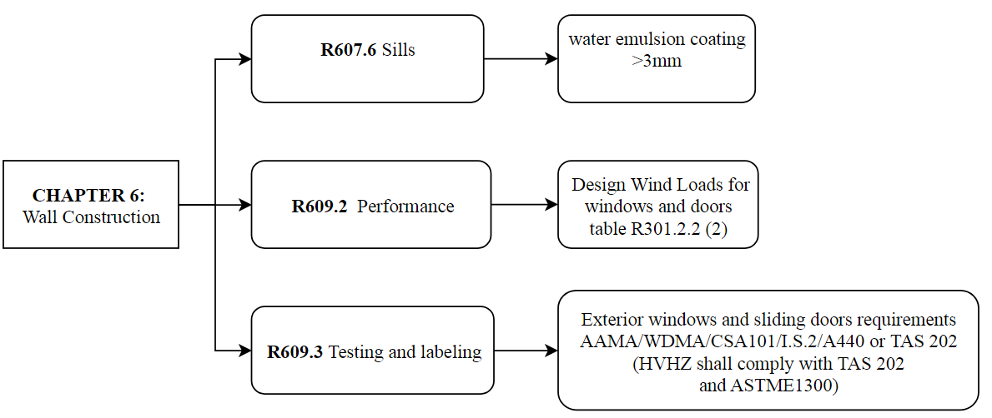
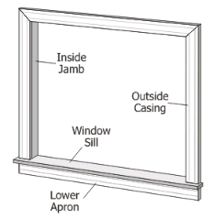
1.1

Slide 9
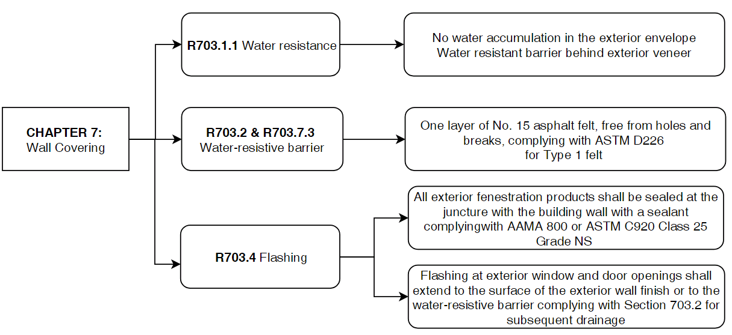
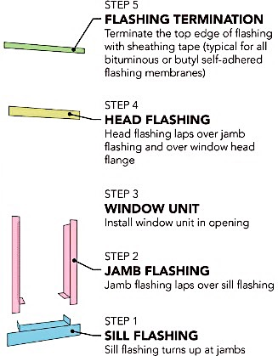
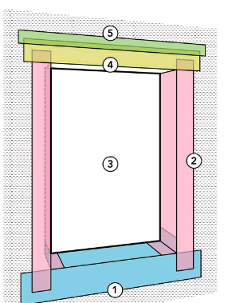
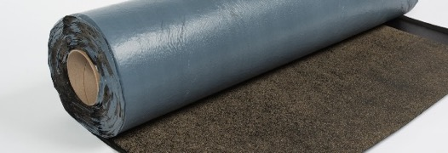
1.2

Slide 10
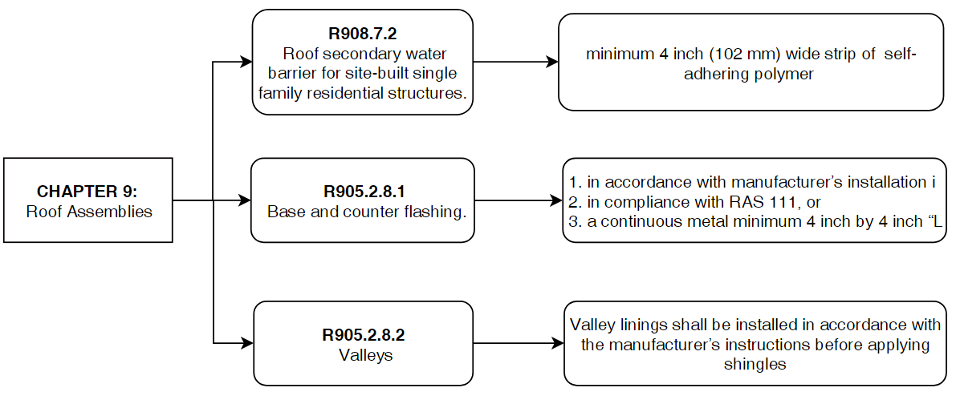
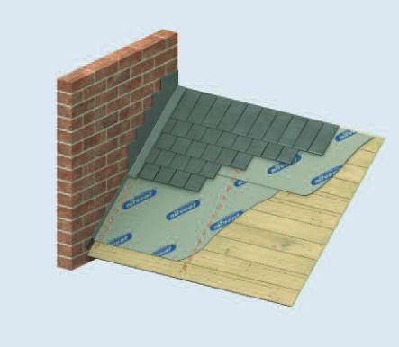
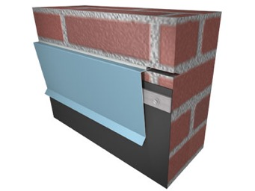
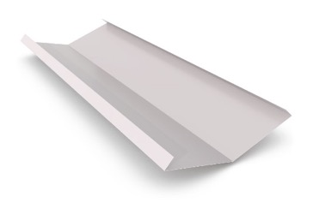
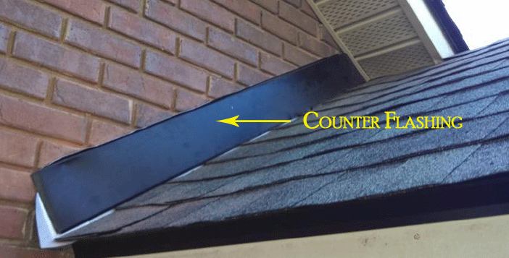
1.3

Slide 11
ASTM E2112-xx: Title
ASTM E2112
ASTM
A: Flashing Applied Over the Face of the Mounting Flange (after window installed)
A1: Flashing Applied Over the Face of the Mounting Flange (before window installed)
B: Flashing Applied Behind the Face of the Mounting Flange (after window installed)
B1: Flashing is Applied Behind the Mounting Flange (before window installed)
2.5

Slide 12
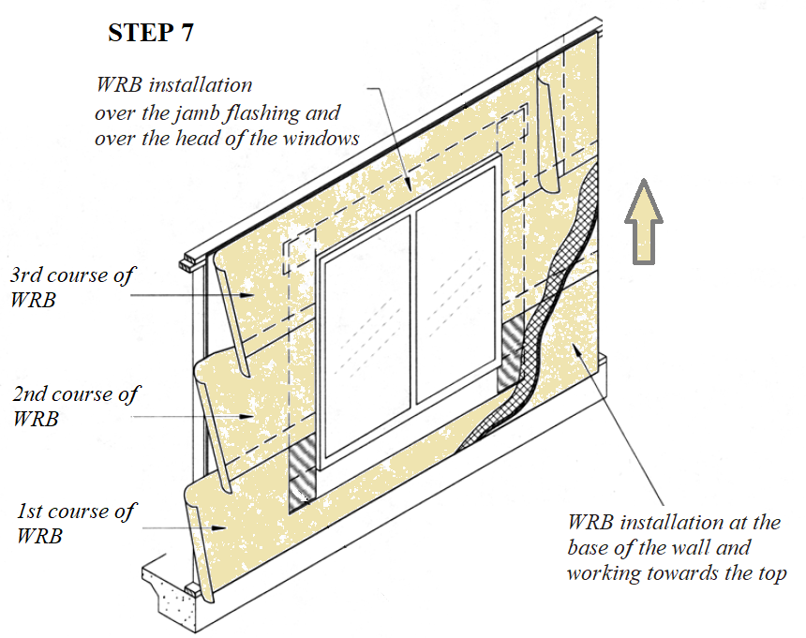
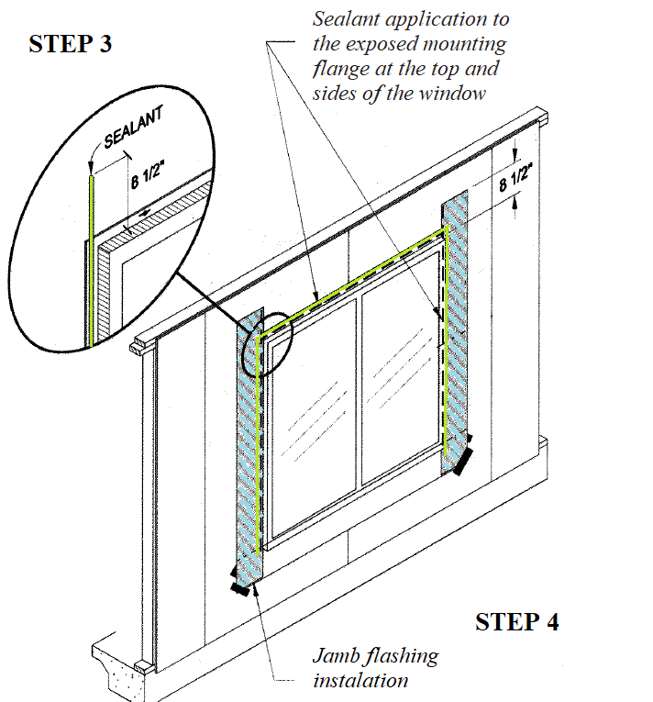
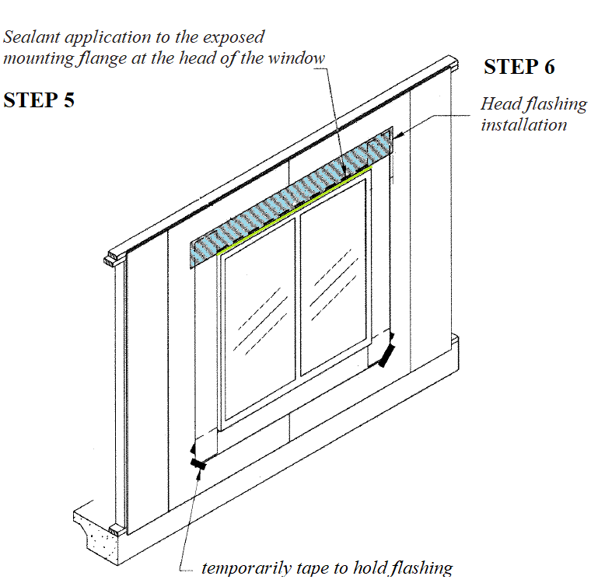
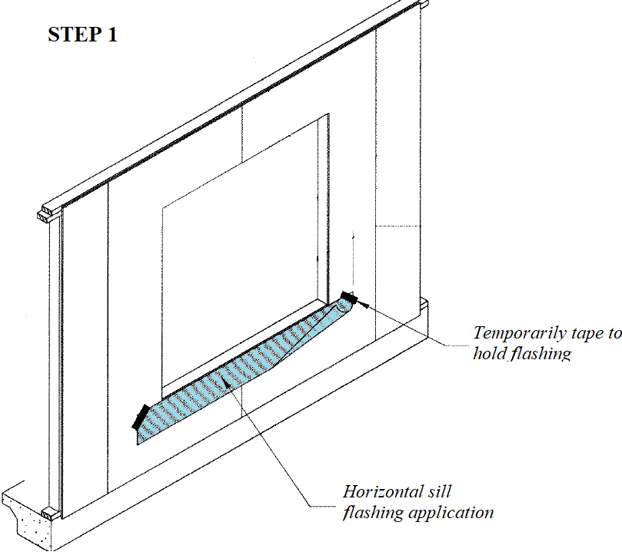
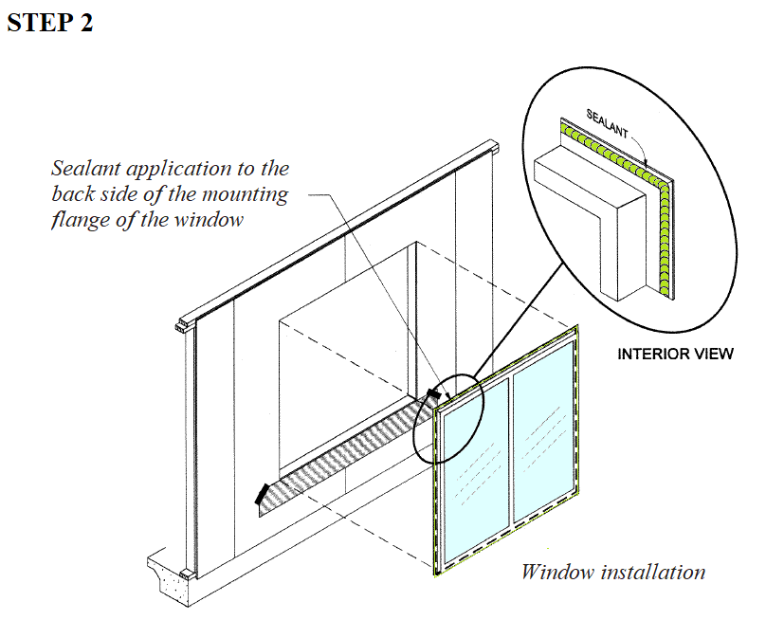
ASTM E2112
Method A
ASTM
Weather-Resistive Barrier (WRB) Applied after the Window Installation—Flashing Applied Over the Face of the Mounting Flange
2.1

Slide 13
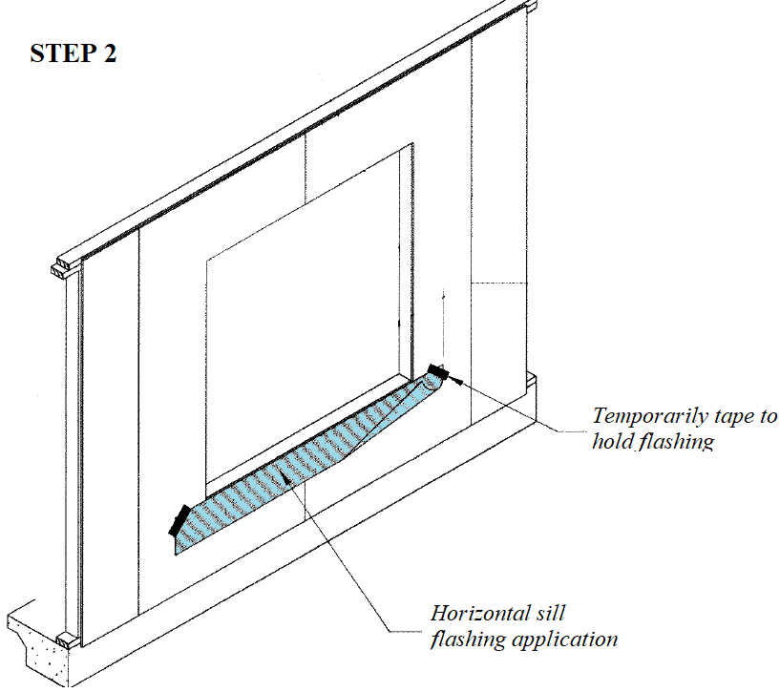
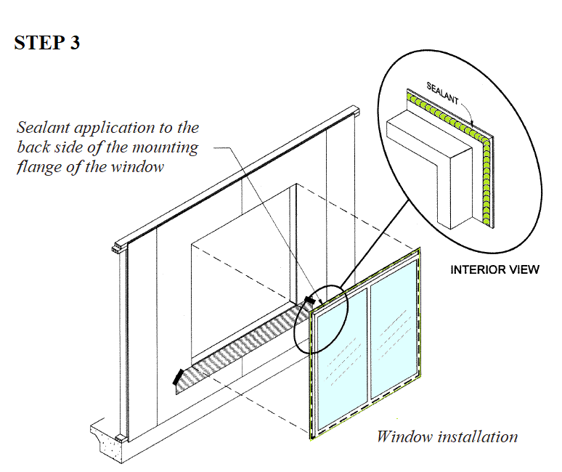
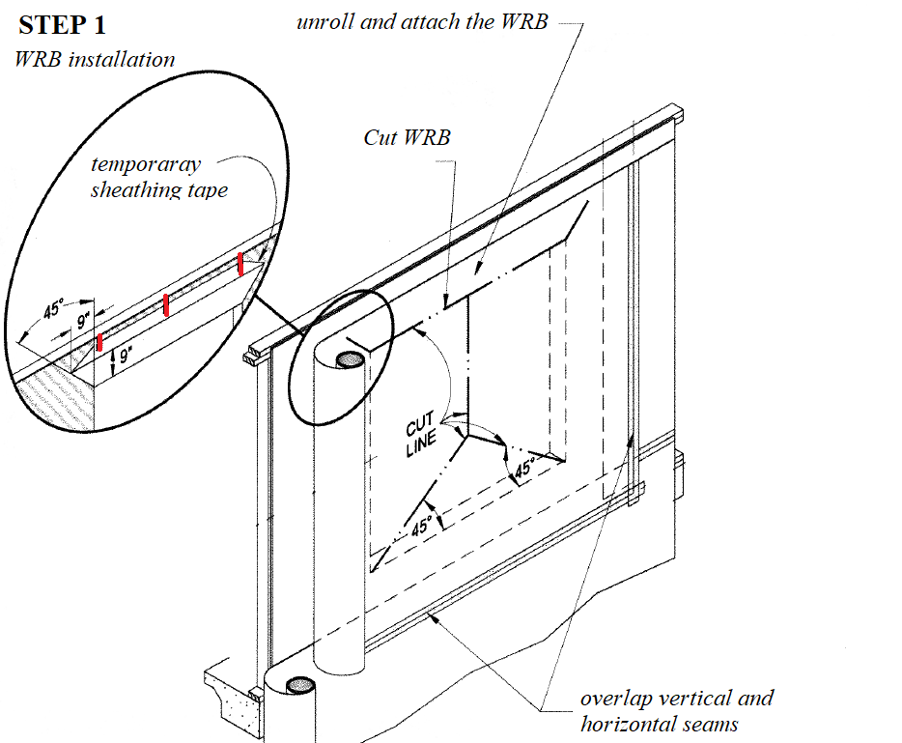
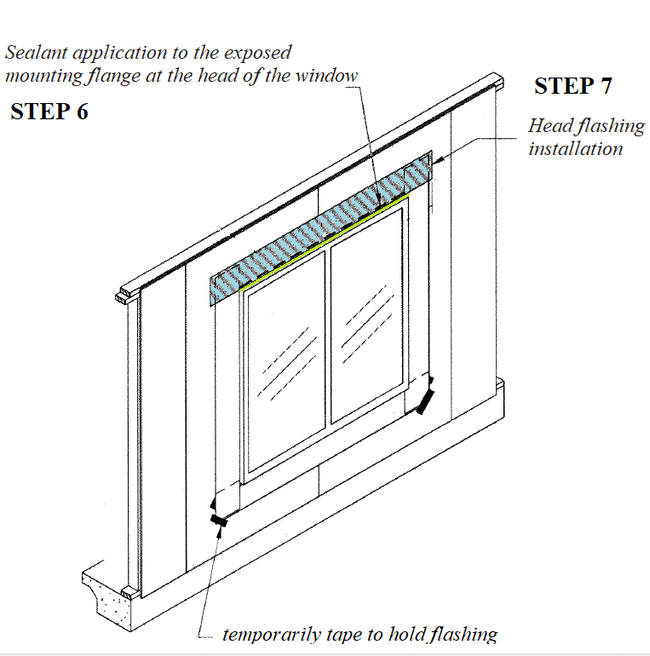
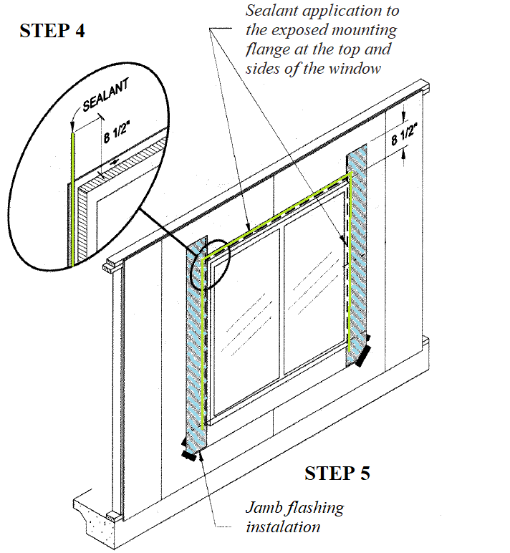
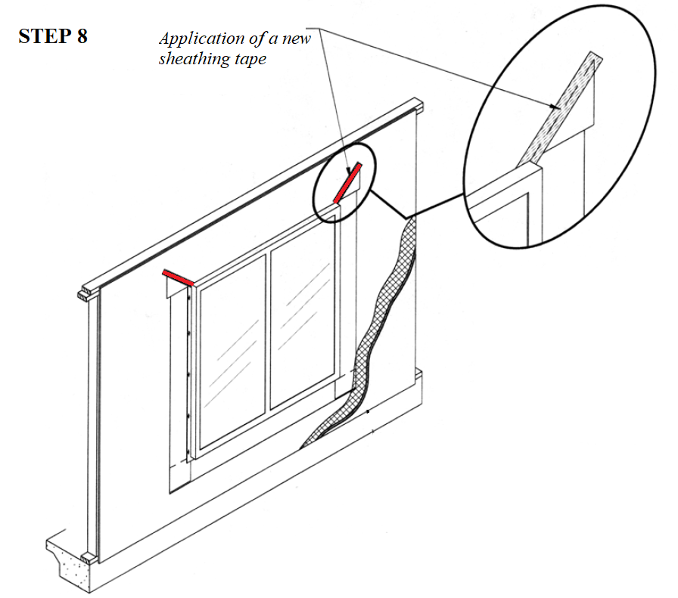
ASTM E2112
Method A1
ASTM
Weather-Resistive Barrier (WRB) Applied Prior to the Window Installation—Flashing Applied Over the Face of the Mounting Flange
of the Mounting Flange
2.2

Slide 14
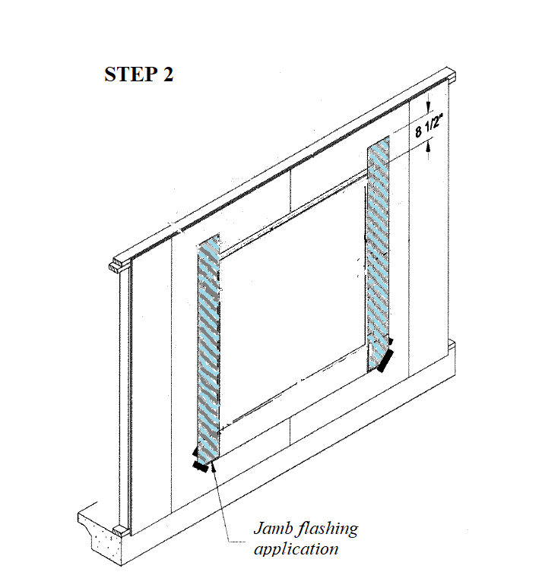
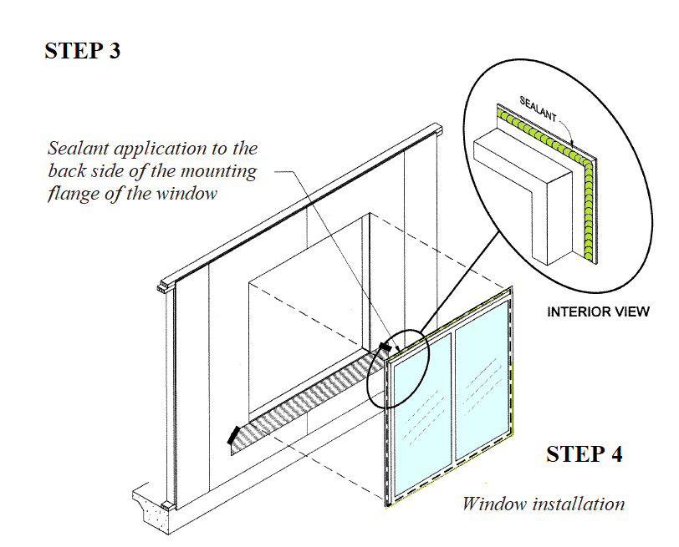

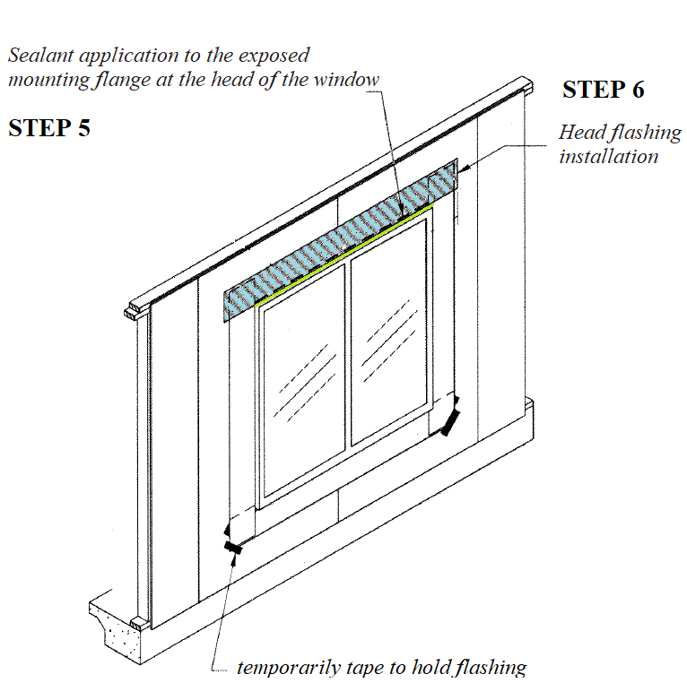
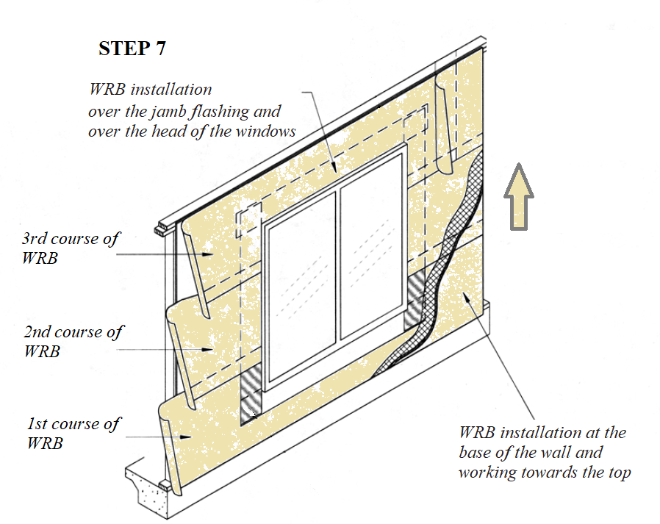
ASTM E2112
Method B
ASTM
Weather-Resistive Barrier (WRB) Applied after the Window Installation-Flashing Applied Behind the Face of the Mounting Flange
2.3

Slide 15
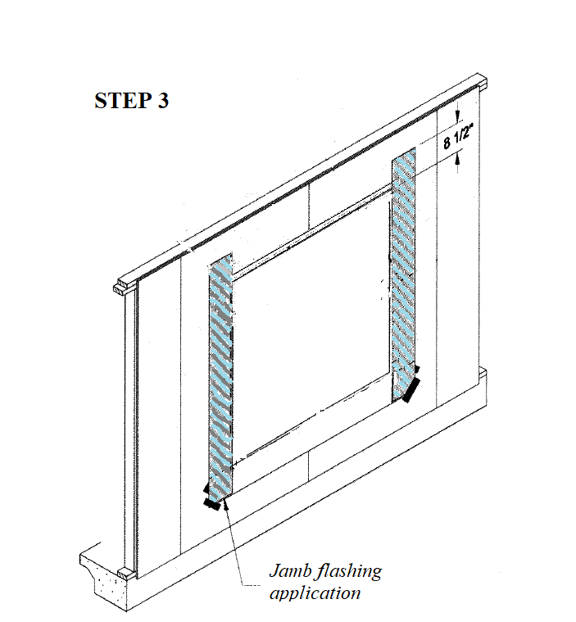
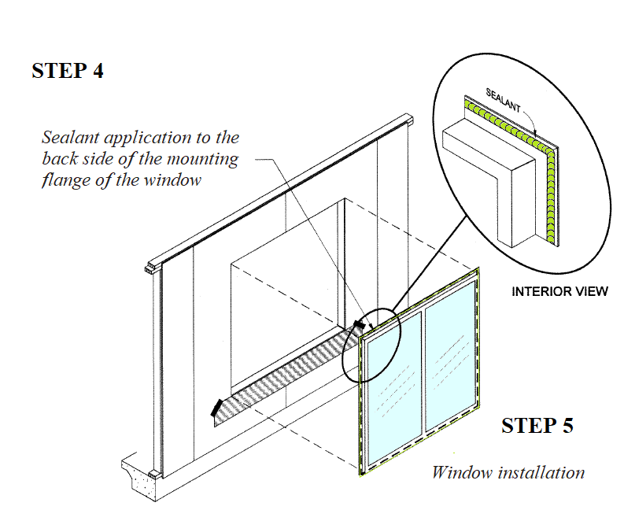
ASTM E2112
Method B1
ASTM
Weather Barrier Applied Prior to the Window Installation—Flashing is Applied Behind the Mounting Flange:
2.4

Slide 16
ASTM E2112
ASTM
COMPARISSON
Feature | Method A | Method A1 | Method B | Method B1
WRB installation sequence | After the Window Installation | Prior to the Window Installation | After the Window Installation | Prior to the Window Installation
Flashing Location | Over the Face of the Mounting Flange | Over the Face of the Mounting Flange | Behind the Face of the Mounting Flange | Behind the Mounting Flange
The same installation features considered but sequence of window and flashing installation is different
2.5

Slide 17
Fenestration Manufacturers Association
FMA/AAMA 100-12
Standard Practice for the Installation of Windows with Flanges or Mounting Fins in Wood Frame Construction for Extreme Wind/Water Conditions
FMA
Wood Systems
PRE-INSTALLATION
ROUGH OPENINGS
No more than 6 mm (1/4 in) deviation from square, height, and width and 3 mm (1/8 in) deviation from plumb shall be allowed.
WATER-RESISTIVE BARRIERS (WRB)
The WRB shall be installed prior to the window installation. Under extreme wind/water exposure, it is recommended that creating a water seal between the WRB and sheathing at the window rough opening.
TWO LAYER WRB SYSTEMS
A two-layer WRB or building paper (BP) system shall be used in accordance with state and local codes for extreme weather. The window shall be flashed/integrated with inner layer WRB.
2.6

Slide 18
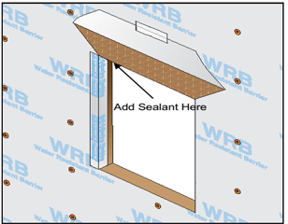
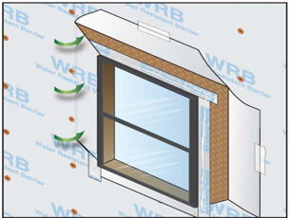
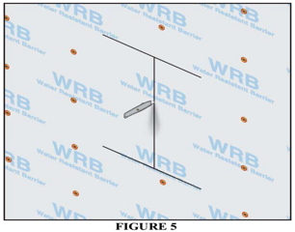
Fenestration Manufacturers Association
FMA/AAMA 100-12
FMA
Wood Systems
WRB INSTALLATION
WRB Method A
1. Box cut WRB
2. Seal with self-adhered flashing
3. Apply sealant at jamb/head interface
WRB Method B
(Integration after Window is installed)
1. Box cut WRB
2. Cut each jamb corner.
3. Fold back jamb
4. Apply sealant along jamb
5. Integrate WRB to self-adhering flashing
WRB Method C
1. I-Cut of WRB
2. Apply sealant onto sheathing
3. Wrap into cavity
4. Attach the WRB .
2.7

Slide 19
Fenestration Manufacturers Association
FMA/AAMA 100-12
FMA
Wood Systems
SILL AND FLASHING INSTALLATION
Rough opening wood sill area is clean
Cut jamb a proper length to form end dams
Cover the sill
WINDOWS INSTALLATION
Inspect and clean windows
Run a proper diameter bead of sealant on the back surface
Apply a discontinuous bead of sealant on the interior surface
For rigid or semi-rigid sill pan ,apply a continuous bead of sealant
Set the window in the opening
Hold the window into position and apply shims
2.8

Slide 20
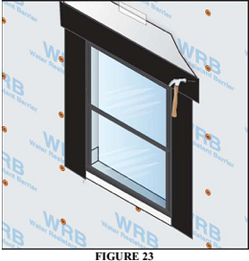
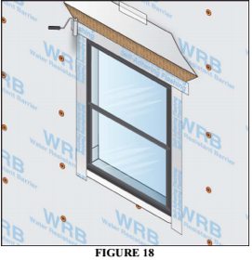
Fenestration Manufacturers Association
FMA/AAMA 100-12
JAMB AND HEAD FLASHING INSTALLATION
FMA
Wood Systems
Mechanically attached flashing installation
Apply a continuous bead of sealant.
Apply jamb flashing in line
Apply mechanically attached flashing to head
Self adhering flashing installation
Apply flashing of the window.
Cut the jamb flashing and adhere the top end of the flashing
Use firm pressure to adhere the self-adhering flashing
2.9

Slide 21
Fenestration Manufacturers Association
FMA/AAMA 100-12
FMA
Wood Systems
POST-INSTALLATION Procedures
Verify that the window frame and the sash are installed plumb, level square and true, within the specified tolerances
Check free movement of operable Elements
Verify smooth operation of locks, cranks, latches and hinges
Verify assembly of all accessories.
Verify blockages or obstructions in drainage holes
2.10

Slide 22
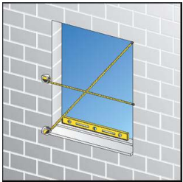
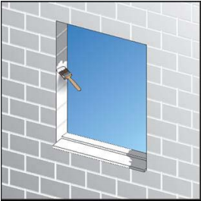
Fenestration Manufacturers Association
FMA/AAMA 200-12
STANDARD PRACTICE FOR THE INSTALLATION OF WINDOWS WITH FRONTAL FLANGES FOR SURFACE BARRIER MASONRY CONSTRUCTION FOR EXTREME WIND/WATER CONDITIONS
FMA
Masonry Systems
PRE-INSTALLATION
Inspect defect of masonry rough opening and remedy any discrepancy..
Check that the size satisfied window manufacturer’s instruction
Verify that sill was installed correctly.
Treat the masonry opening with flashing to against water intrusion.
2.11

Slide 23
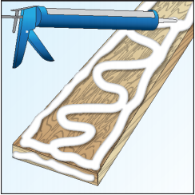
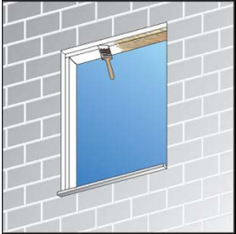
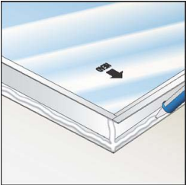
Fenestration Manufacturers Association
FMA/AAMA 200-12
FMA
Masonry Systems
INSTALLATION
Limiting buck edge gaps
No edge gaps exceeding 3mm (1/8 in) between the buck and the masonry sill member
Smoothing buck surfaces
Apply liquid flashing or sealant to all buck surfaces
Coating buck face
Exterior face of buck and the return surface of the jambs shall be coated with a liquid applied flashing
Sealing up window edges and corners
Run a continuous 9 mm (3/8 in) nominal dimeter bead of sealant.
Apply discontinuous bead of sealant on the interior surface of the flange at the sill or
Apply continuous bead of sealant on all four sides of the interior surface of the flange or exterior edge of the buck
Modification
Make sealant surface flat, cut excess shim material.
2.12

Slide 24
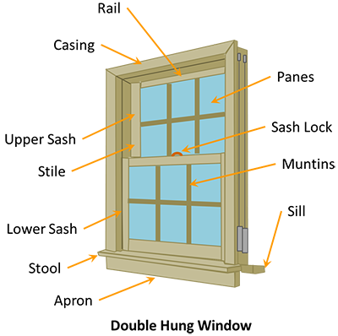
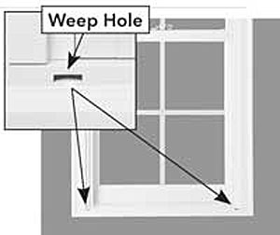
Fenestration Manufacturers Association
FMA/AAMA 200-12
FMA
Masonry Systems
POST-INSTALLATION
Verify window frame and sash are installed plumb, level, square and true within the manufacturer’s specified tolerances
Verify operable sashes can move freely within their frames and that weather-stripping or compressible seals make full contact with mating surface
Inspect blockages in drainage holes
Check location conflicts for window’s weep holes
Verify continuity of sealant joints
2.13

Slide 25
Fenestration Manufacturers Association
FMA/AAMA 200-12
FMA
Masonry Systems
“The techniques demonstrated in this standard practice have been developed specifically to restrict liquid water from entering through the masonry opening and/or around the perimeter of the window frame. The major emphasis is focused on sealing the surrounding area of the window’s masonry opening in such a manner as to restrict liquid water from penetrating the wall at the window opening.”
2.14

Slide 26
Fenestration Manufacturers Association
FMA/AAMA 200-12
FMA
COMPARISSO – CHECK YOUR SPELLING!!
N
FEATURE | FMA/AAMA 200/100 | ASTM E2112-07
Requires that the window rough opening be drainable through the use of sill pan flashing under the fenestration unit. | ✓ | Recommends the use of sill pans.
Specifies that a perimeter air seal between the window frame and the rough opening be installed at or near the interior edge of the window frame. | ✓ | ✗
Includes details on specific installation steps for self-adhering as well as pictorial illustration of the installation steps. | ✓ | ✗
2.15

Slide 27
Fenestration Manufacturers Association
FMA/AAMA 200-12
FMA
COMPARING ASTM E2112 VS. FMA STANDARDS
FEATURE | FMA/AAMA 100/200 | ASTM E2112-07
Window rough opening must be drainable through sill pan flashing under the fenestration unit. | ✓ | Sill pan use is recommended.
Install a perimeter air seal between window frame and rough opening at or near interior edge of the window frame. | ✓ | ✗
Specific installation steps for self-adhering as well as illustrations of installation | ✓ | ✗
2.15

Slide 28
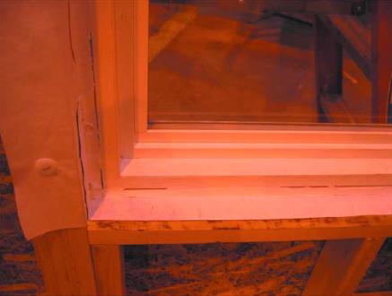
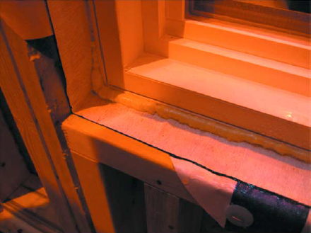
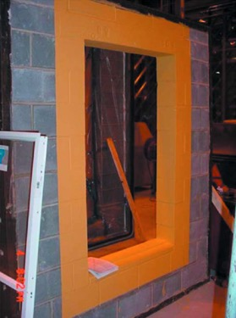
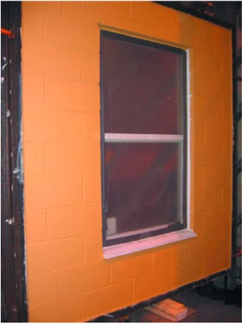
01
Research: Katsaros, J. D., and Carll, C. G. (2009). "Extreme Exposure Fenestration Installations—The Florida Challenge." Journal of ASTM International, 6(5), 1-17
Test Variables
Objective
Outcome
Investigates construction of 1st floor surface barrier CMU walls & 2nd floor membrane-drainage, wood walls.
FMA’s Installation Committee goal to o develop installation guidelines for Florida construction
Fabricated per proposed installation methods
w/w interfaces.
Two wall systems investigated
  CMU
  Wood
Conducted at ATI facilities, PA (Warner and McGill)
Two general guide documents:
FMA/AAMA 100
  Pressure differential
  Thermal Cycling
FMA/AAMA 200
  Pressure differential
  Thermal Cycling
3.1

Slide 29
Experimental Setup
FMA 100
Normative | Window system | Wall system |  | Differences
FMA/AAMA 100 TEST | Flange Mounting Fins | Wood Frame | Wall #1 | self-adhering flashing and polyurethane hybrid sealant
 |  |  | Wall #2 | mechanically attached flashing and low expansion polyurethane foam air sealant
FMA/AAMA 200 TEST | Frontal Flanged | Surface Barrier CMU | Phase 1: test around sealed exterior perimeter area only | water applied only to sealed area of the 230 mm thk. CMU wall up to exterior perimeter of rough opening
 |  |  | Phase 2: test entire wall | Mask (plastic sheet) removed to enable entire wall exposure and water test
FMA 200
Two general installation methods proposed by the Installation Committee and test data for wall assemblies
3.2

Slide 30
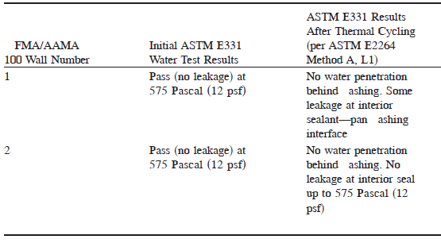
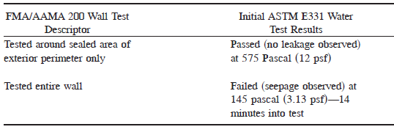
Experimental Results
3.3

Slide 31
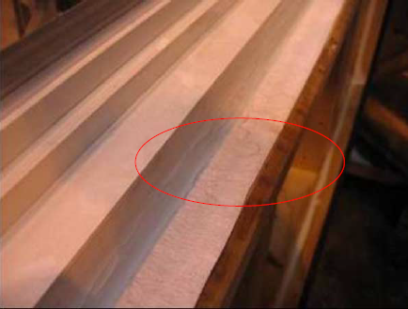
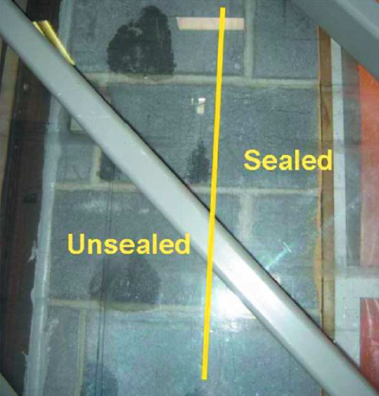
Observations
Water leak formed at 11.29 psf on FMA/AAMA 100 Wall #1
(Katsaros & Carll 2009)
Sill pan
Sealant
FMA/AAMA 200 water seepage through the internal portion of the block at unsealed area
The sill pan flashing suggested by FMA/AAMA 100 and 200 were found to be effective to reduce water penetration which was not observed between the pan and the window bottom flange (where there was not a continuous seal).
Leaks were observed in areas where adhesion between the window frame and the sill pan was not sufficient.
A “whole wall” approach to water management appears necessary due to observed water seepage through the internal portion of the block at unsealed area, but not at in the sealed area.
3.4

Slide 32
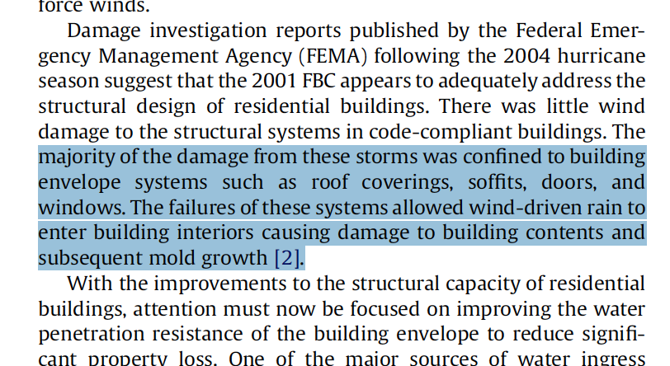




02
Research: Salzano, C. T., Masters, F. J., and Katsaros, J. D. (2010). "Water penetration resistance of residential window installation options for hurricane-prone areas." Building and Environment, 45(6), 1373-1388.
Objective
Variables
Loading
investigate water penetration resistance of current window installation options of single-family houses
Unique combination of fenestration.
Installation methodology.
Wall structural system
Exterior finish.
University of Florida (Masters)
Static air pressure.
The cyclic static air pressure.
The dynamic pressure.
3.5

Slide 33
Research Oversight Committee
Alside;
American Architectural Manufacturers Association;
American Forest & Paper Association (AFPA);
APA–The Engineered Wood Association;
Architectural Testing, Inc.;
Atrium Companies, Inc.;
Cast-Crete Corporation;
C.B. Goldsmith and Associates, Inc.;
CEMEX;
Certified Test Labs;
Do Kim & Associates;
DuPont;
Fenestration Manufacturers Association (FMA);
Florida Building Commission;
Florida Home Builders Association (FHBA);
General Aluminum;
Henkel;
Institute for Business and Home Safety (IBHS);
James Hardie;
JBD Code Services;
JELD-WELD Windows and Doors;
Lawson Industries, Inc.;
Marvin Windows and Doors;
Masonry Information Technologists, Inc.;
MI Windows and Doors;
NuAir Windows and Doors;
Painter Masonry, Inc.;
PGT Industries; PPG Industries;
Protecto Wrap Company;
Silver Line Windows and Doors;
Simonton Windows;
TRACO;
WCI Group, Inc.
Supported by the National Science Foundation (CMMI- 0729739) and the Florida Building Commission.

Slide 34

Experimental Setup
Wall material | Wall finish | Window dimension (cm) | Window material | Operator type | Installation standard | Installation method | Sealant | Flashing
Wood CMU | Stucco FCB DC | 110.5 x 158.8 120.7 x 74.9 | Aluminum Vinyl | Fixed Hung Awning | ASTM E2112 FMA/AAMA 100 FMA/AAMA 200 | Barrier method Drainage method | backer rod & gunnable sealant low expansion foam | 101.6 mm self-adhered flashing 228.6 mm mechanically attached flashing liquid applied flashing
3.6

Slide 35

Experimental Results
3.7

Slide 36



Observations
Contrary to the water barrier method, the drainage method installations did not perform well on the CMU wall specimens tested due to discontinuity between the water shedding surface and the exterior moisture barrier of the window-wall system.
Windows installed into the wood frame walls, both water barrier and drainage installation methods provided sufficient water penetration resistance due to adequate continuity of the critical barriers.
3.8

Slide 37


Observations
Low expansion foam seals prevent leakage for pressures up to 4788 Pa (100 psf) , but only if the excess of foam is not trimmed.
In fact, if the excessive foam is trimmed, its does not present any water resistance.
Selecting an appropriate sealant is paramount to water penetration performance found to work the best.
3.9

Slide 38


03
Research: Lopez, C., Masters, F. J., and Bolton, S. (2011). "Water penetration resistance of residential window and wall systems subjected to steady and unsteady wind loading." Building and Environment, 46(7), 1329-1342.
Objective
Variables
Loading
Investigate the diagnostic ability of standard static & cyclic) water penetration tests
Quantify water ingress rates of operable, sliding windows under wind tunnel derived wind load time-history
Geometric properties of the leakage path
Material properties
Orifice frictional losses
Flexibility of the components
Internal (differential) pressure
Static & Rapid-pulsed testing
Amplitude-, & frequency-modulated sinusoidal sequences
Repeat specimen of static test to ensure no permanent damage
Recommends enhanced test approach to evaluate system-level performance
3.10

Slide 39





Slide 40
Experimental Setup
Part 1: application of static and rapid pulsed loading and simulated rain to residential wall
Wall material | Wall finish | Window dimension (cm) | Window material | Test operator
Wood | Stucco | 121 x 75 | Aluminum | Fixed
CMU | FCB | 90 x 151 | Vinyl | Casement
 | DC | 110 x 159 |  | Hung
 |  | 159 x 110 |  | Horizontal sliding
 |  |  |  | Awning
Part 2: application of static and fluctuating pressure loading and simulated rain to single hung
and horizontal slider windows
Glazing type | Glass thickness | Window dimension (cm) | Window material | Test operator | Wind angle
Single annealed | 3.1750 | 91w x 152h | Aluminum | H | 55 (Cornering)
Laminated dual glazed | 4.7625 | 152w x 91h |  | HS | 80 (Perpendicular)
Note:
FCB: fiber cement siding board
DC : decorative cementitious coating
3.11

Slide 41



Pressure Test Sequences
1
2
3
4
Fig. 8. Load sequence, which is comprised of four segments: static, peak fluctuating (black), maximum mean fluctuating (gray), and a repeat of the static to determine if the window specimen was damaged during the sequence.

Slide 42



Experimental Results
3.12

Slide 43

Observations: Residential wall assemblies
Compression sealed windows are better performers than sliding sealed windows (greater water leakage in sliders)
Water leaks occurs through the window/wall interface
Water tightness of interface joints is crucial for good water tightness of the window system.
A differential pressure of 600 Pa or more window/wall systems exhibit first sign of leaks in dynamic environment
Rapid pulse test loads caused formation of more leakage paths than the static pressure test.
3.13

Slide 44
Observations: Single hung and horizontal slider windows
Sill dam height is critical in reducing rate of water leaks into the interior of building. The sash-to-sill and sash-to-jamb interfaces only partially sheds water;
Water penetrates or fills the air void underneath the sash and rises in proportion to the exterior pressure
Substantial leakage (1 litre/min) will occurs once the mean pressure exceeds the hydraulic pressure required to raise a column of water up to the vertical distance between the bottom of the sash and the top of the sill dam
3.14

Slide 45



04
Research: Beers, P. E., and Smith, W. D. (1998). "Repair Methods for Common Water Leaks at Operable Windows and Sliding Glass Doors." Water Leakage Through Building Facades, ASTM International.
Reasons for leakage Sliding Systems
1. Percolation
Occurs during wind driven rain storms and is observed as water bubbling or spraying through the assembly. When air infiltration occurs through a sill with a water head, it causes some of the water to be blown to the inside.
2. Seepage Through the Sill
Sliding glass door tracks are anchored to the structure with fasteners. Each fastener requires a hole to be drilled or punched in the sill. Naturally, each of these holes provides an opportunity for water infiltration, if not properly sealed.
3. Perimeter Sealant Leaks
Perimeter Sealant Leaks occur when sealants are omitted, improperly installed, or when the sealant material is beyond its useful life and in need of replacement.
A series of tests and repairs is necessary before a successful method is found, test method of ASTM E1105 is recommended.
3.15

Slide 46
01
Standard
02
Tests
03
Summary
04
05
06
Water Intrusion
ASTM
4.1

Slide 47

Modified AAMA 501.1
Dynamic Wind Generation to Simulate Wind-Driven Rain in Windows, Curtain Walls, Architectural Metal Walls, Masonry, EIFS, and Concrete Facades
This approach applies a regulated wind source and calibrated spray rack to simulate a given wind/rain event
01
Standard
02
Tests
03
Summary
04
05
06
Water Intrusion
ASTM
4.2

Slide 48


D226/D226M—17
This specification covers asphalt-saturated organic felts, with or without perforations
Determine the openness of the perforations in saturated felts
01
Standard
02
Tests
03
Summary
04
$$v=\frac{P x A x H}{S}$$
05
06
Water Intrusion
ASTM
4.3

Slide 49

ASTM E331 - 00(2016)
Standard Test Method for Water Penetration of Exterior Windows, Skylights, Doors, and Curtain Walls by Uniform Static Air Pressure Difference
ASTM E547 - 00(2016)
Cyclic Static Air Pressure
ASTM E2268 - 04(2016)
Rapid Pulsed Air Pressure Difference
The ASTM E 331 testing is performed by applying water to the exterior of the test specimen while lowering the pressure inside by means of an air chamber built on the inside or opposite side of the test specimen.
01
Standard
02
Tests
03
Summary
04
05
06
Water Intrusion
ASTM
4.4

Slide 50

ASTM STP 1314
Hose Test
Hose tests is much simpler than other test. In order to perform a hose test, one only needs a diameter of 19 mm (3/4 in.) garden hose, a special nozzle, a valve to control the water flow, a water pressure gauge, and an observer stationed on the interior side of the test area to look for leaks.
01
Standard
02
Tests
03
Summary
04
05
06
Water Intrusion
ASTM
4.5

Slide 51

Probe Method
Probe method for moisture involves using a penetrating probe meter to test for moisture within the walls, floors or ceilings according to the electrical resistance. To do this, small holes-about 3/16 of an inch-must be drilled into the building material. The holes are small and undetectable.
01
Inspection
02
Tests
03
Summary
04
05
06
Water Intrusion
RJF Environmental Consulting Services, Inc.
4.6

Slide 52

Infrared Thermography
Thermography is a non-invasive technology that uses infrared cameras to "see" into the walls of the structure for damage-free moisture detection.
It will photograph the structure using an infrared camera, which picks up what we recognize as heat.
01
Inspection
02
Tests
03
Summary
04
05
06
Water Intrusion
RJF Environmental Consulting Services, Inc.
4.7

Slide 53

Buildings and numbers of units experiencing water intrusion issues with little or no wind damage.
Building | Constructed date | Total Units | Inspected Units | Percentage of inspected units | Height (Stories) | Zip Code | Orientation
A | 1999 | 195 | 195 | 100% | 32 | 33305 | N-S
B | 1973 | 269 | 115 | 43% | 19 | 33019 | E-W
C | 2008 | 193 | 192 | 99% | 17 | 33062 | N-S
D | 1981 | 430 | 430 | 100% | 19 | 34145 | E-W
E | 1982 | 200 | 140 | 70% | 26 | 33140 | N-S
F | 1970 | 201 | 201 | 100% | 16 | 33062 | N-S
G | 1974 | 378 | 5 | 1% | 22 | 33432 | E-W
H | 1977 | 145 | 145 | 100% | 22 | 33009 | E-W
I | 1966 | 336 | 251 | 75% | 6 | 33160 | E-W
J | 1971 | 110 | 19 | 17% | 11 | 33304 | N-S
K | 2005 | 135 | 135 | 100% | 28 | 33019 | E-W
L | 1968 | 51 | 0 | 0% | 7 | 33019 | E-W
M | 1980 | 36 | 4 | 11% | 10 | 33137 | E-W
N | 2006 | 384 | 350 | 91% | 42 | 33131 | N-S
O | 1982 | 246 | 16 | 7% | 27 | 33138 | E-W
5.1

Slide 54



Locations
5.2

Slide 55

Wind Design Wind Speed
5.2

Slide 56

130
140
150
160
170
State of Florida’s
Design Wind Speed vs. Irma Winds
Category II (3-sec. gust)
180

Slide 57



Preliminary Analysis of Water Damaged Units
Percentage of units inspected
Year of construction
Number of Stories
5.3

Slide 58



Commercial Residential Model
FPHLM v6.3
Florida Public Hurricane
Loss Model
Jean-Paul Pinelli, Ph.D.
Florida Institute of Technology
pinelli@fit.edu
6.1

Slide 59
Florida Public Hurricane
Loss Model
Florida Office of Insurance Regulation funded Florida International University to develop a public hurricane loss model for assessing hurricane wind risk and predicting insured losses for residential properties.
The model had to meet 33 major standards in meteorology, engineering, actuarial science, statistics, and computer science
Model first certified in 2007 by the Florida Commission on Hurricane Loss Projection Methodology----the gold standard for such models.
Version 6.2 was certified in 2017.
Deemed to be “accurate and reliable” for predicting insured residential losses in Florida
6.2

Slide 60



Variety of mid/high-rise buildings: 4+ stories mainly condominium buildings
6.3

Slide 61


Mid-high rise buildings characterization
Closed Building
Open Building
6.4

Slide 62

MHRB
Characterization for Modular Approach
Opening Type | Unit type | Quantity* | Dimensions [m] | Total openings Area [m²]
Windows | Corner/Closed | 6 (7) | 1.5 × 1.2 | 11 (13)
 | Corner / Open | 7 (8) | 1.5 × 1.2 | 13 (14)
 | Middle / Closed | 3 (4) | 1.5 × 1.2 | 5 (7)
 | Middle / Open | 4 (5) | 1.5 × 1.2 | 7 (9)
Entry Door | All | 1 | 0.9 × 2 | 1.8
Sliding Door (none) | All | 1(0) | 1.5 × 2 | 3 (0)
*values in parentheses indicate quantity when no sliding door is present
Apartment types
according to location
Number of openings per apartment type
6.5

Slide 63
MHRB
Apartment Modules Definition
Different modules based on:
Building layout (open/closed)
Position of the apartment (Corner/middle)
Base area
Story height (debris hazard)
Opening type (window, door, slider)
Slider or no Slider present
Opening protection (with or without shutters or impact resistant glass)
6.6

Slide 64
Modular approach:
Building treated as collection of apartment units
Type: e.g., Enclosed building, Corner Unit, No shutters, 6 windows
Selected components
  Windows
  Entry Door
  Sliding Door
Action
  Pressure
  Impact
State
  Undamaged
  Damaged but not breached
  Damaged and breached
6.7

Slide 65


Model has vulnerability and damage functions for apartments and openings with and without Impact resistant glass.
Vulnerability Curves
Breached Area Curves
corner/open apartment with slider in the high debris impact zones with non-impact resistant openings (blue) vs. impact resistant opening (red)
6.8

Slide 66

Vulnerability Model of mid/high-rise buildings (MHRB)
Model can estimate the water intrusion through defects and breaches of the envelope (e.g. fenestration) and convert the water intrusion into damage.
See boxes 8 to 11
6.9

Slide 67
Outline for FPHLM with Workgroup
The FPHLM can estimate the hurricane vulnerability of mid/high rise buildings. It includes:
An interior damage model based on a mechanistic model of rain intrusion, including:
  • Deficiencies as a non-negligible damage source @ low wind speeds;
  • Water penetration through all envelope components;
  • Water percolation from story to story; and,
  • Conversion of water accumulation into interior damage.
Hurricane Irma damage data collected can be used to calibrate the model
Once calibrated the model can be used to estimate the benefits/cost ratios of possible mitigation measures
6.14

Slide 68

Hurricane Irma
6.10

Slide 69
Plan of Action - 1
Obtain the locations of the buildings with damage, and the location of the units with damage, within each building (i.e. story height)
Run the wind model of the FPHLM for Irma’s scenario to obtain the wind speeds at the building locations, with their variation with height.
From the wind speeds, obtain the estimate of total wind-driven rain at every building location
6.11

Slide 70
Plan of Action - 2
For each building, use the FPHLM MHR model to compute the estimated interior damage based on wind speed and wind-driven rain.
Compare the results of the model with the observed damage
Calibrate the model against the observed damage (from Workgroup)
6.12

Slide 71
Plan of Action – (Future Studies) beyond scope
Propose new wind-driven rain test standards.
Propose mitigation measures and estimate their cost
Extract study data to improve the FPHLM:
  Incorporate the mitigation measure into the FPHLM
  Quantify the benefits of the mitigation as the difference between the damage without and with mitigation action.
  Do a preliminary benefit/cost analysis on selected apartment buildings
6.13

Slide 72
Remaining Work
Interim report by 15 March 2019
  Support Workgroup as necessary
  Participate in Workgroup meetings
Final report by 15 June 2019
  Recommendations for future studies

Slide 73
Thank You for Your Attention!
David O. Prevatt
dprev@ufl.edu

