Slide 1
Fenestration Water Performance
Presented by: Jaime D. Gascon
Miami-Dade-County

Slide 2
Outline
FBC Fenestration Perimeter Seal Requirements
Water Testing Exceptions
Window Walls
Sliding Glass Doors
Curtain Walls

Slide 3
FBC 6th Edition (2017) Building (HVHZ)
2411.3.1.6
The architect or professional engineer of record shall be required to detail on the drawings submitted for permit, rough opening dimensions, supporting framework, method of attachment and waterproofing procedures for all garage doors, passage doors, skylights, operative and inoperative windows in exterior walls. Said framework and method of attachment shall be designed and constructed so as to sufficiently resist the design wind pressures as outlined in Chapter 16 (High-Velocity Hurricane Zones).
Exception: When detailed engineered shop drawings, along with the notices of product approval, produced by the manufacturer’s specialty engineer and approved by the architect or professional engineer of record, are admitted at the time of permit application, which completely identifies rough openings, supporting framework, method of attachment and waterproofing procedures are prepared and bear the signature and seal of a professional engineer.

Slide 4
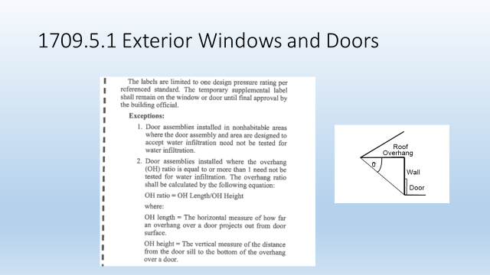

Slide 5
Window Walls
+80 psf and higher approvals (Miami-Dade and State)
Good parts detail and required product seals
Average - poor perimeter seal details

Slide 6
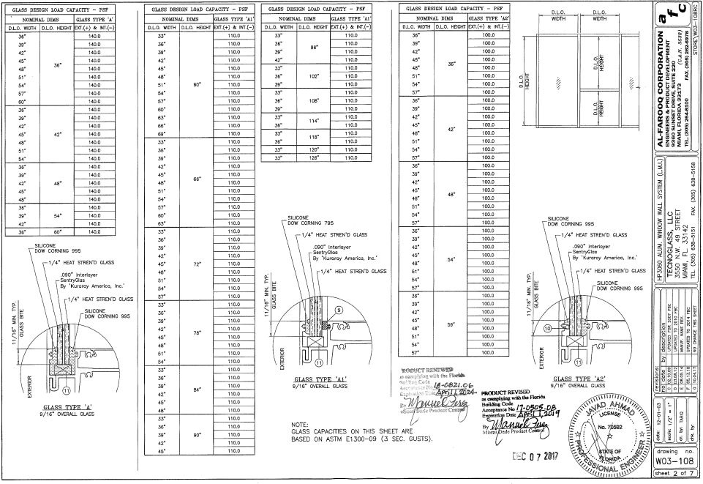

Slide 7
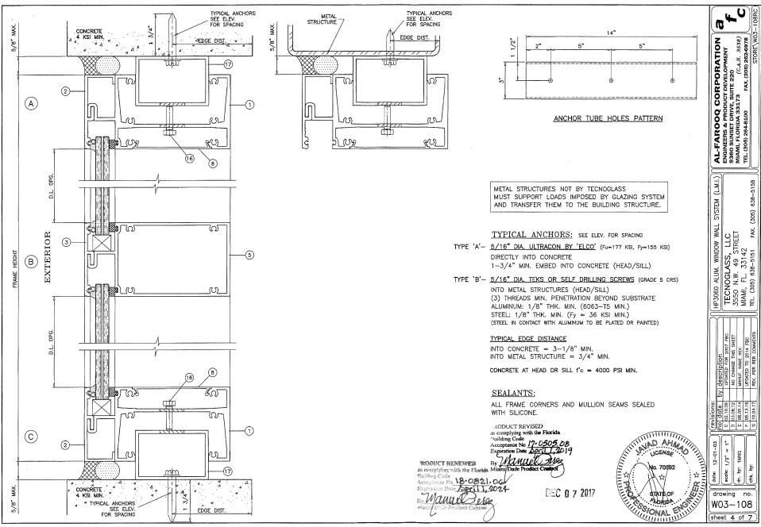

Slide 8
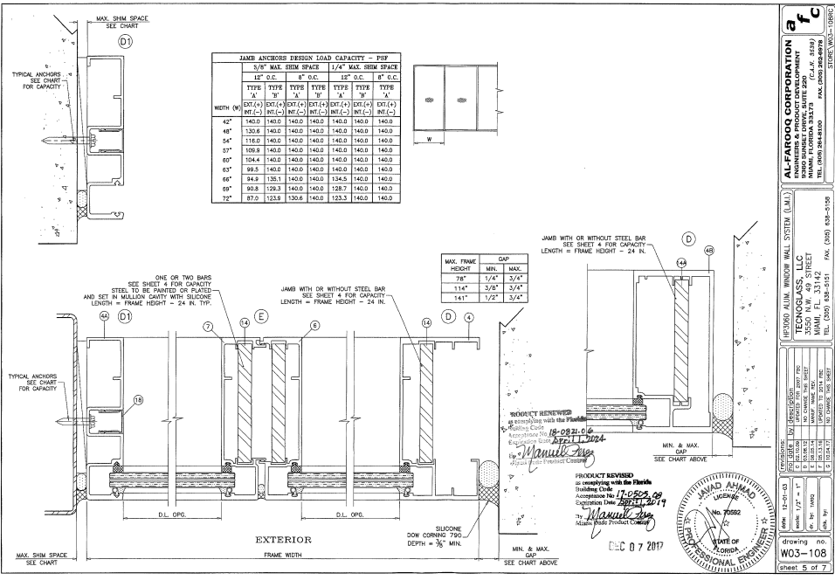

Slide 9
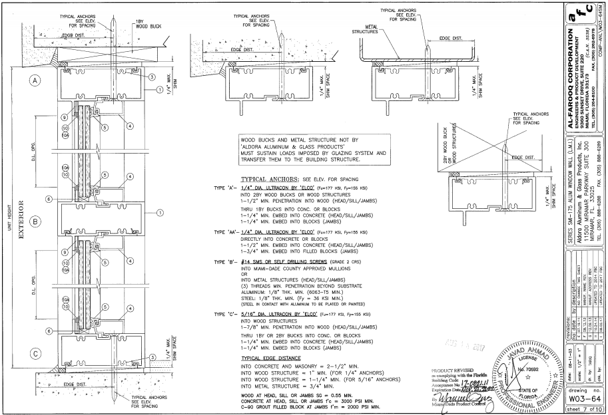

Slide 10
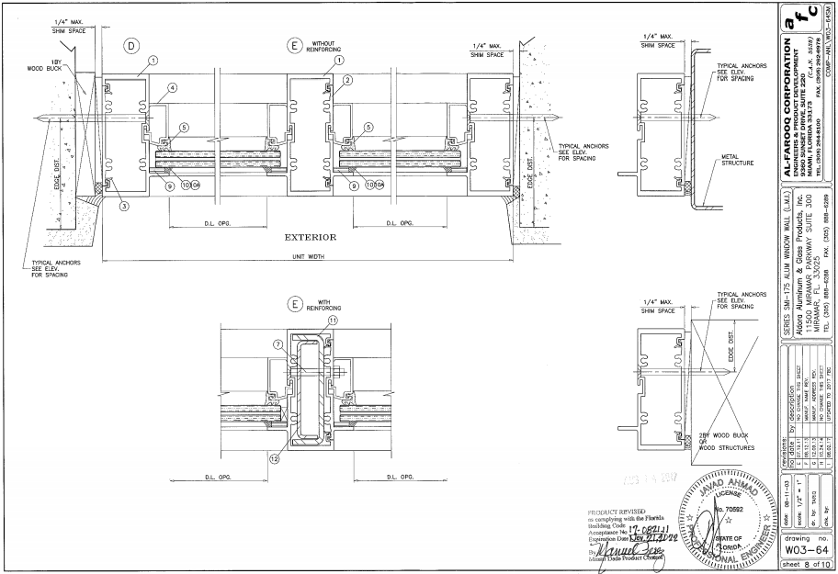

Slide 11
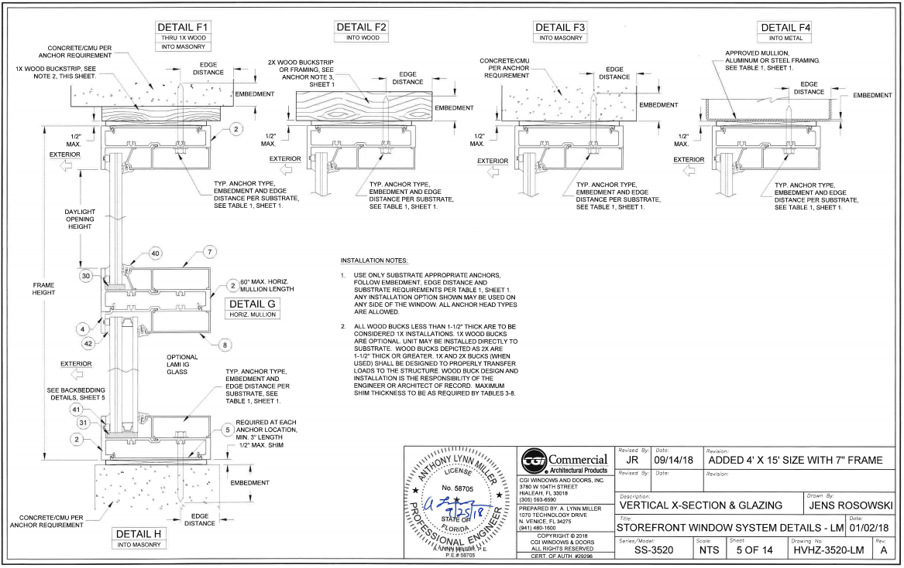
FL25883.1

Slide 12
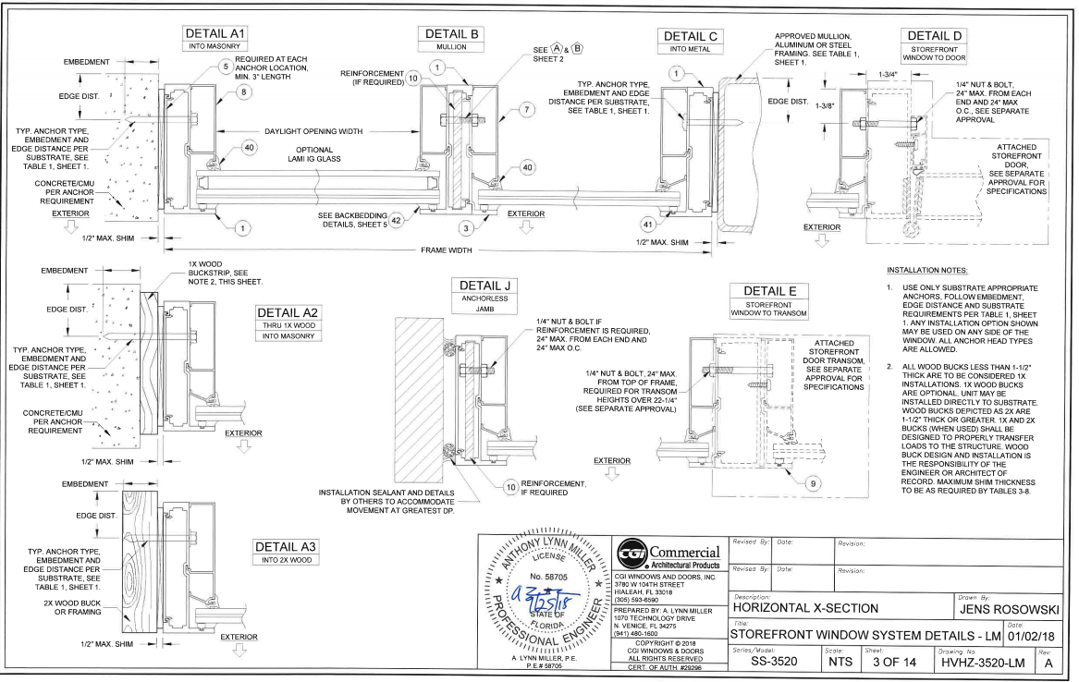

Slide 13
Sliding Glass Doors
Water performance testing does not specify how the test specimen is to be sealed to the wood test buck.
TAS 202 requires loading the specimen to positive design load before performing the water test
Water testing is performed at:
  15% of positive design load
  15 minute duration
  Spraying 5 gal/hr/sq.ft. (which is roughly 8” of rainfall per hr.) (MDC = 5 in/hr)

Slide 14
Sliding Glass Doors
+80 psf and higher approvals (Miami-Dade and State)
Good parts detail and required product seals
Average - poor perimeter seal details

Slide 15
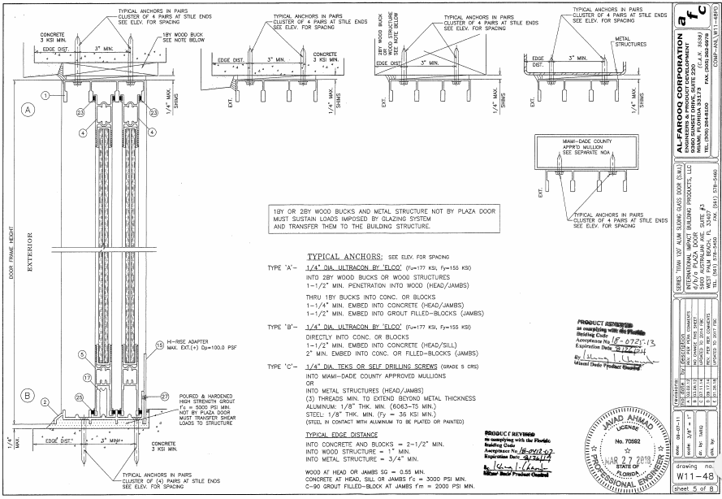

Slide 16
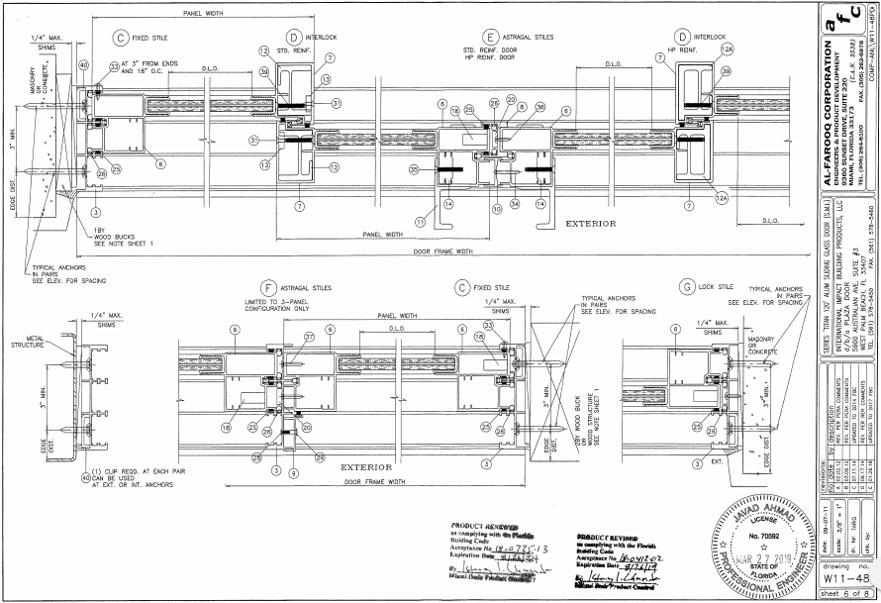

Slide 17
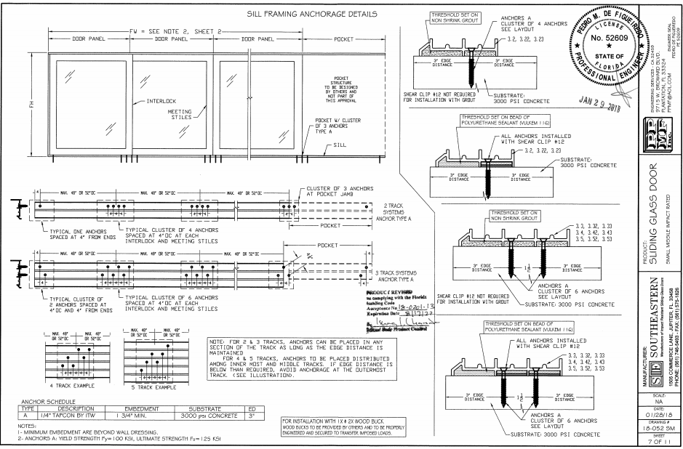

Slide 18
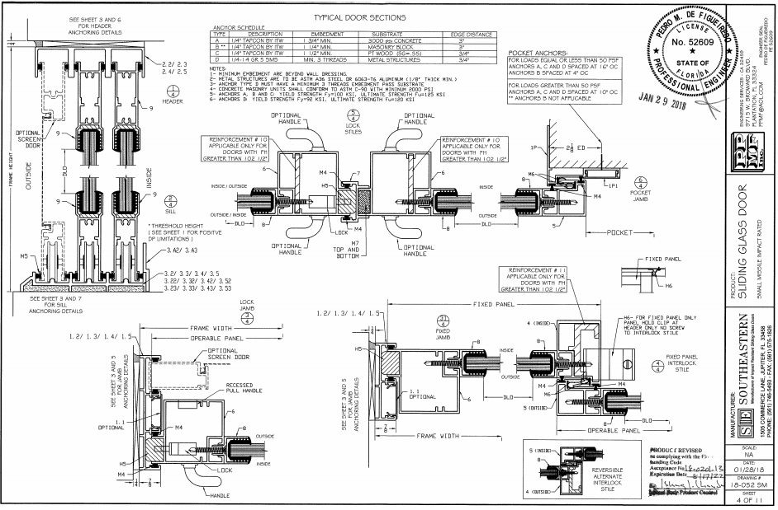

Slide 19
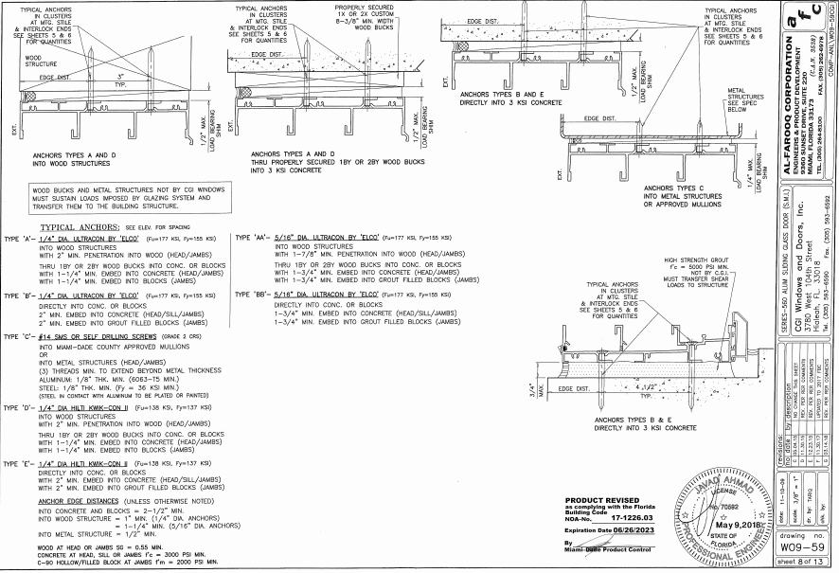

Slide 20
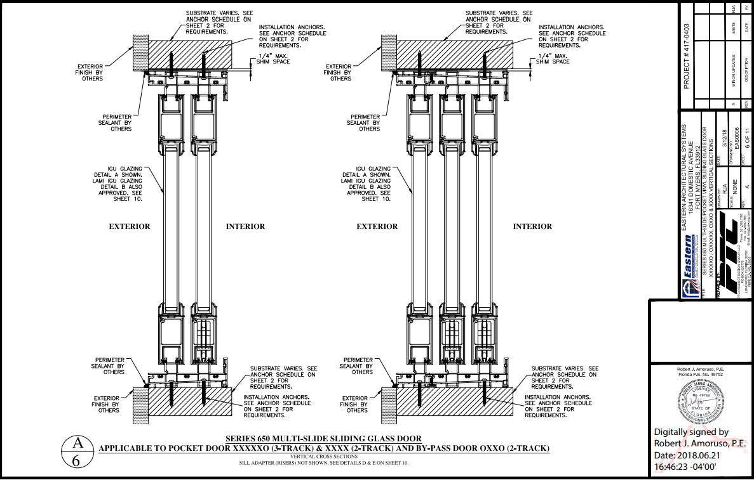
FL27113.1

Slide 21
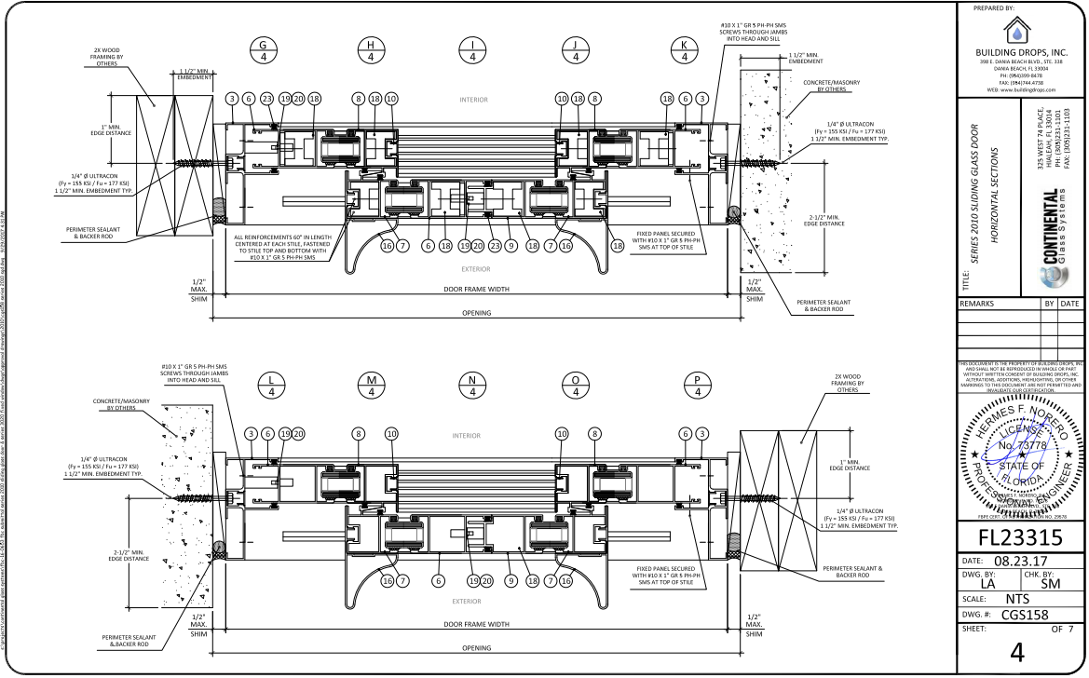
FL23315.1

Slide 22
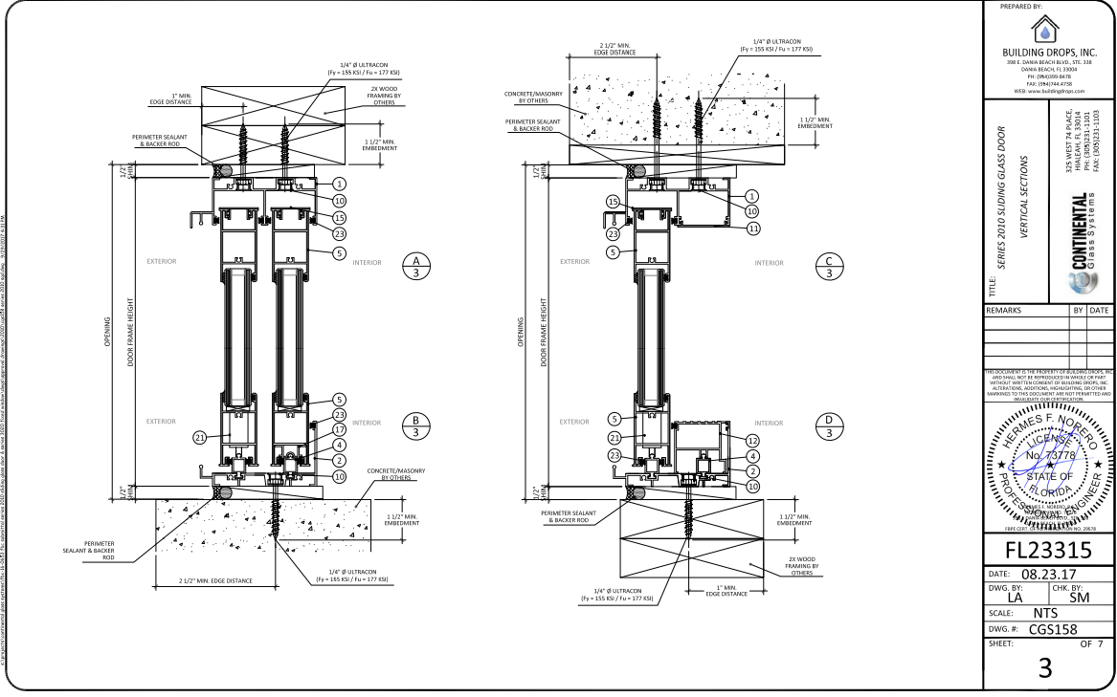
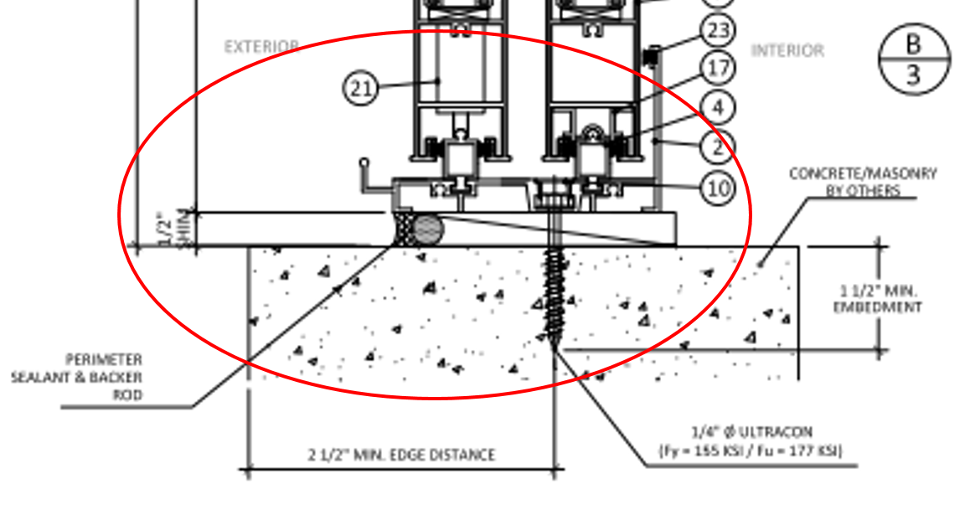

Slide 23
Curtain Walls
+60 psf and higher approvals (Miami-Dade)
Good parts detail and required product seals
Good/average perimeter seal details

Slide 24
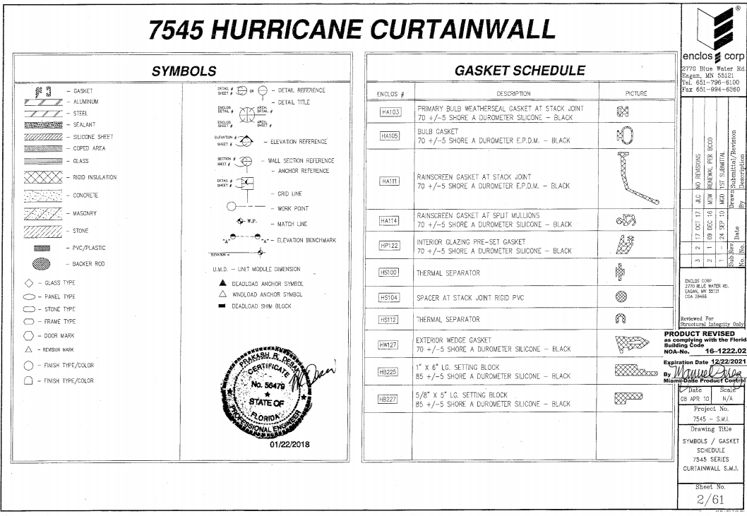

Slide 25
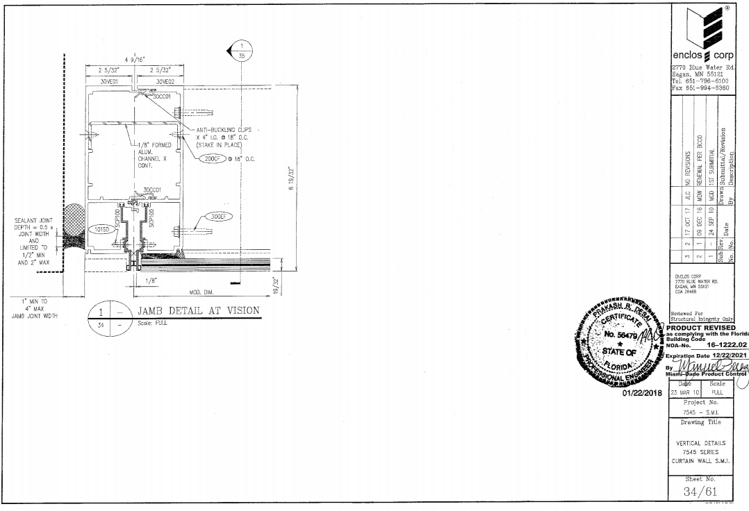

Slide 26
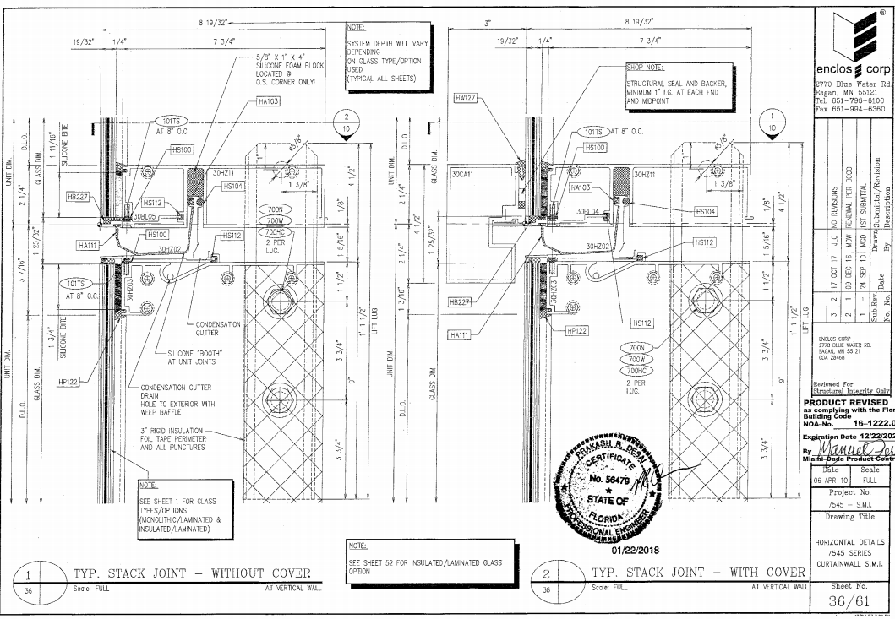

Slide 27
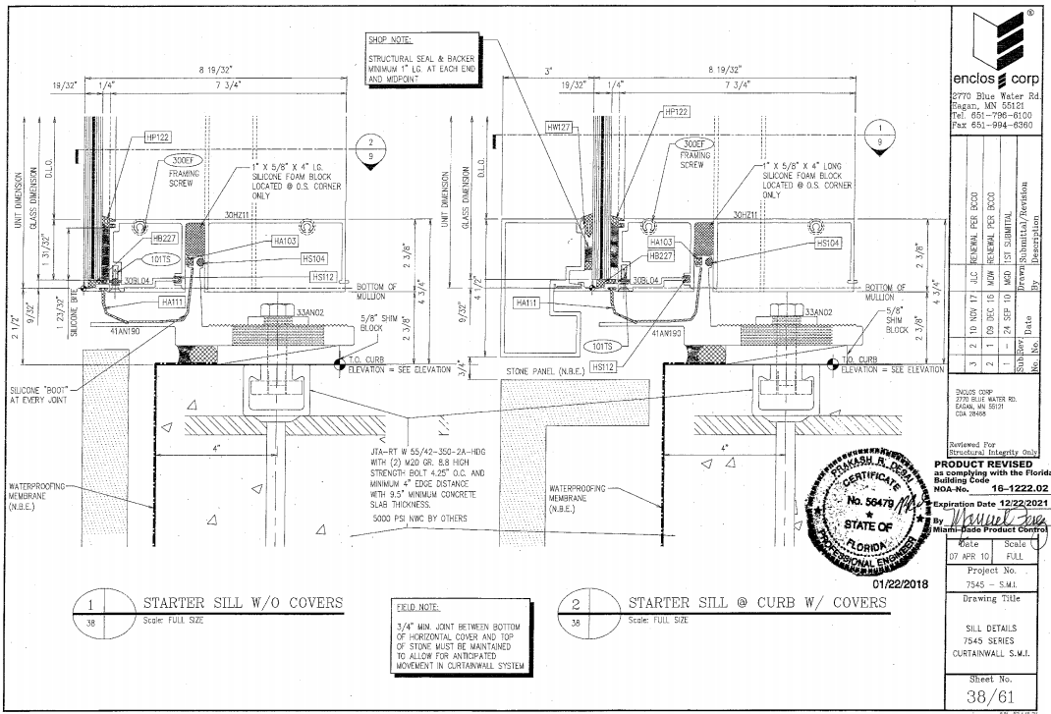

Slide 28
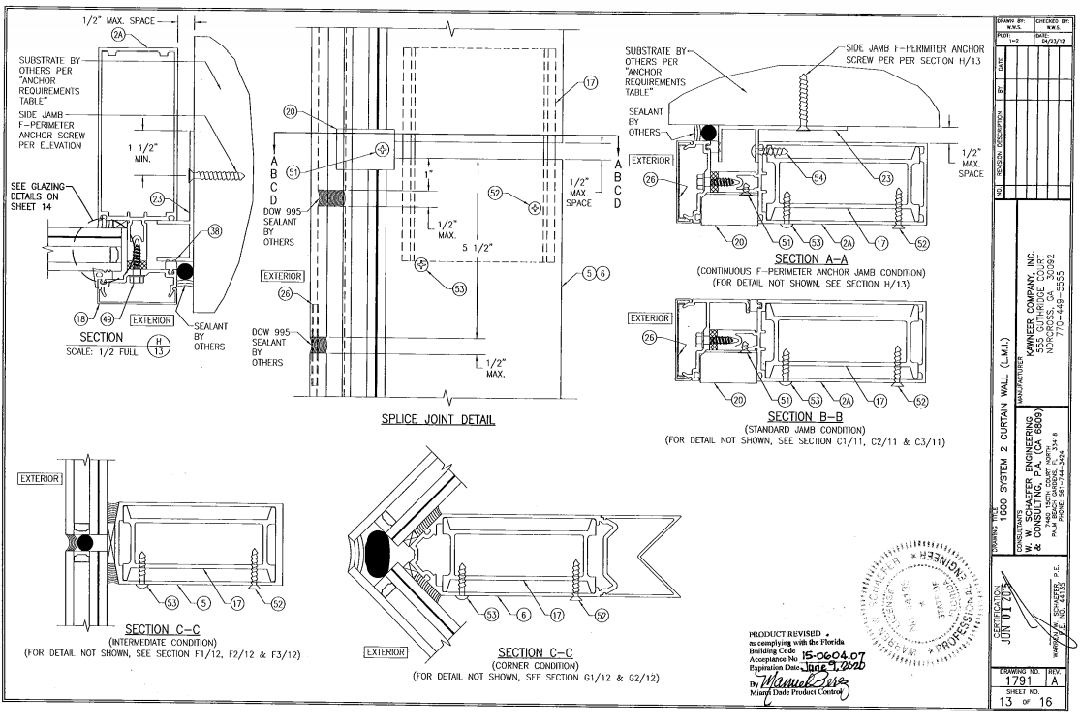

Slide 29
Final thoughts:
Consider effectiveness of existing water testing exceptions for doors
Better details in product approvals are required if these are the only details being relied on.
Ample gap must be provided in areas requiring/allowing frame deflection in order to allow seal to elongate – not crack.
Periodic maintenance check of all seals.

