Slide 1
Investigation of the Effectiveness and Failure Rates of Whole-house Mechanical Ventilation Systems in Florida
Interim Progress Report
FBC Mechanical Technical Advisory Committee Teleconference Meeting
February 25, 2015

Slide 2
Research Purpose and Goal
Investigate the effectiveness and failure rates of whole-house mechanical ventilation systems installed in Florida homes over the last 15 years and seek to determine the reason(s) for any issues identified.

Slide 3
Air Tightening and Ventilation
Air tightening allows control over where and how much outside air enters a house
Measured 2009 Florida Code home average airtightness is ACH50 5.6 (31 home sample)
As homes become tighter, mechanical ventilation becomes more important

Slide 4
Air Tightening and Ventilation
2014 FEC requirement is <= 5 ACH50 (which will tend to make Florida homes more airtight)
2014 FMC will require mechanical ventilation for any home with an ACH50 < 5
Combination of Energy and Mechanical Code requirements means that when the 2014 Code goes into effect most new Florida homes will require mechanical ventilation

Slide 5
Expected Outcome and Impact
on the Code
A project report that will include field study results:
Ventilation system airflow effectiveness
Failure findings
Recommendations for future Florida Code airtightness and ventilation requirements and education

Slide 6
Research Approach
Field study in 20 homes around the state that had whole-house mechanical ventilation systems installed in the last 15 years to include:
A homeowner survey for each home to assess awareness of the ventilation system and its purpose and maintenance practices
Inspection and testing of each home’s ventilation system to assess its operational status, level of ventilation it is currently providing and likely reason(s) for any issue discovered

Slide 7
Progress to Date
Developed and received approvals for all study materials
Fulfilled institutional Review Board / Human Subjects research requirements (for staff and study materials)
Postcard mailing and home visit scheduling

Slide 8
Progress to Date
Homeowner Outreach – Postcards

Slide 9
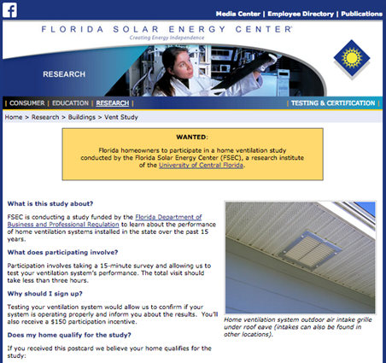
Progress to Date
Homeowner Outreach – Web Page

Slide 10
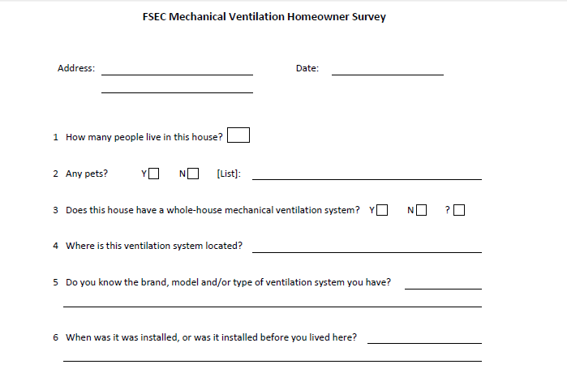
Progress to Date
Developed 27-Question Homeowner Survey
Includes operation and maintenance questions

Slide 11
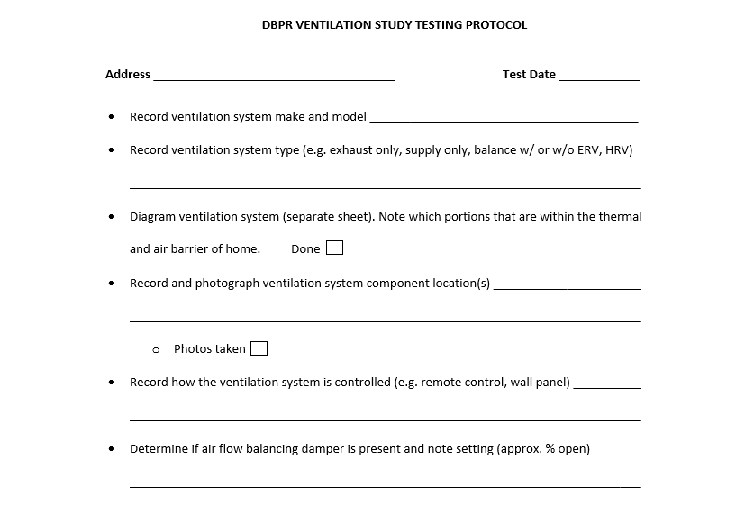
Progress to Date
Developed Ventilation System Test Protocol

Slide 12
Progress to Date
Current Homeowner Outreach Status
935 postcards mailed out February 11th
30 initial homeowner responses to date
30 follow-up calls or emails
Four signed Homeowner Agreements received / six additional requested
First two home visits scheduled
Scheduling is ongoing; calling owners of older homes for which no response yet

Slide 13
Next Steps
Continue phone calls and assessing responses to date
Second mailing in early March likely
Continue to schedule home visits
Compile survey and test data as obtained

Slide 14
Project Completion
Begin data review and analysis in April
Complete data analysis and write final report mid to late April though May
Final report delivered by June 1st

Slide 15
Current Issues
Only two of the 30 initial responses are for homes that are definitely 2+ years old; another six may be 2+ years old
Working on identifying additional older homes (e.g. following-up with homeowner in ~2010-built neighborhood who is willing to talk to neighbors)

